Slide 1
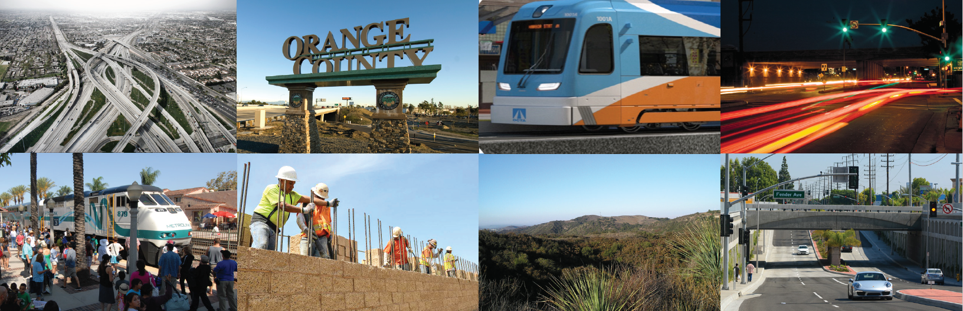
Measure M2 Quarterly Progress Report for the Period of January 2020 Through March 2020 J
Notes:
Good morning Chair XXXX and members of the XXXXXX.
My name is Tami Warren and I am the Manager of the Measure M Program Management Office.
As you know, Measure M provides funding for a broad range of freeway, transit, streets and roads, and environmental programs.
The M2 Ordinance No. 3 outlines OCTA’s “contract” with the voters and includes a number of safeguards including the requirement to produce quarterly progress reports.
Staff has prepared a Measure M2 quarterly progress report for the period of January 2020 through March 2020 that will highlight the progress on Measure M2 projects and programs.
I also want to note that we are currently going through unprecedented times as a result of the coronavirus (COVID-19) pandemic which has seen impacts in several of our programs. I will be these impacts later in this presentation.

Slide 2
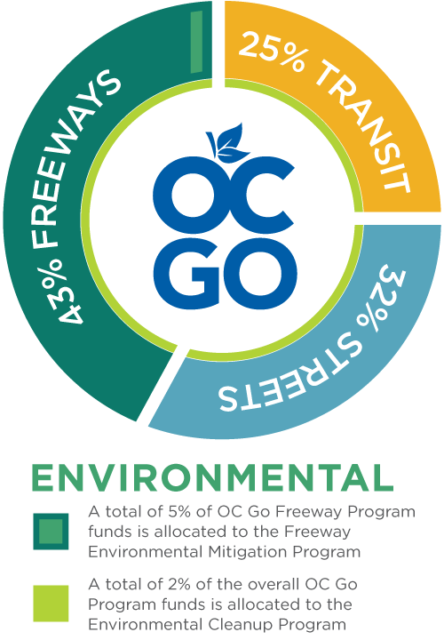
Overview
Highlights activity, status and challenges of M2 project and program delivery including safeguards
Reports progress on updated Next 10 Plan deliverables and risks
Provides budget and schedule information
Includes revenue and expenditure actuals, in addition to program projections and local allocations
M2 – Measure M2
Notes:
Overview
The M2 Quarterly Report is designed to provide transparency and be easy to navigate.
The report highlights the progress on
All Measure M2 projects and programs, including safeguards
Provides progress on the Board adopted updated-Next 10 Plan deliverables and their RISKS
M2 revenue and expenditure actuals
Budget and schedule information from Capital Programs and includes M2 program projects and local jurisdiction allocations
Existing challenges of project and program delivery

Slide 3
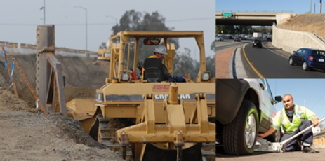
Program Highlights - Freeways
In Year Ten of 30-year M2 Program;
12 of the 30 freeway segments are complete - $695 million
Four in construction and another three on the way - $2.6 billion*
Remaining 11 in project development - $1.8 billion
534,152 motorists assisted by the Freeway Service Patrol since June 2012
*without $475 million non-M2 portion of Interstate 405 (I-405)
Notes:
The M2 Freeway Program, which previously consisted of 27 projects or project segments, now has 30 projects or project segments to be delivered by 2041. Two projects, the I-5 between I-405 and SR-55 (Project B) has now been broken into two segments and SR-91 between SR-57 and SR-55 (Project I) has been broken into three segments. Segmenting takes place to provide more opportunity for bidders to increase competition. While the new segment count will be tracked at 30, the increase does not change the overall commitment detailed in the plan.
Completed Projects
C I‐5 ‐ Vista Hermosa to PCH $75.31
C I‐5 ‐ PCH to San Juan Creek Road $74.29
C I‐5 ‐ Avenida Pico to Vista Hermosa/Pico Interchange $83.51
D I‐5 ‐ I‐5/Ortega Interchange $78.24
E SR‐22 ‐ Access Improvements at Euclid St M1
G SR‐57 ‐ (NB) Orangethorpe to Yorba Linda $52.30
G SR‐57 ‐ (NB) Katella to Lincoln $37.99
G SR‐57 ‐ (NB) Yorba Linda to Lambert $54.13
H SR‐91 ‐ (WB) I‐5 to SR‐57 $59.23
I SR‐91 ‐ (WB) Tustin Interchange to SR‐55 $42.47
J SR‐91 EB ‐ SR‐241 to SR‐71 $57.77
J SR‐91 ‐ SR‐55 to SR‐241 $79.74
Sub Total $ 694.98
In Construction
A I‐5 ‐ SR‐55 to SR‐57 $41.48
K I‐405 ‐ I‐605 to SR‐55 $1,425.00
K I‐405 ‐ I‐605 to SR‐55 express lanes portion $475.00
C, D I‐5 ‐ Oso Pkwy to Alicia Pkwy/La Paz Interchange $203.07
C, D I‐5 ‐ SR 73 to Oso Pkwy/Avery Interchange $196.09
Sub Total $1,865.64 or $2,340.64 with $475 express lane portion
In Design
C I‐5 ‐ Alicia Parkway to El Toro Road $184.10
F SR‐55 ‐ I‐405 to I‐5 $410.93
I SR-91, SR-55 to Lakeview Ave. $102.48
Sub Total $697.51
4 Construction + 3 Design = 1865.64 + 697.51 = 2,563.15 (round to 2.6 ok)
Shelf‐Ready Projects intended for Construction by 2026
B I-5, I-405 to SR-55 $438.67 (broken into 2 segments)
F SR-55, I-5 to SR-91 $122.43
I SR‐91, La Palma to SR-55 $223.14
I SR-91, Acacia St to La Palma $109.68
M I-605 Interchange $29.02
L I-405, I-5 to SR-55 $238.8
D I-5, El Toro Interchange $112.3
G SR-57, Orangewood to Katella $67.8
G SR-57, Lambert to County $167.5
J SR-91, SR-241 to I-15 $292.5
Sub Total $1,801.84
TOTAL: 694.48 +1865.64+ 697.51 + 1,801.84 = 5,059.47

Slide 4
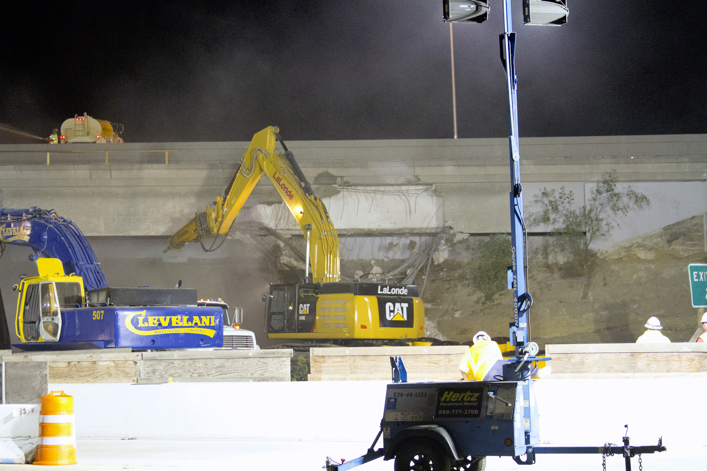
3rd Quarter Freeway Highlights
I-5 between I-405 and SR-55 – Environmental phase complete
I-5 / El Toro Road Interchange – Review of Project Alternatives
SR-55 between I-5 and SR-91 – Environmental phase complete
SR-91 between SR-57 to SR-55 – Design Phase
Interstate 5 – I-5
State Route 55 – SR-55
State Route 57 – SR-57
State Route 91 – SR-91
State Route 405 – I-405
Notes:
I-5, I-405 to SR-55 (Project B): The environmental phase was completed on February 28, 2020. This project has been split into two segments, with the northerly segment between Yale Ave. and SR-55 design RFP anticipated to be released at the end of this month (June 22).
I-5/El Toro Interchange (Project D): An update to the Board was presented on March 9,2020. OCTA is working with the cities of Laguna Hills, Laguna Woods, and Lake Forest, as well as Caltrans to procure a consultant to facilitate a review of scoping of the project alternatives.
SR-55, I-5 and SR-91 (Project F): The environmental phase was completed on March 30. Based on funding, design of the project is anticipated to begin in early 2022.
SR-91, SR-57 to SR-55 (Project I):
SR-55 to Lakeview Ave (Segment 1): Design started March 30 – Parsons Transportation Group, Inc.
La Palma to SR-55 (Segment 2): Board approved consultant selection on Feb 10, 2020 – WKE, Inc.
Acacia to La Palma (Segment 3): An RFP for design was approved for release by the Board on March 9. This is the westernmost of three segments.
All three segments are anticipated to be in the design phase by the end of 2020. By the end of the year, all three segments of Project I will be in the design phase.

Slide 5
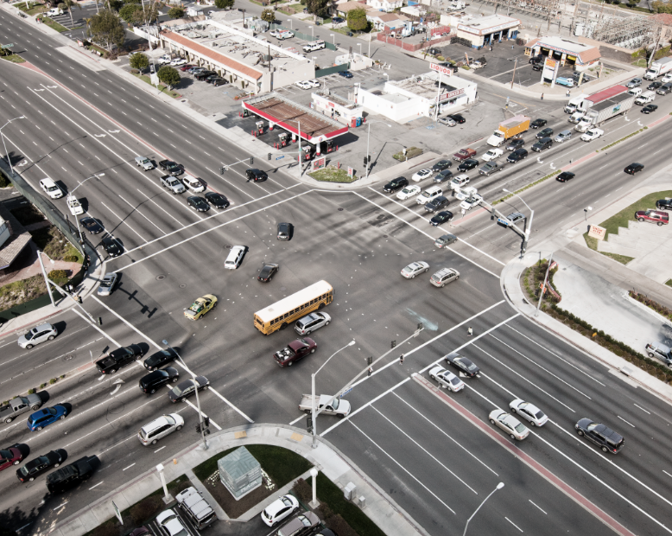
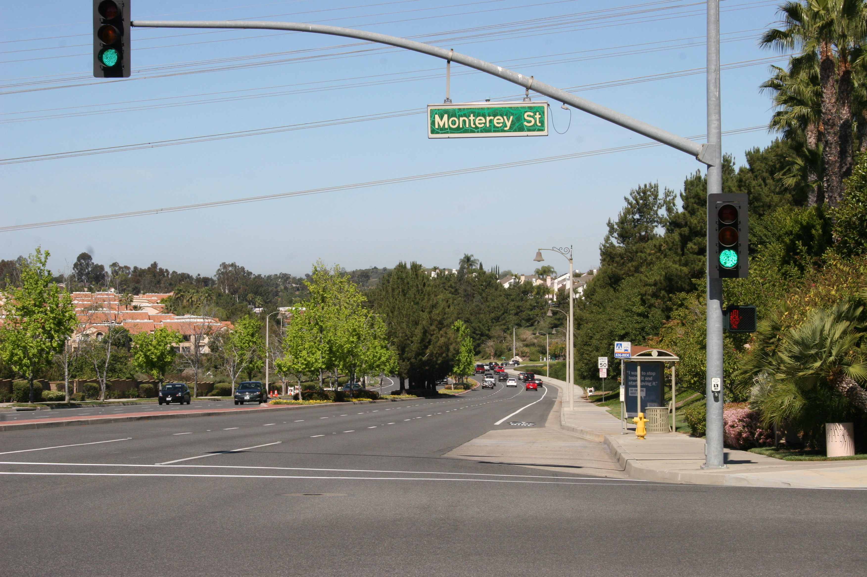
Program Highlights – Street and Roads
Approximately $814 million provided to local jurisdictions to date:
139 street capacity improvement projects
108 signal synchronization projects
Over $416 million in flexible funding
3rd Quarter Highlights
Review of Project O & P applications for 2020 Call for Projects
Notes:
Streets and Roads
~ $814 million has been provided… Through the three M2 Street and Roads programs – Regional Capacity, Signal Synch and the Local Fair Share (* does not include Stanton or Santa Ana $)
These programs provide transportation improvements through streets and roads competitive and formula funding programs.
To date 147 projects totaling more than $296 million have received funding through nine rounds of funding through the Regional Capacity Program, and
111 projects totaling more than $106 million through nine rounds the Regional Signal Synchronization program. OCTA and local agencies have synchronized more than 2,800 intersections along more than 739 miles of streets.
Additionally, M2 provided a portion of the $664 million to grade separate seven rail crossings and successfully leveraged the majority of the funds ($520 million) from state and federal sources.
2020 Call for Projects: During the quarter, staff reviewed the applications for the 10th call for projects for eligibility, consistency and adherence to guidelines and overall program objectives. Programming recommendations for 14 projects totaling $35.5 million were presented to the Board on May 11, 2020.
8 RCP ($23.4 million)
6 RTSSP ($12.1 million)

Slide 6
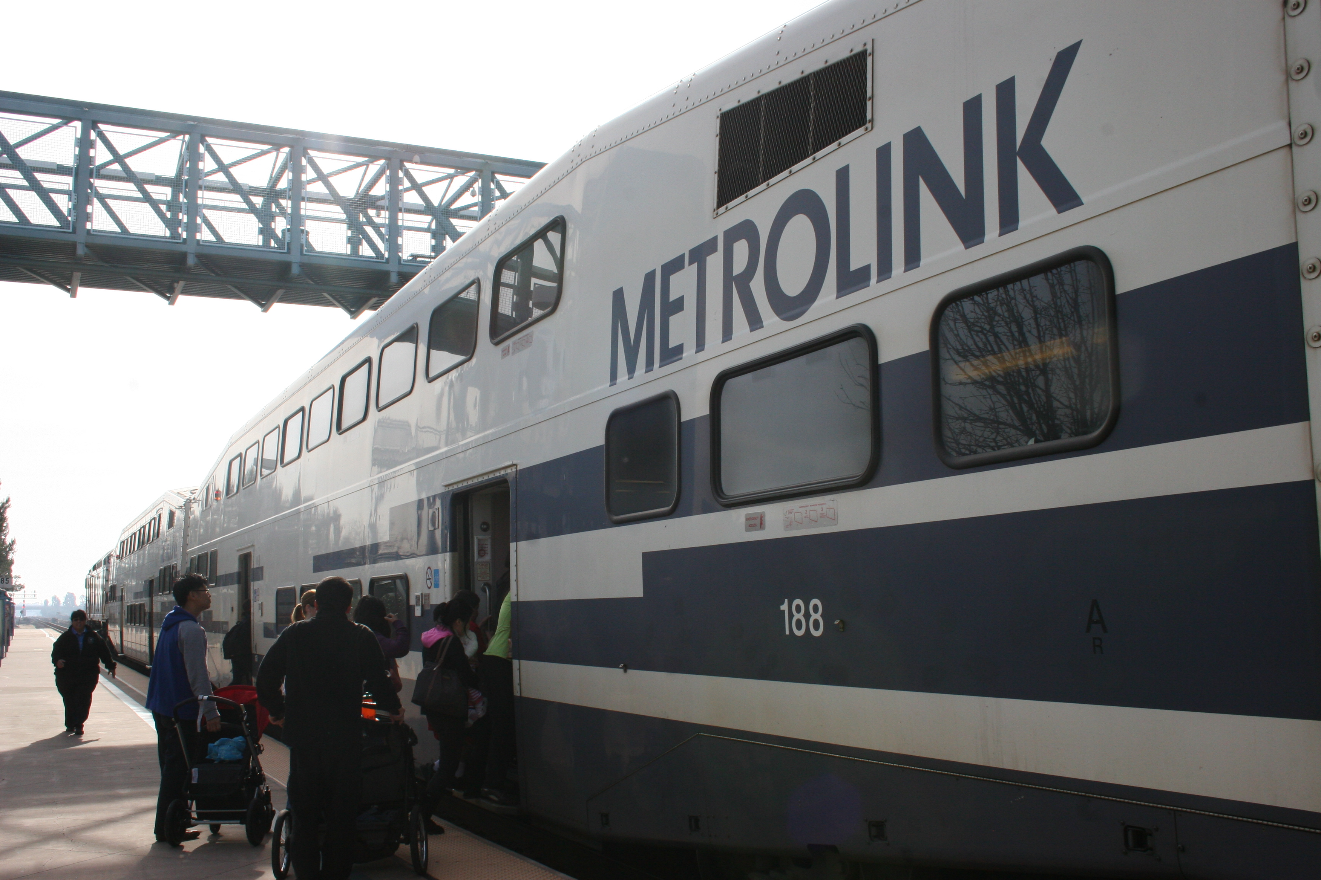
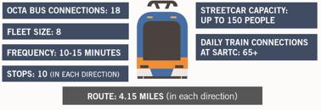
Program Highlights - Transit
$182 million used to fund OC Metrolink service
$477 million invested in station and grade crossing improvements
OC’s first modern streetcar underway; 59 percent externally funded
20 community-based transit/circulators in operation
$2 million allocated to improve 79 transit stops
$77.6 million allocated to expand mobility choices for seniors and persons with disabilities
OC – Orange County
Notes:
$25-30 million a year totaling $182 million to date Metrolink Subsidy for OC Share of Operations
$477 million – invested to date in Metrolink station and grade crossing improvements to enhance and support additional Metrolink service between OC and LA (ARTIC, Orange parking, Tustin parking, Fullerton Parking Expansion & Elevators, LN/MV ADA ramps, San Clemente Beach Trail safety, OCX, San Canyon Grade Crossing)
$107 million underway – San Juan Creek Bridge, LN SJC Passing Siding, Placentia Station
OC Streetcar $408 million – FFGA $
OCTA is ready to implement additional Metrolink service between OC and LA following the finalization of indemnification liability agreement with BNSF. Metrolink’s April 6, 2020 service change was put on hold until full service is reinstated.
$77.6 million allocated to expand mobility choices for seniors and persons with disabilities (SMP = 2,411,000 + SNEMT 940,720 + FS 119,000,000 = 122 million boardings) *$ does not include Santa Ana & Stanton
20 Community Based Transit/Circulators are in operation to provide a mixture of special event, fixed-route, and on-demand projects.
$2 million allocated to improve 79 transit stops (43 stops + 36 new stops approved on June 24, 2019) to ease transfers and increase convenience for bus customers.
Began Construction in November 2018 - OC Streetcar Funding Breakdown – Full NTP on March 4th. Anticipated to begin revenue service in 2022.
53% Federal $216.68 - New Starts $148.96, CMAQ $54.46, FTA 5307 $13.26 =
6% State $25.52 Cap and Trade
41% M2 - Project S $166.11
TOTAL $407.76

Slide 7
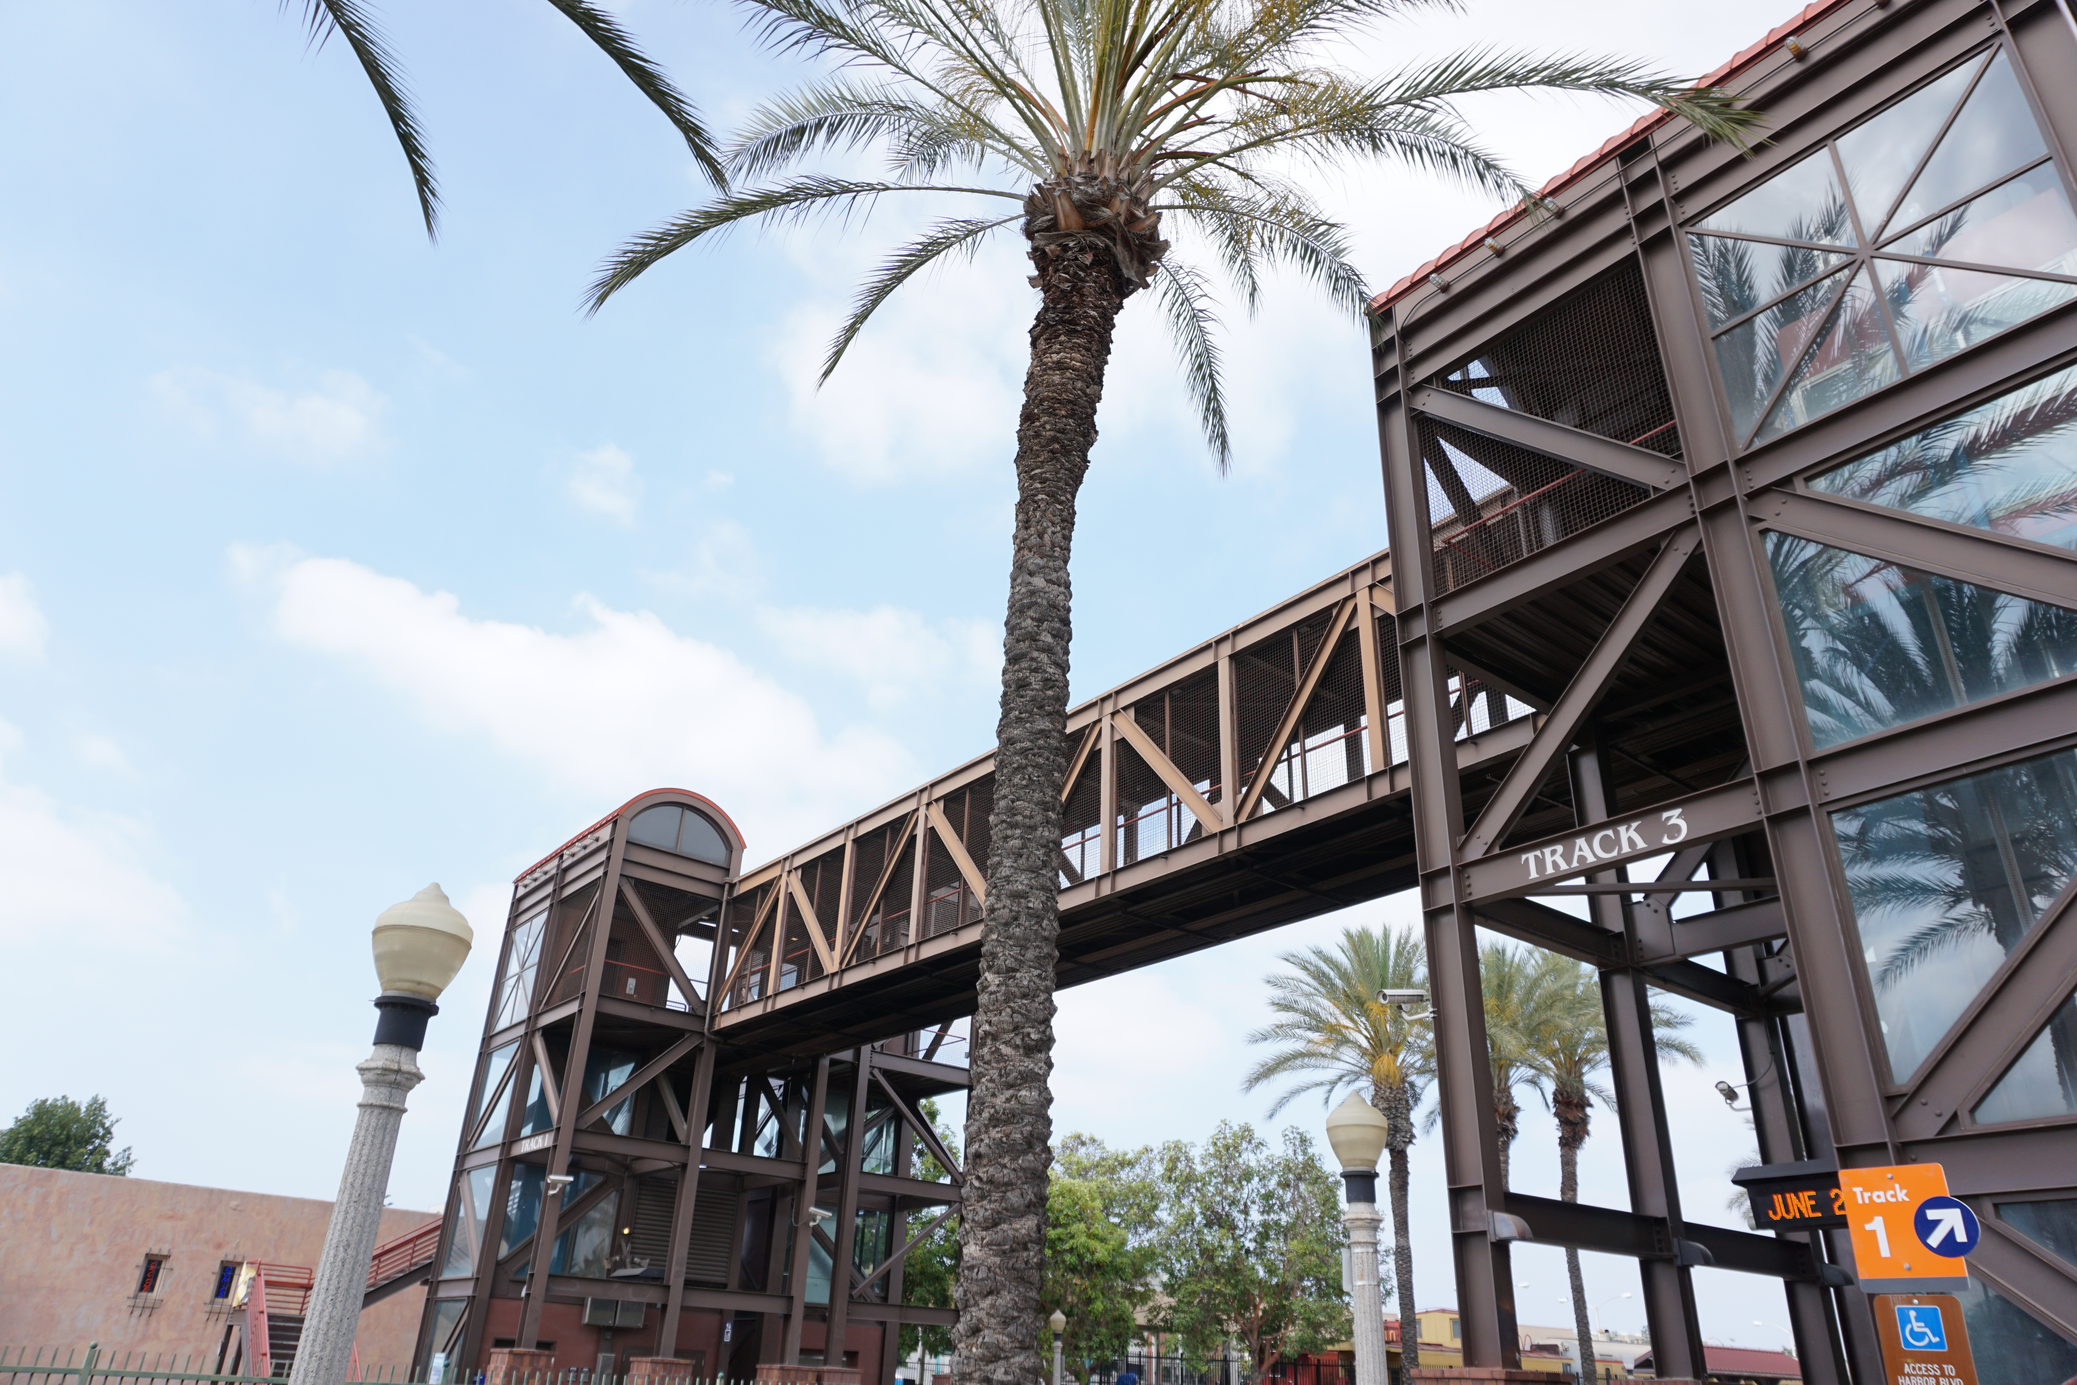
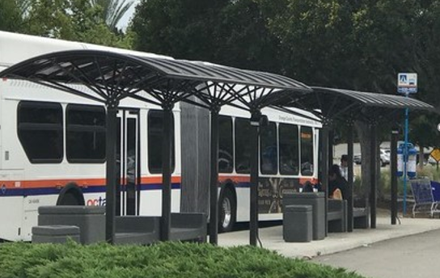
3rd Quarter Transit Highlights
Metrolink update presented to the Board
Review of 13 Project V applications
Notes:
Metrolink update presented to the Board on May 11 : Prior to COVID-19, February ridership for the OC Line, 91/PV Line, and IEOC Line saw an increase of 8.3% compared to 2019.
For FY through February ridership was up 4.3% from a year ago, while fare revenue was up 3.7% over the same period.
Project V: Fourth Call for Projects: Received 13 applications by the December 12, 2019 deadline. During the quarter, OCTA staff scored the applications consistent with revised program guidelines. Programming recommendations for six capital and operating reserves and three planning studies, totaling $9.2 million, were presented to the Board on April 13, 2020.

Slide 8
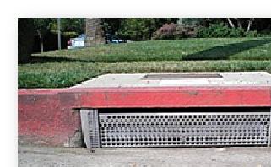
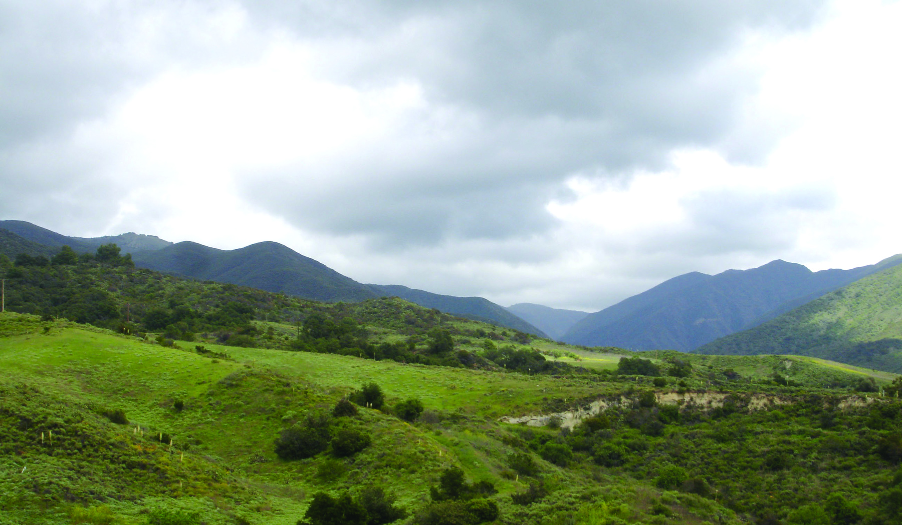
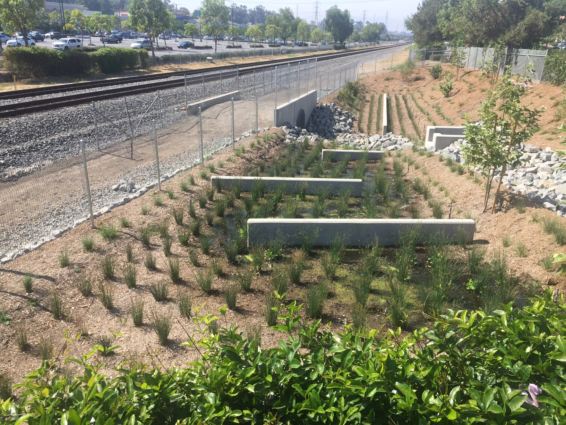
Program Highlights - Environmental
Environmental Cleanup Program
$49.9 million allocated for 170 water quality improvement projects
8 million gallons of trash captures annually (50 Olympic-size swimming pools) since inception
Freeway Environmental Mitigation Program
1,300 acres of open space preserved and 350 acres restored
Receipt of biological and water quality permits streamlining freeway projects
Endowment established to protect acquired lands in perpetuity. As of March 31, 2020, the balance of the endowment was $11,137,651.
Notes:
$49.9M allocated for 170 (Tier 1) and 19 (Tier 2) water quality projects.
It is estimated that nearly eight million gallons of trash are captured annually, which is the equivalent of filling 50 Olympic-size swimming pools since inception of the program.
It is also estimated that the funded Tier 2 projects, once fully functional, will have an annual groundwater recharge potential of approximately 157 million gallons of water from infiltration or through pumped and treated recharge facilities.
OCTA has acquired more than 1,300 acres and funded 12 restoration projects across Orange County. The wildlife and habitat on the acquired lands are protected in perpetuity, and long-term management of the properties will be funded by an endowment.
As of March 31, 2020, the balance of the endowment was $11,137,651.

Slide 9
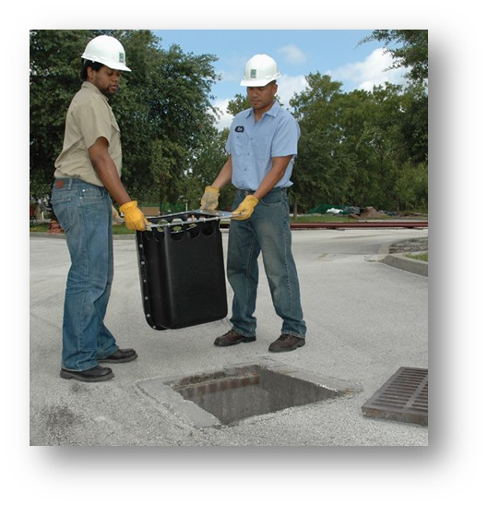
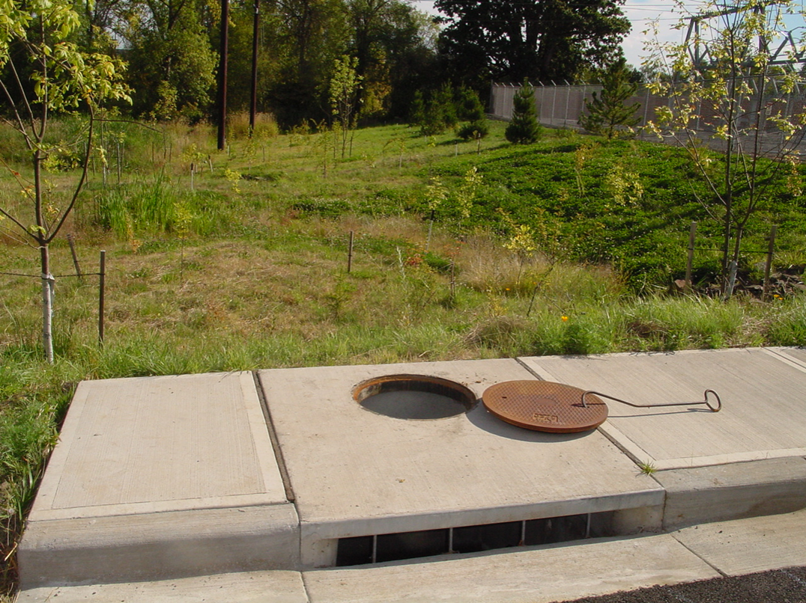
3rd Quarter Environmental Highlights
Environmental Cleanup Program Tier 1 call for projects was authorized by the Board on March 9, 2020 for approximately $2.8 million
Notes:
ECP’s tenth Tier 1 call was authorized by the Board on March 9, 2020, for approximately $2.8 million. Applications were originally due on May 7, 2020; however, due to COVID-19 impacts and requests from local jurisdictions for additional time, the deadline was extended to June 25, 2020.

Slide 10
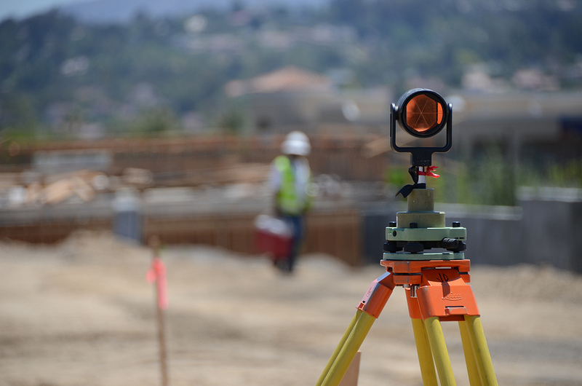
M2 Eligibility Determination
City of Stanton and City of Santa Ana
March 23, 2020 – Audit results presented
April 13, 2020 – Both cities found eligible to receive M2 net revenues and suspended payments disbursed
Notes:
On April 13, 2020, the cities of Santa Ana and Stanton were found by the Board to be eligible again to receive M2 net revenues. All suspended payments been disbursed. This concluded the action taken on May 13, 2019, when the Board found the cities ineligible and suspended M2 funding allocations and disbursements until confirmation by audit of compliance and subsequent Board action. OCTA expedited the review efforts and on March 23, 2020, OCTA staff presented FY 2018-19 audit results for the cities of Santa Ana and Stanton, which verified that both cities met their FY 2018-19 MOE requirement including the additional MOE expenditures to make up for the shortfall identified in the FY 2017-18 audit.

Slide 11
COVID-19 Pandemic
The PMO is proactively monitoring COVID-19 impacts to M2 to ensure projects and programs continue to be delivered as promised to voters.
Freeways
Increased productivity of construction work due to traffic volume reduction
No substantial risks in construction material supply chain and subcontractor labor availability
Right-of-way acquisition and utility relocation impacts
Novel Coronavirus – COVID-19
Notes:
Traffic volume reduction on freeways due to the stay-at-home order have allowed for increased productivity of construction work on essential projects. Construction crews are working under direction from OCTA and Caltrans to take advantage of more daytime lane closures and extended nighttime work windows. On the I-405 project between SR-73 and I-605, it is estimated that these extended closures have provided more than 4,800 additional work hours for contractor productivity. Daytime closures has lessened now, given that traffic levels are increasing again – extended night closures continue.
To date, no substantial COVID-19 risks in construction material supply chain and subcontractor labor availability have surfaced. However, some material and product suppliers and subcontractors have submitted advance notice of potential material and supply delays.
ROW acquisition processes and utility relocation issues are beginning to surface. ROW acquisition offers to owners, associated discussions, negotiations, and meetings are impacted by business closures and availability of owners and attorneys. There are also impacts due to court closures, filing and service delays, potential temporary easement timeline expirations, land and business valuation challenges, and appraisal and site inspection issues.
Utility relocations have also been affected as utility companies are unable to schedule energy shut off during this pandemic.

Slide 12
COVID-19 Challenges (cont.)
Streets and Roads
Timely use of funds for local projects
Transit
Metrolink
Ridership levels down 90 percent in April 2020
Implemented 30% service reduction
Additional work windows
Laguna Niguel to San Juan Capistrano Passing Siding Project
OC Streetcar
Notes:
Streets and Roads
Due to COVID-19, Staff reopened and extended the timeline for semi-annual review period in late March. This allowed local jurisdictions an additional opportunity to review and assess their local projects and funds to submit requests for project adjustments and timely use of funds extensions due to COVID-19. Eligible timely use of funds requests, including other eligible requests related to COVID-19 will be presented at the August Board meeting.
Transit:
Travel patterns have also affected Metrolink operations with ridership down by 90 percent as of April 2020, when compared to 2019.
Metrolink implemented a 30 percent service reduction on March 26, 2020 and continues to provide vital transportation services for essential trips.
Metrolink is working with partner agencies to develop a recovery plan framework and ridership recovery scenarios.
Additional Work Windows
The stay-at-home order has allowed for increased productivity for the Laguna Niguel to San Juan Capistrano Passing Siding Project and OC Streetcar Project. The reduced rail service and cancelled weekend services has allowed the contractor to work on reconstruction of the private railroad crossing site near Saddleback Church. The OC Streetcar Project has also taken advantage of lower traffic volumes to use daytime street closures for storm drain and water line installation while many downtown businesses are closed.

Slide 13
COVID-19 Challenges (cont.)
Transit
Senior Mobility Program
Community-Based Transit Circulator Program Suspension
Timely Use of Funds
M2 Maintenance of Effort
Temporary adjustment to the MOE Requirement
Public hearing and Board meeting to consider on June 22, 2020
Maintenance of Effort - MOE
Notes:
Transit
Due to COVID-19, many local jurisdictions have altered or suspended their transportation programs that meet the needs of seniors in the communities through the Senior Mobility Program. In May, OCTA staff was notified that one transit service provider serving multiple cities (Keolis), will cease operations in Orange Cunty effective May 31, 2020. An item was presented to the Board on May 22, 2020 to allow for service continuity in the short-term.
Services under the community-based transit circulator program have also been suspended as-stay at-home orders are in place.
As mentioned previously in the streets and roads section, the timely use of funds requirement to expend M2 funds may also affect M2 transit programs that are delayed or temporarily suspended. Staff will monitor the situation and report to the Board as appropriate.
M2 MOE
To proactively address impacts that COVID-19 will have on local jurisdiction general fund revenue sources, and amendment to Ordinance No. 3 was initiated on May 11, 2020. A component of eligibility in the Ordinance is the MOE requirement, which is the amount local jurisdictions spend on general fund revenues for streets and roads purposes. The intent is to ensure that M2 revenues do not supplant funding for streets and roads that a local jurisdiction was previously spending. The amendment will temporarily adjust the MOE requirement for local jurisdictions in FY-19-20 and FY-20-21. A public hearing at which the Board will consider adopting the amendment to Ordinance No. 3 has been set for June 22, 2020.

Slide 14
PMO Activities
Construction Cost Pressure Index Update
Ordinance Safeguards
Sales Tax Revenue Forecast / Next 10 Delivery Plan Review
PMO – Program Management Office
Notes:
At the Board’s direction, OCTA contracts with two local economists to monitor and analyze key early warning indicators affecting the construction market. The information is incorporated in a cost pressure index model to identify potential cost risk factors on M2 project delivery. The results of the analysis were presented to the Board on October 28, 2019, and identified that OCTA will potentially experience a moderate cost environment of two to six percent inflation during 2020 through 2022. To reduce the potential risk of cost pressures, information from this analysis was incorporated into the M2 cashflow for the 2019 updated Next 10 Delivery Plan.
During the quarter, the consultant team completed an update of the cost pressure index model. The report was finalized prior to the novel coronavirus (COVID-19) being declared a pandemic by the World Health Organization on March 11, 2020. The update indicates reduced cost pressures from a range of two to six percent inflation to one to two percent inflation in 2021
and 2022.
There is a great deal of uncertainty regarding the extent of COVID-19 impacts on the construction market. Staff will continue to monitor impacts closely and update the Board as appropriate.
The PMO annually reviews and updates an M2 ordinance Compliance Matrix, which is created to ensure that OCTA tracks compliance with all requirements in Ordinance No. 3. During the quarter, the annual review for January 1, 2019 to December 31, 2019, was completed by the PMO in coordination with the responsible OCTA points of contact. The matrix was shared with the Taxpayers Oversight Committee (TOC) Audit Subcommittee and with the full TOC on May 12, 2020 as an information item.
Ordinance No. 3 includes a requirement for a performance assessment to be conducted at least once every three years to evaluate OCTA’s efficiency and effectiveness in delivery of M2 as promised to the voters. The fourth of these performance assessments, covering the period of July 1, 2015 through June 30, 2019, was completed and presented to the Board on March 11, 2019. The final report on the status of action items from the eight recommendations for enhancements identified in the performance assessment was provided to the Regional Planning and Highways (RPH) Committee on January 6, 2020, and to
the Board on January 13, 2020. There are no outstanding action items.
Sales Tax Revenue Forecast review/Next 10 Update – Staff is working with Finance to review the sales tax revenue forecast and will analyze year end revenues received. A Next 10 update is planned for November to incorporate the new forecast.

Slide 15
Summary
Resource for information on all aspects of M2 Plan and activities
Status of Next 10 Plan delivery progress
Success and challenges of M2 implementation
Transparent and fulfills Ordinance No. 3 requirements
Available to the public via the OCTA website: https://www.octa.net/About-OC-Go/OC-Go-(2011-2041)/Documents-and-Reports/
OCTA – Orange County Transportation Authority

