Slide 1
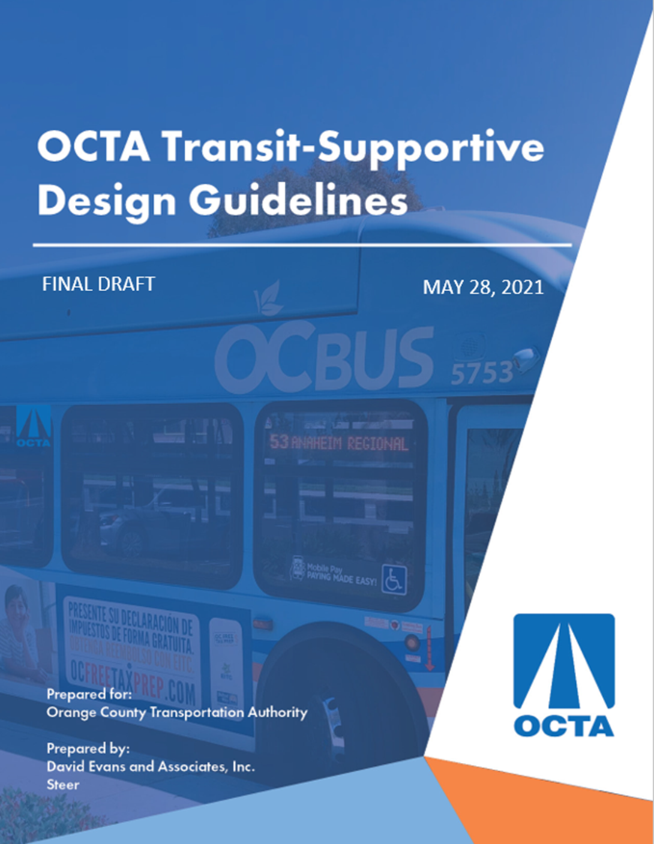

Presentation:
Technical Advisory
Committee
June 23, 2021

Slide 2
Contents
Overview and Purpose of Update
Major Changes
Agency Outreach
Best Practices Research
TSDG Framework
Next Steps
Questions

Slide 3
Overview and Purpose of Update
2004 Bus Stop Safety and Design Guidelines
  Focused on engineering recommendations for bus stop design
Purpose of update
  Modernize guidelines to conform to evolving OCTA operations
  Update technical information and standards (e.g., new technologies, ADA)
  Incorporate transit-supportive community planning principles (i.e., land use and network planning, complete streets)
  Integrate current best practices and new design concepts
  Comprehensive “one-stop” guidance and resource handbook

Slide 4
Major Changes in Updated Guidelines
Restructured guidelines into three parts:
  1) Introduction and overview of OCTA services
  2) Planning principles
  2) Engineering design guidance
  Incorporated transit-supportive land use and network planning principles
  Added design guidance covering many new topics
  Included resource links to best practices publications
  Shifted updated technical specifications to appendices
  Included bus stop design process and ADA checklists

Slide 5
Agency Outreach - Surveys
Objective
  Identify agency’s role in planning and design of bus stops
  Resource's agencies use
  Challenges faced in implementing high quality bus stops
  Specific guidance agencies find most valuable
Survey directed to planning and engineering staff
  All 34 cities in Orange County
  Orange County public works and airport departments
Response
  25 responses from 21 agencies—a response rate of 60 percent

Slide 6
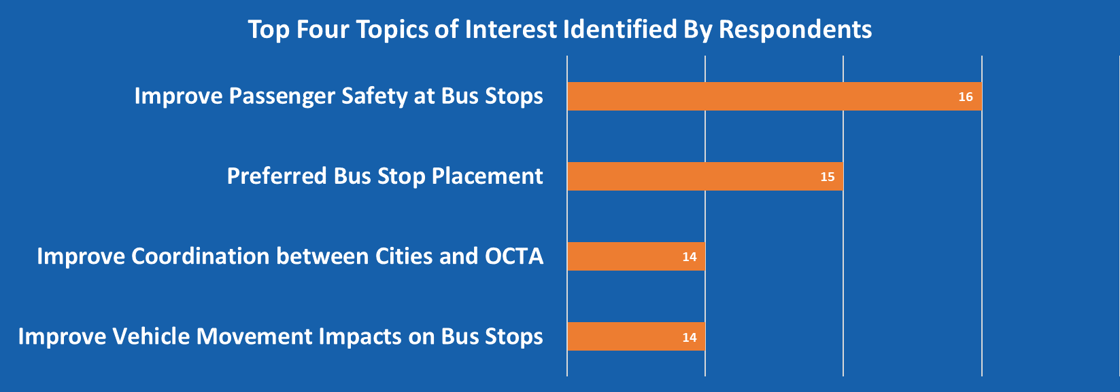
Agency Outreach – Surveys (Cont.)

Slide 7
Agency Outreach – Interviews
Objective
  Follow up surveyed agencies for clarification on responses
  Agency insight regarding content of the guidelines
Response
  11 responses—a response rate of 31 percent
Top issues / challenges
  Funding for bus stop amenities
  Regular maintenance such as trash collection and graffiti removal, and expectations for third party maintenance contracts
  Transient use of bus stop property
  Right of way constraints
  On-street parking impacts of bus stops

Slide 8
Agency Outreach – Interviews (Cont.)
Top needs for guidance
  Highly prescriptive guidance and procedural direction
  Tools to assist the design process
  Design solutions for bike lanes adjacent to bus stops
  Updated warrants triggering installation of shelters/amenities

Slide 9
Best Practices Research
Transit Cooperative Research Program (TCRP) Publications
Professional Organization Publications
Department of Transportation and Transit Authority Design Guidelines
Academic and Local Agency Publications
ADA Related Publications
Over 50 resources used to develop TSDG

Slide 10
TSDG Framework
  Introduction
    Transit-supportive design and benefits
    Purpose of the TSDG
    TSDG audience and use of document
  Transit in Orange County
    Transit service overview
    OC Streetcar
    OC Transit recommendations
    Agency roles / responsibilities
  Planning principles
    Transit-support land use planning
    Transit supportive network planning
    Complete Streets planning
    Bus stop typologies
  Engineering design guidance
    Vehicle operations
    Roadway geometric design
    Bus stop placement, configuration, and design
    Boarding area design and amenities
    Pedestrian and bicycle access
    Accessibility requirements
    Transit priority measures
    Transit centers and PnR facilities
    Signing and pavement markings
    Passenger information
    Design checklists
  Appendices
    OCTA Revenue Fleet Specifications
    Bus Turning Radii Templates
    Bus Stop Technical Specifications
    ADA Checklists
    Bus Stop Design Process Checklists
    Master List of Resources

Slide 11
Next Steps
Prepare final TSDG
Submit by June 30, 2021
Posted on OCTA website
PDF will be made available to interested stakeholders

Slide 12
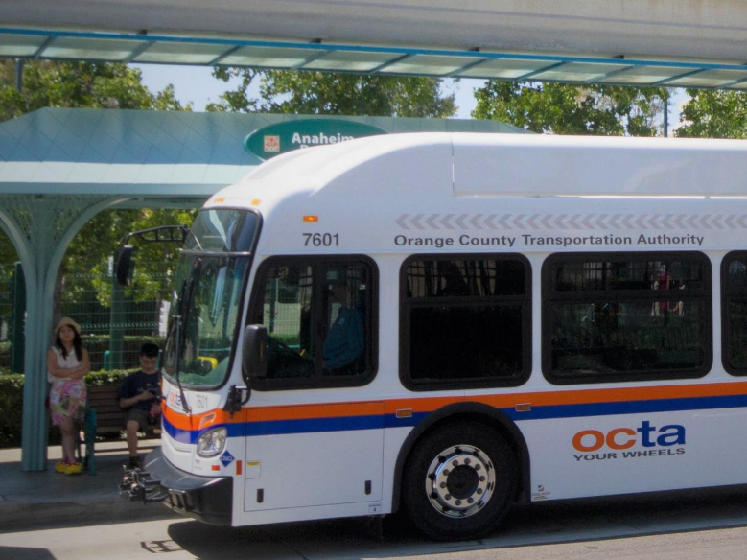
Questions?

