Slide 1
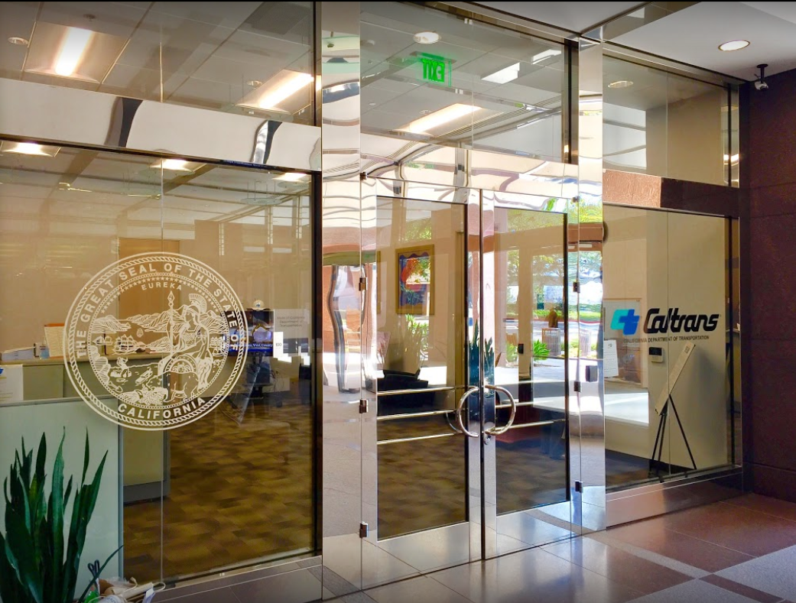
TECHNICAL ADVISORY COMMITTEE MEETING
LOCAL ASSISTANCE UPDATE
Jonathan Lawhead Kathleen Nguyen
D12 Local Assistance Branch Chief (DLAE) D12 Local Assistance Program Manager
Caltrans District 12 Caltrans District 12
Jonathan.Lawhead@dot.ca.gov Kathleen.Nguyen@dot.ca.gov
(424) 413-1124 (805) 732-9777
March 27, 2024

Slide 2
TECHNICAL ADVISORY COMMITTEE MEETING
LOCAL ASSISTANCE UPDATE
TABLE OF CONTENTS
PAGE | UPDATE ITEM
1 CTC Meetings
2 Inactive Invoices
3 ATP
4 HSIP
5 Clean California
6 DBE/QAP
7 PED Extensions
8 CRRSAA/PMRF
9 References and Training Opportunities
10 Title VI
11 Staff Assignments/Contacts

Slide 3
CTC Meetings
Deadlines to submit allocations and time extensions to District 12 Local Assistance:
April 29, 2024 for the June 2024 CTC Meeting
June 17, 2024 for the August 2024 CTC Meeting
1

Slide 4
Inactive Invoices
Deadline to submit inactive invoices for this quarter was on February 22, 2024
New inactive quarter begins on April 1, 2024
Reminder letters will be sent out later in April once HQ publishes a new official inactive list
Inactivity may prevent E-76s from being processed
The official inactive list can be viewed here:
https://dot.ca.gov/programs/local-assistance/projects/inactive-projects
If you have questions or issues with submitting invoices, please contact your assigned Local Assistance Area Engineer for further assistance
2
Notes:
We have had several cases statewide and even in the district where E-76s were rejected last FFY because there were ongoing inactives.

Slide 5
Active Transportation Program (ATP)
ATP Cycle 7 (2025):
Call-for-Projects - March 21-22, 2024
Application deadline - June 17, 2024
ATP CalSMART Project Reporting Quarter 3 (FY 23/24) opens April 1, 2024
Deadline to submit is April 15, 2024
For more info and guidance, please see Caltrans’ ATP webpage: https://dot.ca.gov/programs/local-assistance/fed-and-state-programs/active-transportation-program
3
Notes:
Project progress reporting is required and non-compliance will result in ineligibility for future allocations or programming actions until issues are corrected.

Slide 6
Highway Safety Improvement Program (HSIP)
HSIP Cycle 12
Call-for-Projects – Expected to be announced around late April or early May 2024
For more info and guidance, please see Caltrans’ HSIP webpage: https://dot.ca.gov/programs/local-assistance/fed-and-state-programs/highway-safety-improvement-program
4

Slide 7
Clean California Local Grant Program (CCLGP)
Cycle 1 delivery deadline is June 30, 2024, without an extension
If an extension will be required, please reach out to your assigned Local Assistance Area Engineer ASAP
Please see the Clean CA webpage for more info and application guidelines: https://cleancalifornia.dot.ca.gov/local-grants/local-grant-program
5

Slide 8
DBE/QAP
Quality Assurance Program (QAP) forms need to be updated and approved every 5 years
QAP forms and annual DBE Forms need to be up to date and on file with Caltrans D12 Local Assistance in order to process E-76s and receive federal funding
If you have questions or issues with submitting DBE/QAP forms, please contact your assigned Local Assistance Area Engineer for further assistance
6

Slide 9
PED Extension
New way to request extensions for Project End Dates (PED)
Entirely online and replaces old E-76 system
Link: https://app.smartsheet.com/b/form/dd8ec43edae54b8aad35159cacec011a
Work done after a PED cannot be reimbursed!
More info and a report listing upcoming PED expirations can be found here: https://dot.ca.gov/programs/local-assistance/projects/projects-with-expiring-end-dates
7

Slide 10
CRRSAA / PMRF
CRRSAA/PMRF funding for unobligated projects was subject to rescission per the Fiscal Responsibility Act of 2023
The State and Caltrans HQ reconciliation effort to determine which projects with federal funds affected by the recission could be exchanged for state funds was completed in December 2023. The January 25-26, 2024 CTC meeting published a revised CRRSAA approved project list to reflect which projects received approval to exchange federal funds for state funds
If your CRRSAA/PMRF project is proceeding with state funds, please work with your assigned Local Assistance Area Engineer to process a CRRSAA Allocation Request Package
If you have questions, please contact your assigned Local Assistance Area Engineer for further assistance
8
Notes:
Caltrans HQ Local Assistance, CTC, and Caltrans Budgets are performing a reconciliation effort to address the various challenges resulting from the passing of the Fiscal Responsibility Act of 2023 and to develop a complete fiscal plan related to this effort. An update will be provided to all Districts, MPO’s, and RTPA’s once more information is available.

Slide 11
References and Training Opportunities
Cooperative Training Assistance Program:
https://ca-ctap.org/
California LTAP training:
https://caltap.org/training.aspx
Local Assistance Blog:
https://www.localassistanceblog.com/local-assistance-training/
Local Assistance Procedures Manual (LAPM)
https://dot.ca.gov/programs/local-assistance/guidelines-and-procedures/local-assistance-procedures-manual-lapm
9

Slide 12
Title VI
Title VI of the Civil Rights Act of 1964 prohibits discrimination by recipient of Federal assistance on the basis of race, color, and national origin, including the denial of meaningful access for limited English proficient (LEP) Persons.
Requirements include but are not limited to:
Title VI nondiscrimination statement
Assurances (as part of the Master Agreement and Program Supplement Agreement.
Designation of a Title VI Coordinator.
Complaint Procedures.
Data Collection.
Training.
Dissemination of Information.
Contracts and Agreements.
Environmental Justice.
Public Hearings and Meetings.
Right of Way activities.
Construction contract compliance.
Monitoring.
Caltrans has also recently updated our webpage on Filing a Complaint, and it provides guidance to local agencies on how to process Title VI complaints.
10

Slide 13
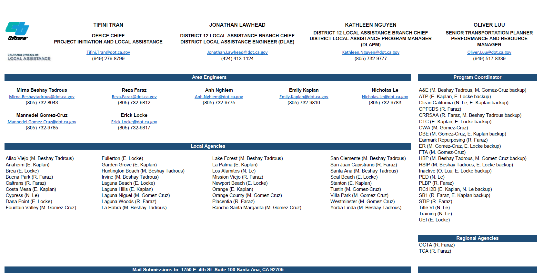
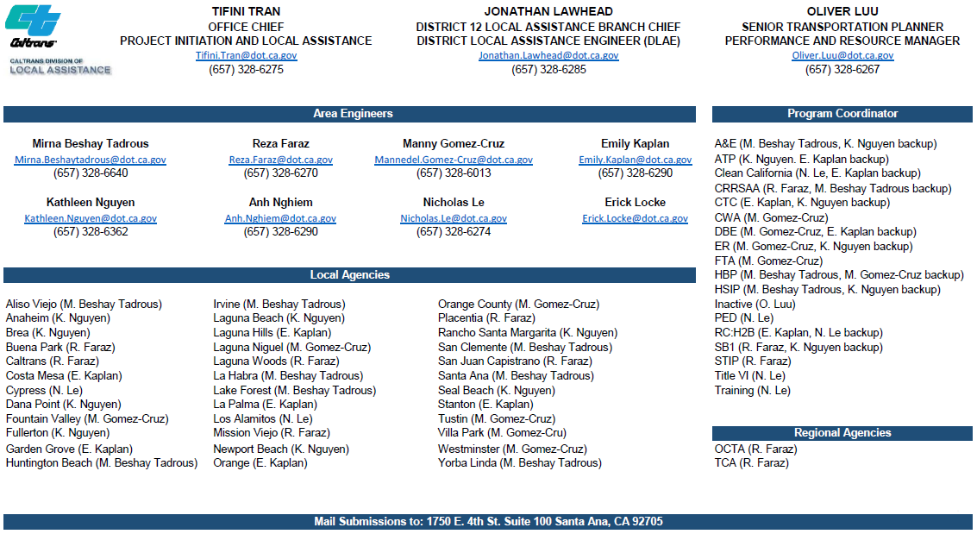
10

