Slide 1
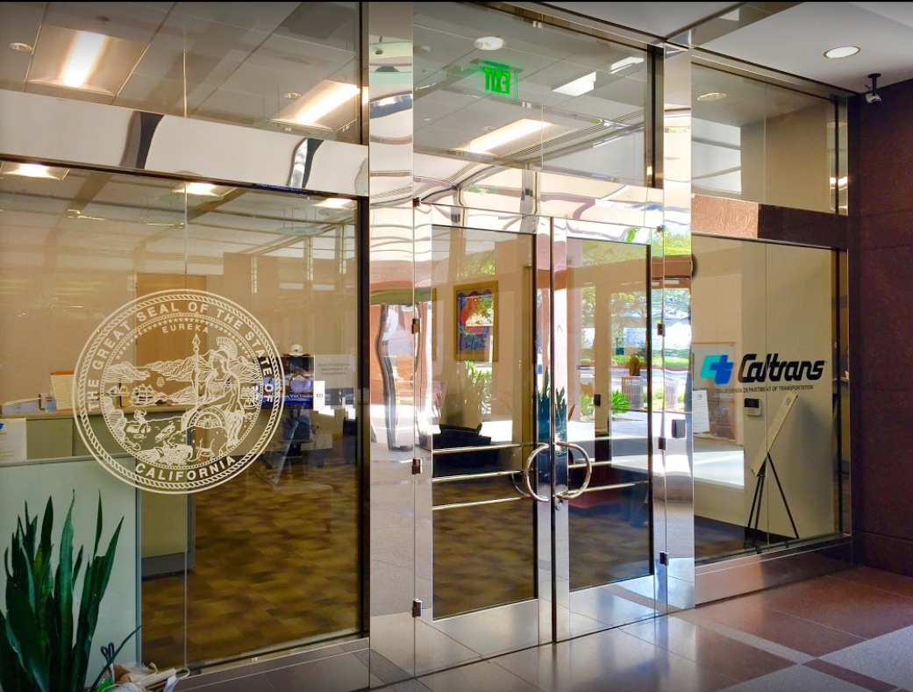

TECHNICAL ADVISORY COMMITTEE MEETING
LOCAL ASSISTANCE UPDATE
Tifini Tran Oliver K. Luu
District Local Assistance Engineer Associate Transportation Planner
Caltrans District 12 Caltrans District 12
Tifini.Tran@dot.ca.gov Oliver.Luu@dot.ca.gov
(657) 328-6275 (657) 328-6267
April 26, 2023

Slide 2
TECHNICAL ADVISORY COMMITTEE MEETING
LOCAL ASSISTANCE UPDATE
TABLE OF CONTENTS
PAGE | UPDATE ITEM
1 CTC Meetings
2 Inactive Invoices
3 ATP
4 Clean California
5 HSIP
6 Construction Contract Standards
7 HBP
8 Training
9 Title VI
10 Staff Assignments/Contacts

Slide 3
CTC Meetings
Deadlines to submit allocations and time extensions to District Local Assistance:
  May 1, 2023 for the June 2023 CTC Meeting
  June 19, 2023 for the August 2023 CTC Meeting
  August 21, 2023 for the October 2023 CTC Meeting
1

Slide 4
Inactive Invoices
The deadline to submit inactive invoices is May 23, 2023
The official inactive list can be viewed here: https://dot.ca.gov/programs/local-assistance/projects/inactive-projects
Agencies with inactive projects that still need invoice submittal as of 4/21/23:
  Anaheim – 5055(187)
  OCTA – 6071(169)
  Santa Ana – 5063(190), 5063(191)
  Westminster – 5338(052)
If you have questions or issues with submitting invoices, please contact your area engineer/planner for further assistance
2

Slide 5
Active Transportation Program
CTC adopted the Statewide component of ATP Cycle 6 on December 7-8, 2022
MPO component will be posted May 12, 2023 and finalized for the June 2023 CTC Meeting
For more info and guidance, please see Caltrans’ ATP webpage: https://dot.ca.gov/programs/local-assistance/fed-and-state-programs/active-transportation-program
3

Slide 6
Clean California Local Grant Program (CCLGP)
Cycle 2 application deadline is April 28, 2023
  Applications MUST be submitted by 5:00 PM
  August/September 2023 for project award notification
Recordings of previous Cycle 2 application workshops can be viewed on the Caltrans website
Cycle 1 quarterly progress report is due April 30, 2023
Please see the Clean CA webpage for more info and application guidelines: https://cleancalifornia.dot.ca.gov/local-grants/local-grant-program
4

Slide 7
HSIP (Highway Safety Improvement Program)
Approved Cycle 11 projects were announced on March 9
Many Cycle 11 projects are state funded, so NEPA is not required, only CEQA
For more info and guidance, please see the Caltrans HSIP webpage: https://dot.ca.gov/programs/local-assistance/fed-and-state-programs/highway-safety-improvement-program
5

Slide 8
Construction Contract Standards
Agencies need to implement 2022 standards by May 1
The next standards edition, the 2023 Standards, will be implemented on July 24
More info can be found here: https://dot.ca.gov/programs/design/ccs-standard-plans-and-standard-specifications
6

Slide 9
HBP (Highway Bridge Program)
Agencies can now come in for EPSP and Post-Programming changes for bridge projects
Please contact your Local Assistance Area Engineer if you have questions about EPSP and/or Post-Programming for HBP projects
More info can be found in Chapter 6.7 of the LAPG: https://dot.ca.gov/-/media/dot-media/programs/local-assistance/documents/lapg/g06.pdf
7

Slide 10
Training
LTAP link for training registration and info: https://ca-ctap.org/index.cfm?pid=1609
Local Assistance Training Day (June 7)
Labor Compliance for Local Public Agencies (Jun 13-15)
Program Funding Opportunities Webinar (May 12)
A&E Oversight Training (for D12 Agencies) (May 23)
  Please register here: https://apps.cce.csus.edu/sites/cce/reg/?CID=6185
  Space is limited to one person per agency
8

Slide 11
Title VI
Title VI of the Civil Rights Act of 1964 prohibits discrimination by recipient of Federal assistance on the basis of race, color, and national origin, including the denial of meaningful access for limited English proficient (LEP) Persons.
Requirements include but are not limited to:
  Title VI nondiscrimination statement
  Assurances (as part of the Master Agreement and Program Supplement Agreement.
  Designation of a Title VI Coordinator.
  Complaint Procedures.
  Data Collection.
  Training.
  Dissemination of Information.
  Contracts and Agreements.
  Environmental Justice.
  Public Hearings and Meetings.
  Right of Way activities.
  Construction contract compliance.
  Monitoring.
Caltrans has also recently updated our webpage on Filing a Complaint, and it provides guidance to local agencies on how to process Title VI complaints.
9

