Slide 1
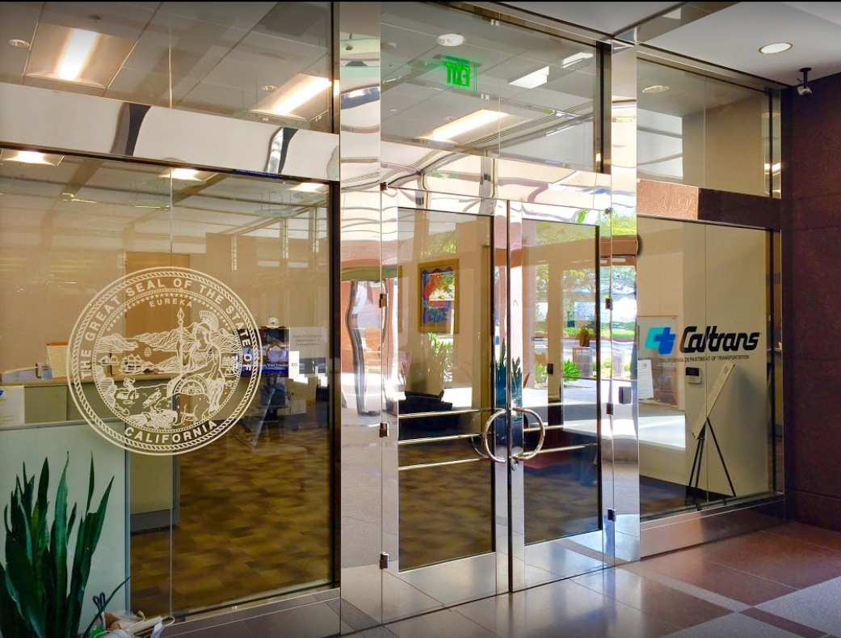

TECHNICAL ADVISORY COMMITTEE MEETING
LOCAL ASSISTANCE UPDATE
Reza Faraz Oliver K. Luu
District Local Assistance Engineer (Acting) Associate Transportation Planner
Caltrans District 12 Caltrans District 12
Reza.Faraz@dot.ca.gov Oliver.Luu@dot.ca.gov
(657) 328-6270 (657) 328-6267
May 25, 2022

Slide 2
TECHNICAL STEERING COMMITTEE MEETING
LOCAL ASSISTANCE UPDATE
TABLE OF CONTENTS
PAGE | UPDATE ITEM
1 CTC Meetings
2 Inactive Invoices
3 DBE & QAP Reminders
4 Active Transportation Program
5 Clean California Local Grant Program
6 HSIP
7 PMRF (CRRSAA)
8 Buy America
9 Training
10 Title VI
11 Staff Assignments/Contacts

Slide 3
CTC Meetings
Upcoming deadlines to submit allocations and time extensions to District Local Assistance:
  June 20, 2022 for the August 2022 CTC Meeting
  August 15, 2022 for the October 2022 CTC Meeting
1

Slide 4
Inactive Invoices
The current inactive quarter began on April 1, 2022.
Caltrans’ official list of inactive projects can be viewed here: https://dot.ca.gov/programs/local-assistance/projects/inactive-projects
Currently, Caltrans and FHWA are discussing potential changes to how the inactive list is compiled and disseminated to agencies
If you have any questions or issues with submitting invoices, please contact your area engineer/planner for further assistance
2

Slide 5
DBE & QAP Reminders
DBE Exhibits 9-B and 9-C are due to the district by June 30, 2022
Quality Assurance Program (QAP) needs to be updated and approved every 5 years
  See Chapter 16 of the LAPM for more information
These documents need to be approved for projects to get authorization and funding
3

Slide 6
Active Transportation Program
June 15, 2022 is the deadline to submit projects for Cycle 6
For scoring sheets, please contact Elika Changizi at the CTC at Elika.Changizi@catc.ca.gov
The State Highway System Impact Assessment Form was due 5/16/22 (formerly called the R/W Impact Checklist) for projects that affect the state highway system
  Approval from Caltrans required before submitting applications
For more info and guidance, please see Caltrans’ ATP webpage: https://dot.ca.gov/programs/local-assistance/fed-and-state-programs/active-transportation-program
4

Slide 7
Clean California Local Grant Program (CCLGP)
If you have questions about Clean CA, please contact Troy Andres at troy.andres@dot.ca.gov or (657)328-6310
Please see the Clean CA webpage for more info, including the guidelines and FAQ: https://cleancalifornia.dot.ca.gov/local-grants/local-grant-program
5

Slide 8
HSIP
HSIP Cycle 11 call for projects was announced on May 9, 2022
For more info and guidance, please see the Caltrans HSIP webpage: https://dot.ca.gov/programs/local-assistance/fed-and-state-programs/highway-safety-improvement-program
6

Slide 9
PMRF (CRRSAA)
For CRRSAA/PMRF projects already in the FTIP, please note:
  It will take at least 6-8 weeks for approval of R/W documents depending on the complexity of the project
  Preliminary Environmental Study (PES) must be sent in for review before the final plans/specs
If you have any questions or issues about your CRRSAA/PMRF projects, please contact your area engineer/planner for further assistance
7

Slide 10
Buy America
Per FHWA, all materials used in federal projects must be purchased under Buy America requirements as of May 14, 2022
  Awards for projects issued on or after May 14 must include a Buy America Preference
  Affects iron, steel, manufactured products, and construction materials
Projects cannot be authorized unless Buy America requirements are met
Caltrans HQ is currently discussing the details with FHWA
Please see this link for more information about these requirements: https://www.whitehouse.gov/wp-content/uploads/2022/04/M-22-11.pdf
8

Slide 11
Training
LTAP link for training registration and info: https://californialtap.org/index.cfm?pid=1077
Federal Aid Series
  Getting Your Federal Aid Started (Jun 14-15)
  Procedures for Right-of-Way Acquisition (Jul 26-27, Oct 4-5)
HSIP Cycle 11 Webinar (Jul 28)
Positioning for Successful Grant Applications (Jun 8-9, Jun 29-30)
Labor Compliance (Jul 19-21)
Local Assistance Training Day (Jun 7, Sep 8)
Residents Engineer Academy (Sep 19-22, Nov 14-17)
9

Slide 12
Title VI
Title VI of the Civil Rights Act of 1964 prohibits discrimination by recipient of Federal assistance on the basis of race, color, and national origin, including the denial of meaningful access for limited English proficient (LEP) Persons.
Requirements include but are not limited to:
  Title VI nondiscrimination statement
  Assurances (as part of the Master Agreement and Program Supplement Agreement.
  Designation of a Title VI Coordinator.
  Complaint Procedures.
  Data Collection.
  Training.
  Dissemination of Information.
  Contracts and Agreements.
  Environmental Justice.
  Public Hearings and Meetings.
  Right of Way activities.
  Construction contract compliance.
  Monitoring.
Caltrans has also recently updated our webpage on Filing a Complaint, and it provides guidance to local agencies on how to process Title VI complaints.
10

