Slide 1
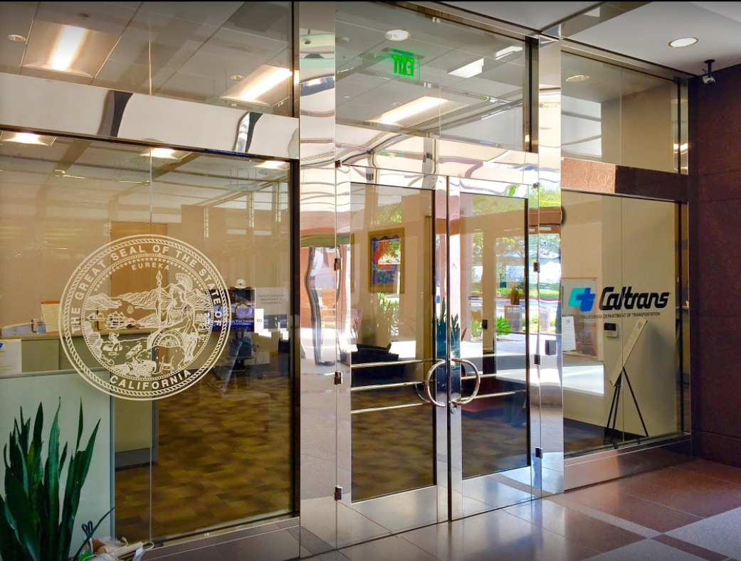

TECHNICAL ADVISORY COMMITTEE MEETING
LOCAL ASSISTANCE UPDATE
Tifini Tran Oliver K. Luu
District Local Assistance Engineer (DLAE) Associate Transportation Planner
Caltrans District 12 Caltrans District 12
Tifini.Tran@dot.ca.gov Oliver.Luu@dot.ca.gov
(657) 328-6275 (657) 328-6267
January 26, 2022

Slide 2
TECHNICAL STEERING COMMITTEE MEETING
LOCAL ASSISTANCE UPDATE
TABLE OF CONTENTS
PAGE | UPDATE ITEM
1 CTC Meetings
2 Inactive Invoices
3 Active Transportation Program
4 Clean California Local Grant Program
5 Clean California (Cont’d)
6 Training
7 Title VI
8 Staff Assignments/Contacts

Slide 3
CTC Meetings
Upcoming deadlines to submit allocations and time extensions to District Local Assistance:
  March 21, 2022 for the May 2022 CTC Meeting
  May 2, 2022 for the June 2022 CTC Meeting
1

Slide 4
Inactive Invoices
The current inactive quarter began on January 1, 2022 and the deadline to submit inactive invoices to Caltrans for this quarter is February 22, 2021
Caltrans’ official list of inactive projects can be viewed here: https://dot.ca.gov/programs/local-assistance/projects/inactive-projects
If you have any questions or issues with submitting invoices, please contact your area engineer/planner for further assistance
2

Slide 5
Active Transportation Program
Development workshops have been scheduled for Cycle 6
  Scoring Rubrics: February 8, 2022 from 1:00 – 4:00 PM
  Optional Workshop: February 23, 2022 from 9:30 AM – 12:30 PM
Link to register: https://catc.ca.gov/programs/active-transportation-program
If your agency plans to apply for Cycle 6 with a project that is on or will impact Caltrans Right of Way, we recommend you start working on the Right of Way Impact Checklist as soon as possible to prevent any delays to your application submittal
3

Slide 6
Clean California Local Grant Program (CCLGP)
Purpose: to beautify and clean up local streets and roads, tribal lands, parks, pathways, transit centers, and other public spaces
Approximately $296 Million
3-year competitive statewide program – projects must be completed and open to the public, with all funds expended, by June 30, 2024
Deadline to submit applications is Feb 1, 2022 – late applications will NOT be accepted
Agencies will be notified of project award on March 2, 2022
4

Slide 7
Clean California (Cont’d)
Please see the Clean CA webpage for more info, including the guidelines, FAQ, and recordings of the Clean CA workshops: https://cleancalifornia.dot.ca.gov/local-grants/workshops-milestones
Email contact for questions related to guidelines: CleanCA.LocalGrant@dot.ca.gov
5

Slide 8
Training
LTAP link for training registration and info: https://californialtap.org/index.cfm?pid=1077
Federal Aid Series
  Getting Your Federal Aid Started (Feb 22-23, Apr 19-20, Jun 14-15)
  Environmental Requirements (Mar 15-16, May 10-11)
  Project Development: Design to Construction (Mar 1-2)
  Federal Rules for Contract Admin & Project Completion (Feb 1-2, Mar 8-9)
FHWA Right of Way Workshops (Feb 8-10, Mar 15-17)
Labor Compliance (Feb 15-17, Mar 22-24, Apr 25-28)
Resident Engineers Academy (Feb 28-Mar 3, Apr 25-28)
6

Slide 9
Title VI
Title VI of the Civil Rights Act of 1964 prohibits discrimination by recipient of Federal assistance on the basis of race, color, and national origin, including the denial of meaningful access for limited English proficient (LEP) Persons.
Requirements include but are not limited to:
  Title VI nondiscrimination statement
  Assurances (as part of the Master Agreement and Program Supplement Agreement.
  Designation of a Title VI Coordinator.
  Complaint Procedures.
  Data Collection.
  Training.
  Dissemination of Information.
  Contracts and Agreements.
  Environmental Justice.
  Public Hearings and Meetings.
  Right of Way activities.
  Construction contract compliance.
  Monitoring.
Caltrans has also recently updated our webpage on Filing a Complaint, and it provides guidance to local agencies on how to process Title VI complaints.
7

