Slide 1
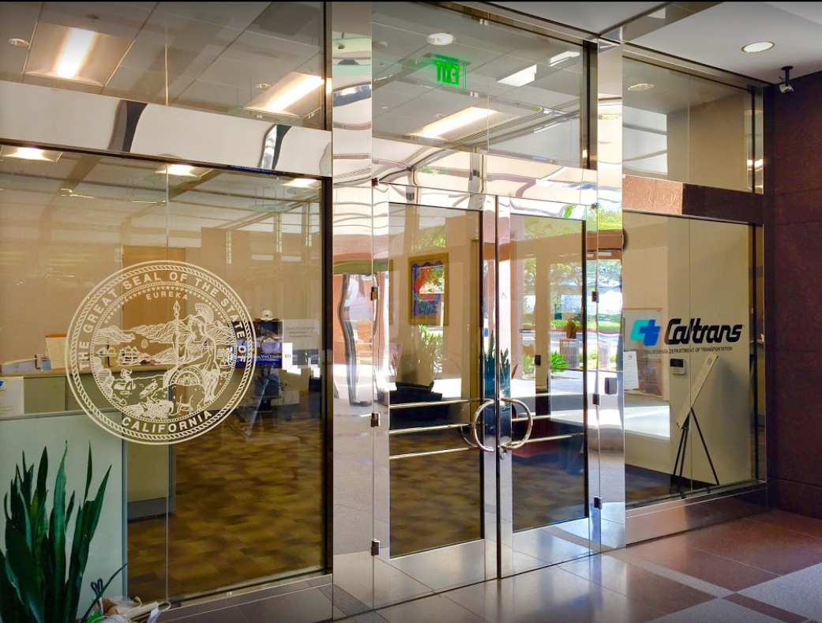

TECHNICAL ADVISORY COMMITTEE MEETING
LOCAL ASSISTANCE UPDATE
Tifini Tran Oliver K. Luu
District Local Assistance Engineer (DLAE) Associate Transportation Planner
Caltrans District 12 Caltrans District 12
Tifini.Tran@dot.ca.gov Oliver.Luu@dot.ca.gov
(657) 328-6275 (657) 328-6267
October 27, 2021

Slide 2
TECHNICAL STEERING COMMITTEE MEETING
LOCAL ASSISTANCE UPDATE
TABLE OF CONTENTS
PAGE | UPDATE ITEM
1 CTC Meetings
2 Inactive Invoices
3 Active Transportation Program
4 Clean California Local Grant Program
5 LAPM Changes
6 Training
7 Title VI
8 Staff Assignments/Contacts

Slide 3
CTC Meetings
Upcoming deadlines to submit allocations and time extensions to District Local Assistance:
  November 29, 2021 for the Jan 2022 CTC Meeting
  January 18, 2022 for the Mar 2022 CTC Meeting
1

Slide 4
Inactive Invoices
The current inactive quarter began on October 1, 2021 and the deadline to submit inactive invoices to Caltrans for this quarter is November 22, 2021
Caltrans’ official list of inactive projects can be viewed here: https://dot.ca.gov/programs/local-assistance/projects/inactive-projects
If you have any questions or issues with submitting invoices, please work with your area engineer/planner for further assistance
Agencies that have inactive projects with unsubmitted invoices:
  Anaheim (2 Projects)
  Placentia (1 Project)
  Santa Ana (2 Projects)
2

Slide 5
Active Transportation Program
Cycle 6 kick-off meeting is scheduled for November 9, 2021 from 9:30-12:30
Registration info will be posted on the CTC’s ATP webpage once it is finalized: https://catc.ca.gov/programs/active-transportation-program
If your agency plans to apply for Cycle 6 with a project that is on or will impact Caltrans Right of Way, we recommend you start working on the Right of Way Impact Checklist as soon as possible to prevent delay to your application submittal
3

Slide 6
Clean California Local Grant Program (CCLGP)
Purpose: to beautify and clean up local streets and roads, tribal lands, parks, pathways, transit centers, and other public spaces
Approximately $296 Million
3-year competitive statewide program – projects must be completed and open to the public, with all funds expended, by June 30, 2024
Technical workshop on November 8 from 10 AM – 12 PM
  Register at the Caltrans Clean California webpage: https://cleancalifornia.dot.ca.gov/local-grants/workshops-milestones
Call for projects will be in December 2021
Email contact for guidelines questions: CleanCA.LocalGrant@dot.ca.gov
4

Slide 7
LAPM Changes
LAPM Chapter 10
  Updated to specify how local public agencies may submit evidence of adopting LAPM Chapter 10 for federal A&E contract
  Deadline for agencies to comply with this requirement is November 15, 2021
5

Slide 8
Training
LTAP link for training registration and info: https://californialtap.org/index.cfm?pid=1077
Federal Aid Series
  Getting Your Federal Aid Started (Dec 1-2)
  Environmental Requirements (Dec 7-8)
  Procedures for Right of Way Acquisition (Dec 14-15)
Document Submittal for agencies (Nov 17)
Excavation and Trenching Safety (Nov 30 and Dec 9)
Labor Compliance (Dec 14-16)
Resident Engineers Academy (Jan 24-27, Feb 28-Mar 3, Apr 25-28)
6

Slide 9
Title VI
Title VI of the Civil Rights Act of 1964 prohibits discrimination by recipient of Federal assistance on the basis of race, color, and national origin, including the denial of meaningful access for limited English proficient (LEP) Persons.
Requirements include but are not limited to:
  Title VI nondiscrimination statement
  Assurances (as part of the Master Agreement and Program Supplement Agreement.
  Designation of a Title VI Coordinator.
  Complaint Procedures.
  Data Collection.
  Training.
  Dissemination of Information.
  Contracts and Agreements.
  Environmental Justice.
  Public Hearings and Meetings.
  Right of Way activities.
  Construction contract compliance.
  Monitoring.
Caltrans has also recently updated our webpage on Filing a Complaint, and it provides guidance to local agencies on how to process Title VI complaints.
7

