Slide 1

October 6, 2020
Community Meeting

Slide 2
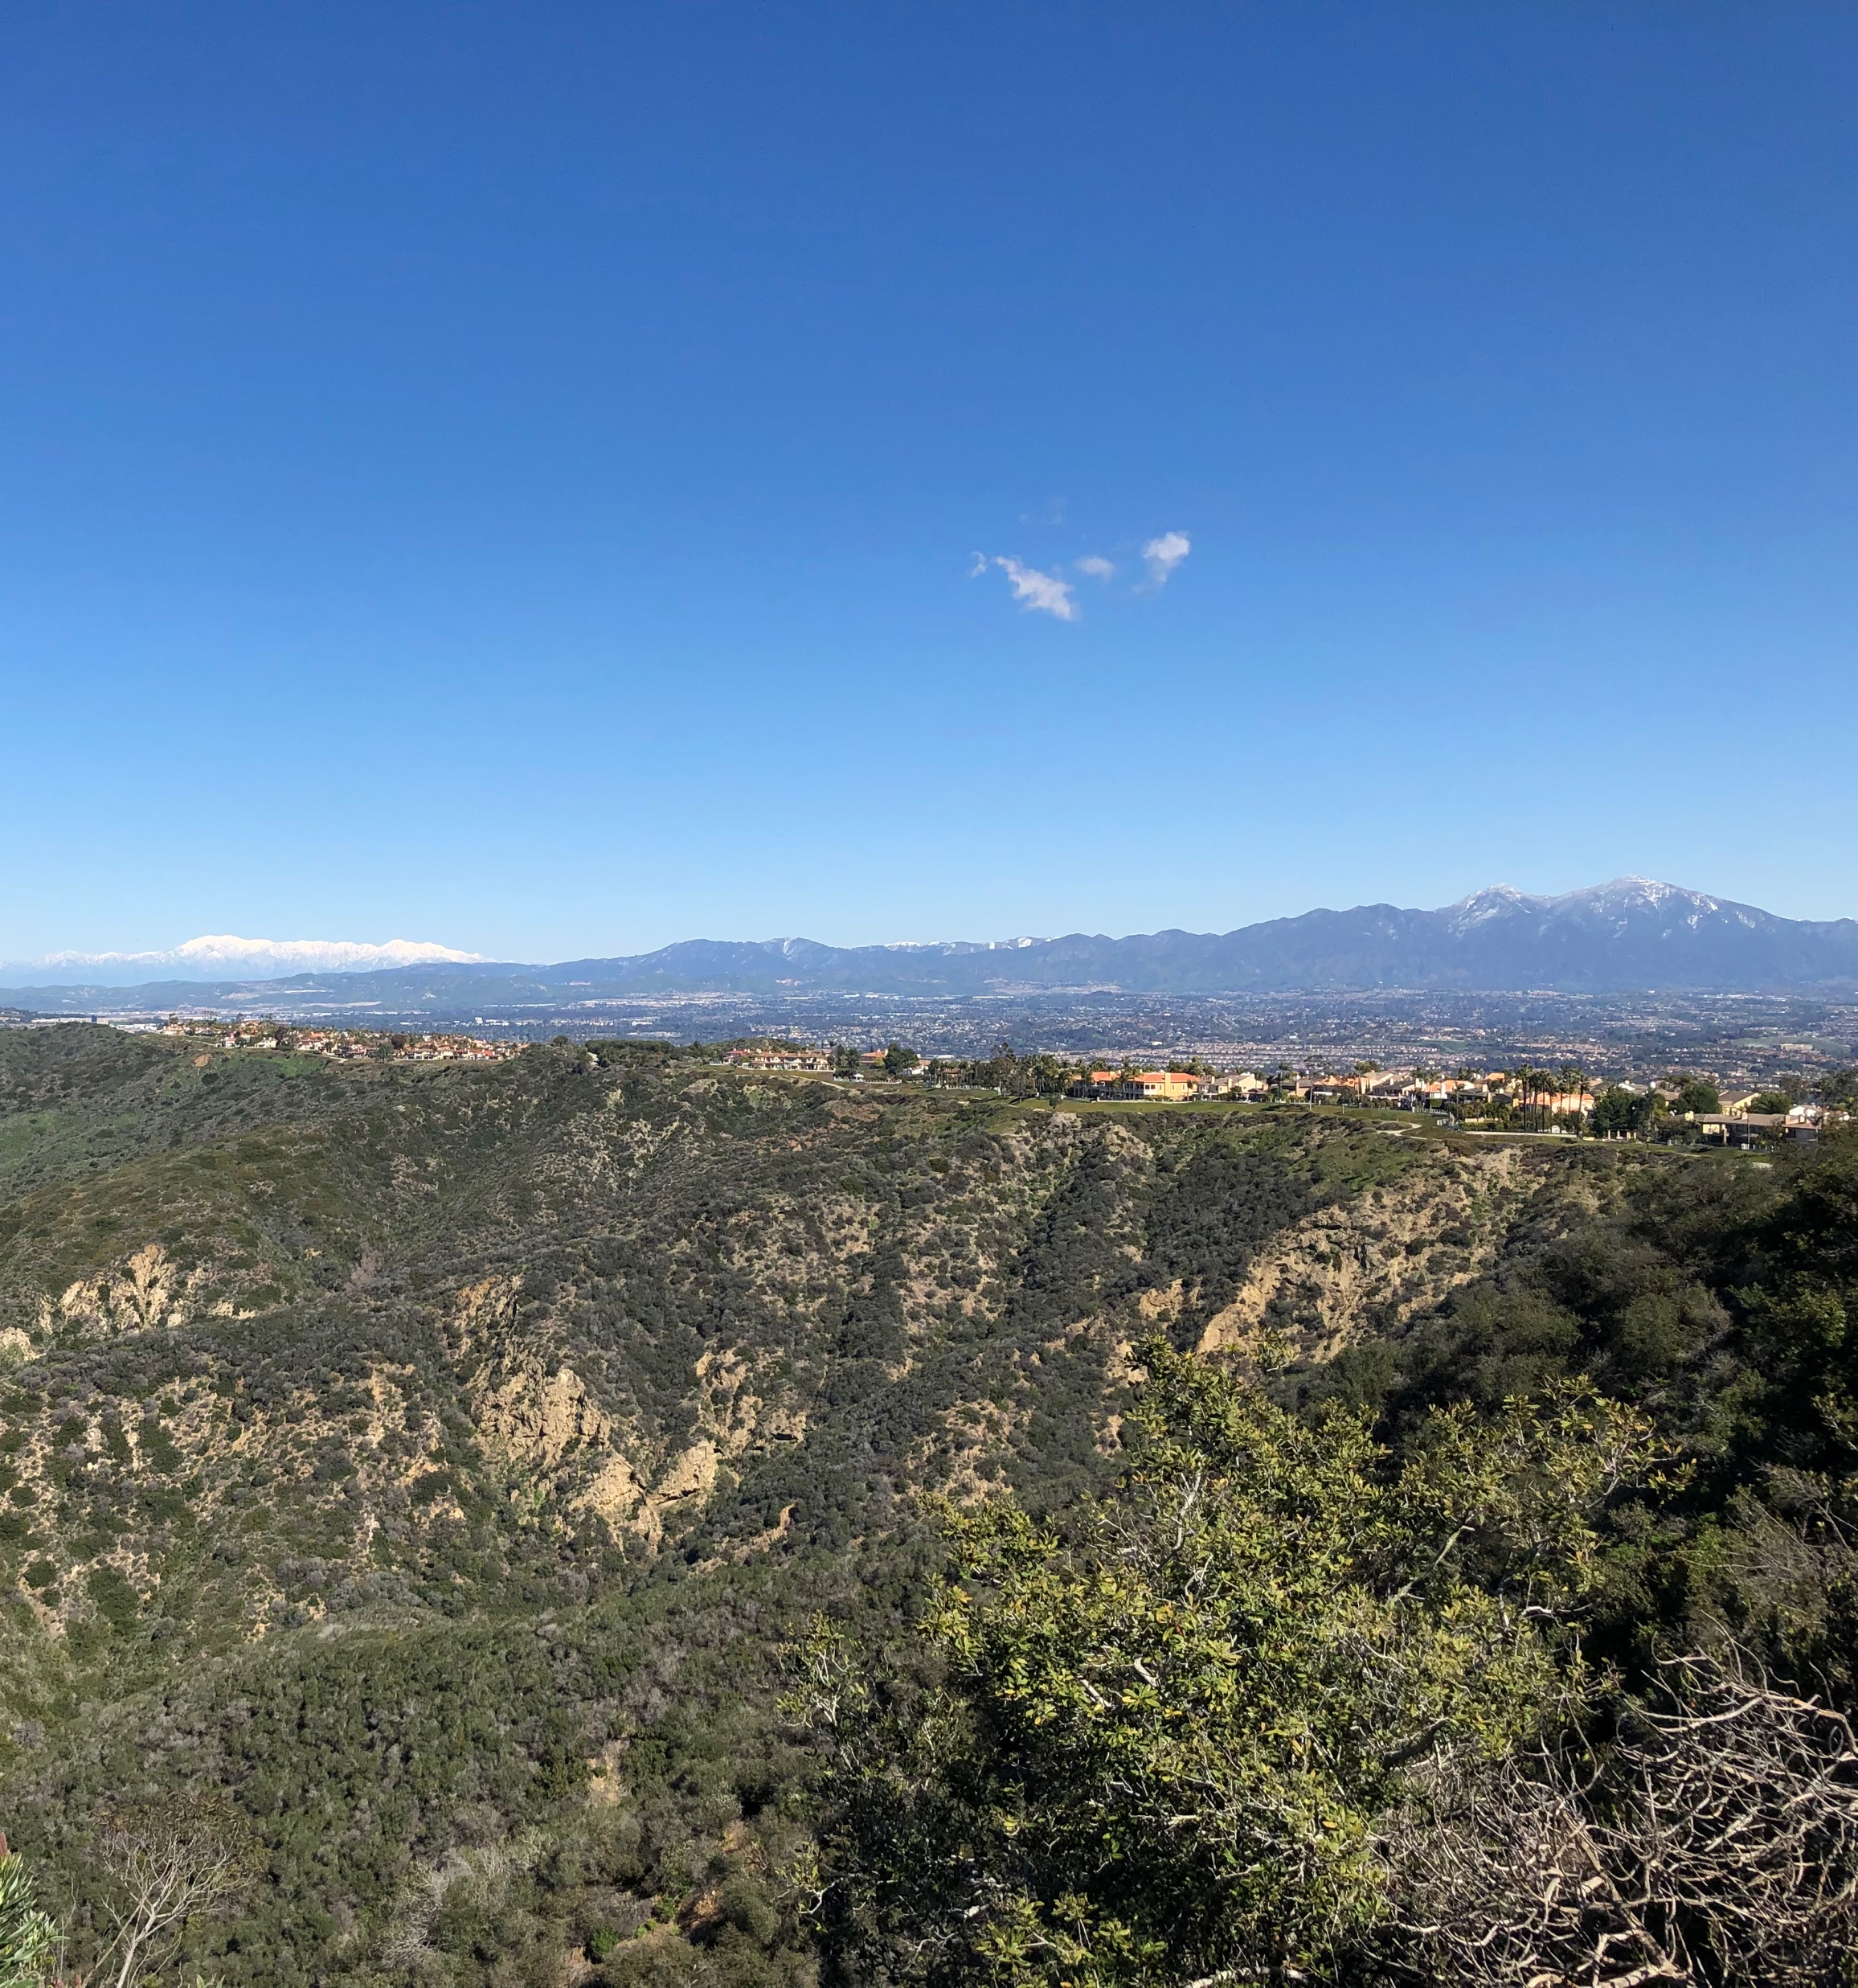
Today’s Agenda
Background
Study Objectives and Scope Highlights
Partner Agency and Public Engagement
Existing and Future No-Build Conditions
Transportation Issues and Opportunities
Study Goals
Wrap-Up and Next Steps

Slide 3
Background
Multimodal Transportation Studies
OCTA conducts multimodal studies to develop a vision for the transportation system to address long-term needs within the study area
Once the LPS is determined through OCTA Board approval, study recommendations can be considered in the LRTP for implementation
OCTA LRTP
SCAG RTP/SCS
FTIP
Four-year cycle
20+ year plan
Four-year cycle
20+ year plan
Two-year cycle
Six-year funding program
LPS: locally preferred strategy | LRTP: Long-Range Transportation Plan | SCAG RTP/SCS: Southern California Association of Governments Regional Transportation Plan/Sustainable Communities Strategy | FTIP: Federal Transportation Improvement Program

Slide 4
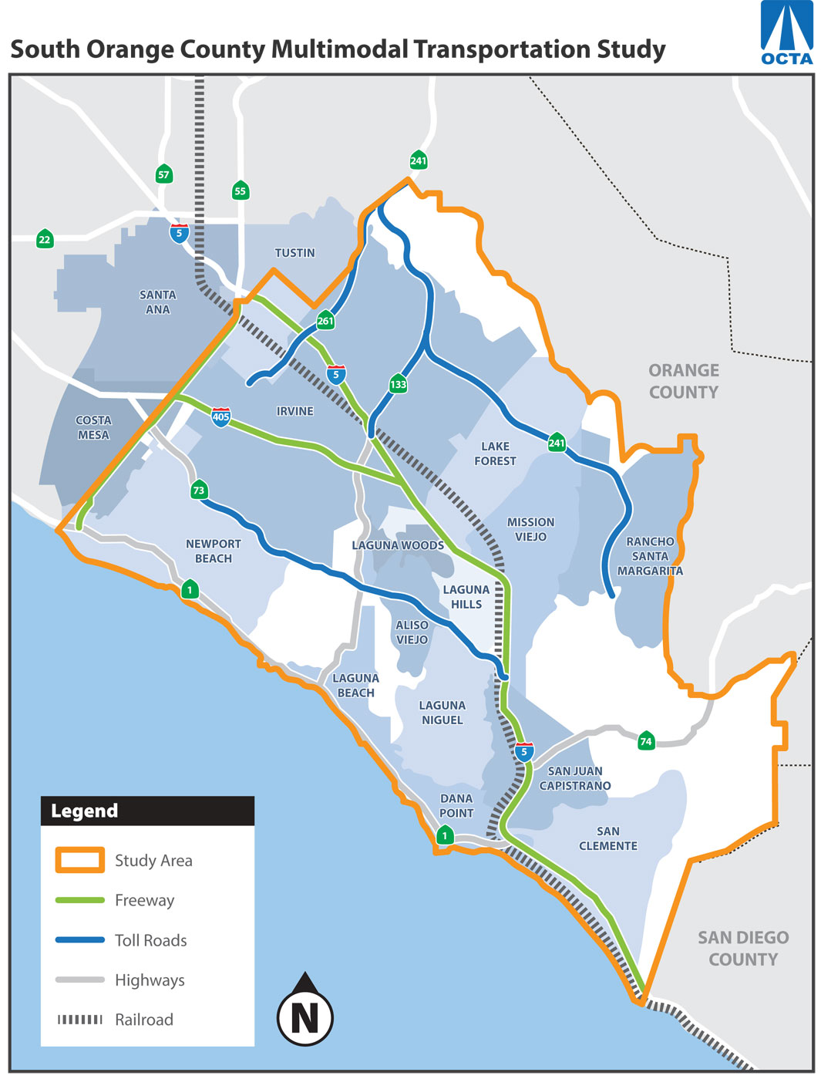
Study Objectives
Develop consensus on a set of multimodal transportation improvements
Update to 2008 South Orange County Major Investment Study (SOCMIS)
Reflect progress and latest planning assumptions

Slide 5
Study Scope Highlights
Phase 1
Phase 2
Phase 3
Identify Issues and Opportunities
Develop Purpose and Need Statement
Develop Initial Alternative Strategies
Screening Alternative Strategies
Select Reduced Set of Alternative Strategies
Analysis of Reduced Set
Recommend a Locally Preferred Strategy
2020
2021

Slide 6
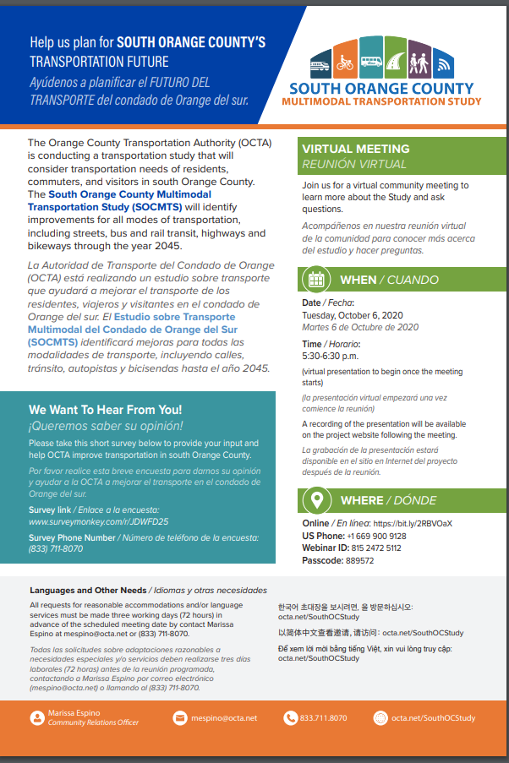
Public Engagement
Online survey open until Oct. 30
SouthOCStudysurvey.com
Hotline
(833) 711-8070
Public Webinar
Recording and FAQ available on
octa.net/SouthOCStudy

Slide 7
Existing and Future No-Build Conditions
Documents existing and future demographic, land use, and multimodal transportation system conditions
Helps identify and understand transportation issues and opportunities
Existing & Future (2045) No-Build Conditions
Demographics and Land Use
Transit
Active Transportation
Arterials
Travel Patterns
Highways and Toll Roads
Transportation Demand Management

Slide 8
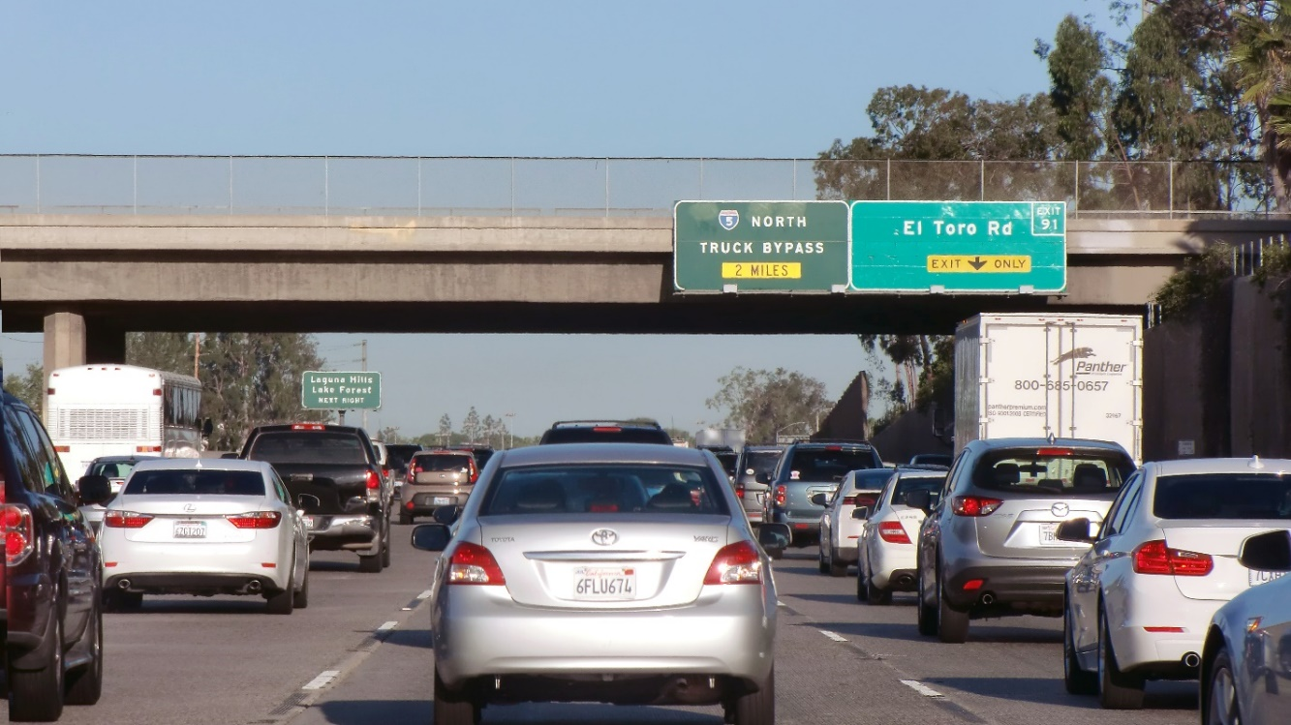
Transportation Issues and Deficiencies
Highways, Toll Roads, Arterials
Weekday, weekend, and seasonal congestion
Low travel time reliability (expected delays)
Critical bottlenecks on I-5 and I-405
Dependence on east-west arterials

Slide 9
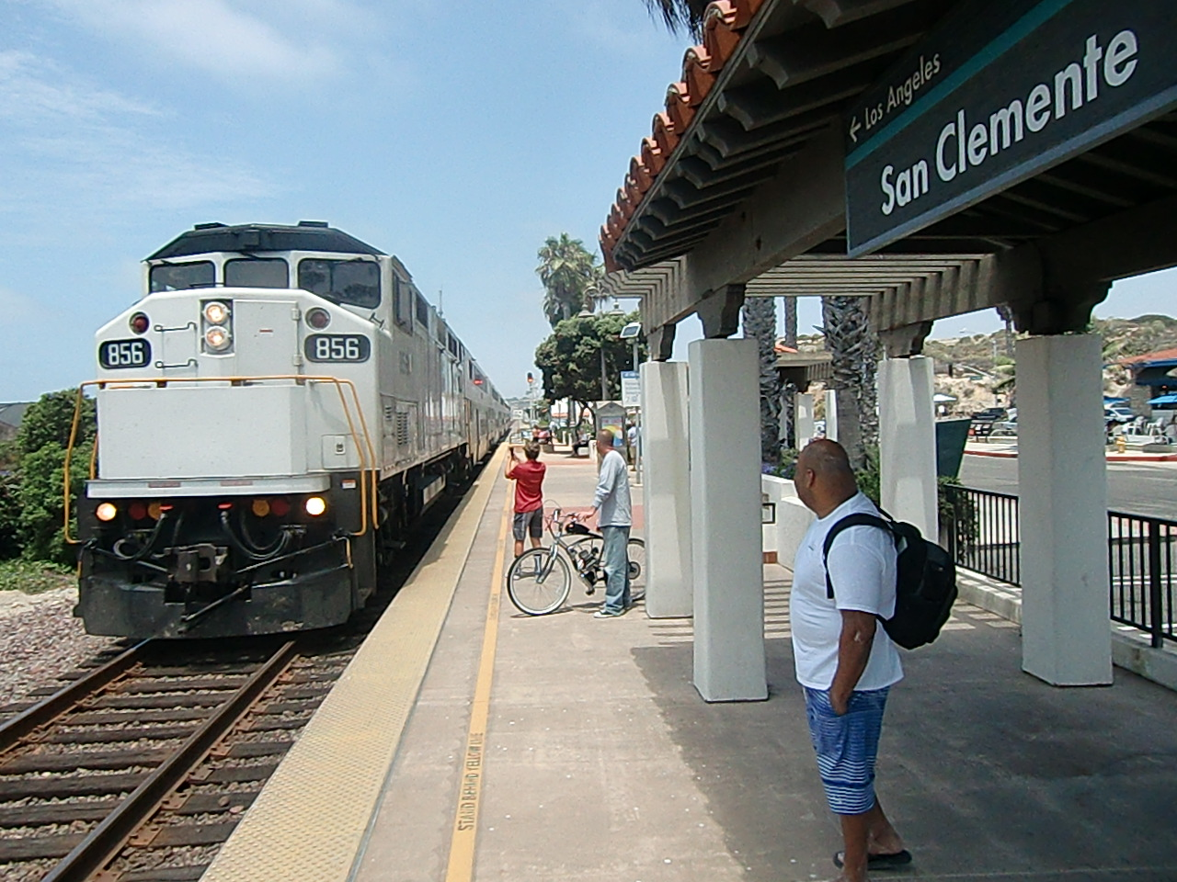
Transportation Issues and Deficiencies
Transit
Limited transit accessibility attributable to low-density land use patterns
Infrequent service, inconsistent reliability
Less convenient than driving (wait times, transfers)

Slide 10
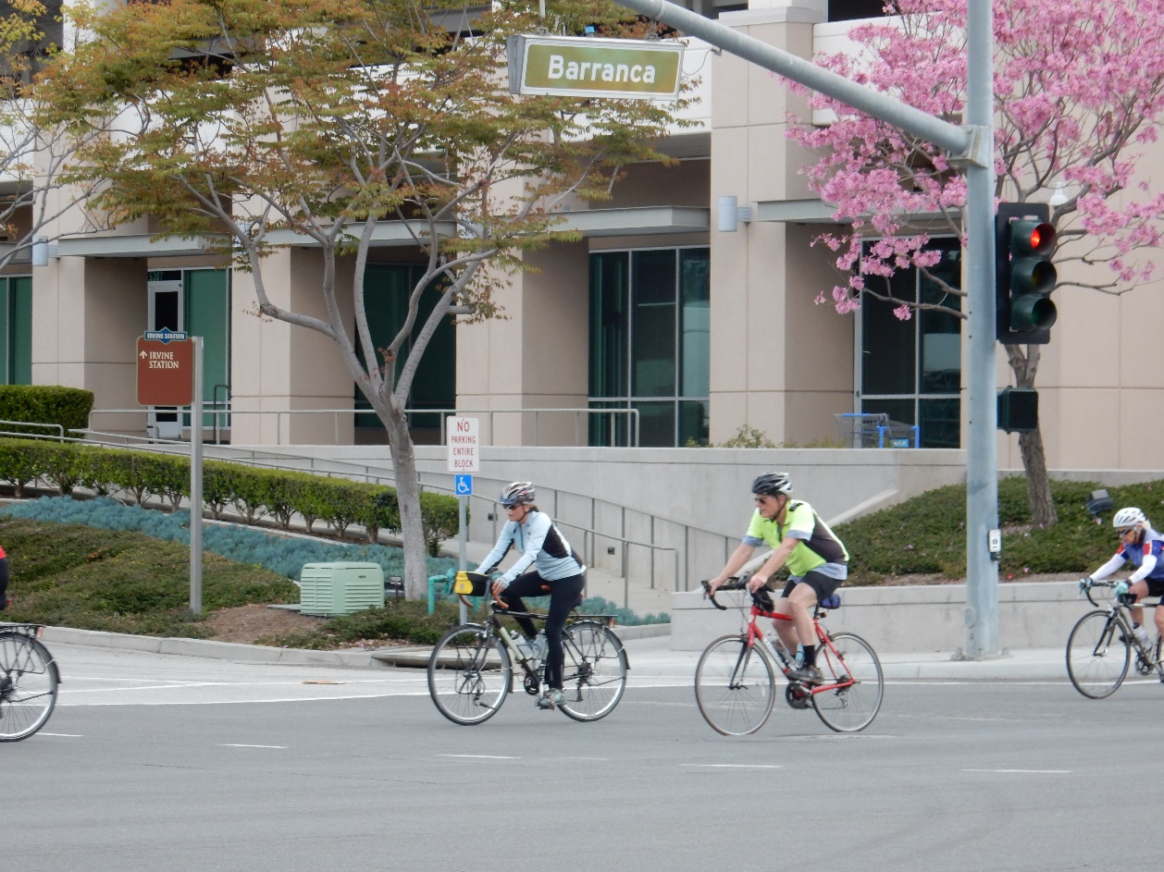
Transportation Issues and Deficiencies
Active Transportation
Gaps in the active transportation network
Low usage due to circuitous road network, long trip distances
Safety concerns for pedestrians and bicyclists

Slide 11

Transportation Issues and Deficiencies
Transportation Demand Management (TDM)
Long-distance, peak period commute trips to North OC and other counties (especially LA)
Low transit mode share in South OC

Slide 12
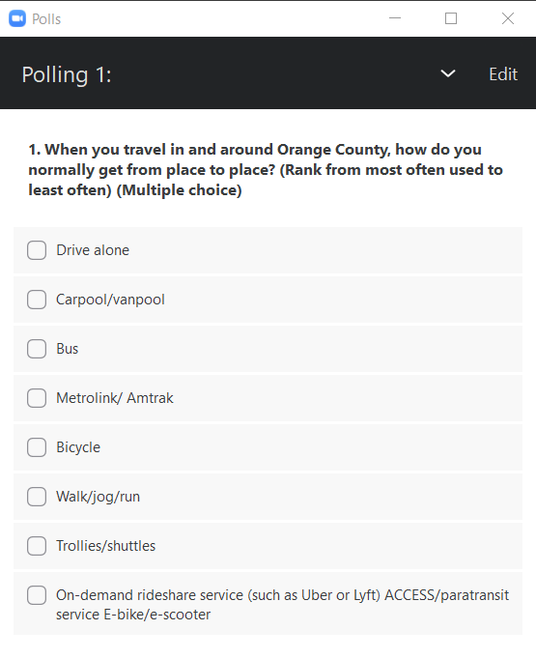
Discussion
Zoom Poll
Update image

Slide 13
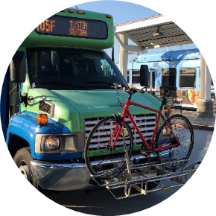
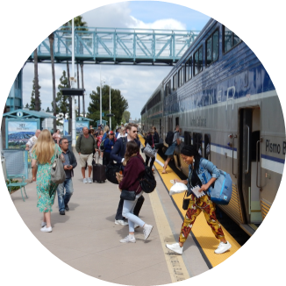
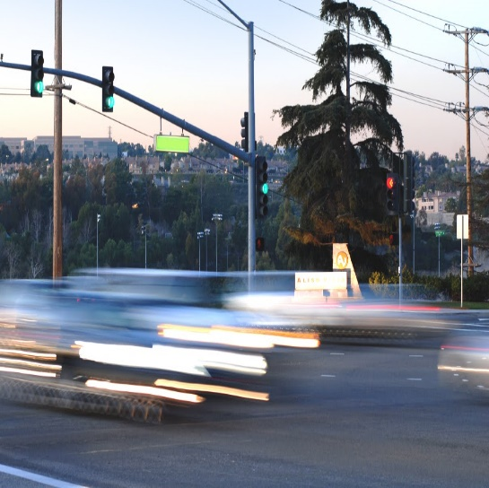
Context for Study Goals
Long-range transportation plans at the county, regional, and statewide levels
Study area transportation issues and opportunities

Slide 14
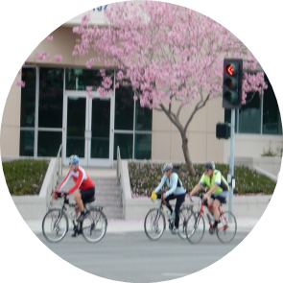
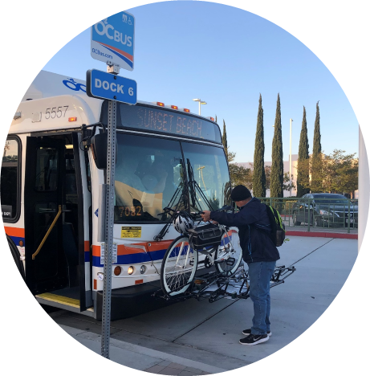
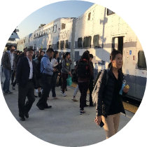
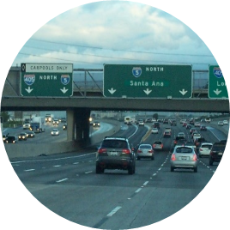
Draft Study Goals
Improve System Performance
Expand System Choices
Support Sustainability
Enhance Equity and Quality of Life

Slide 15
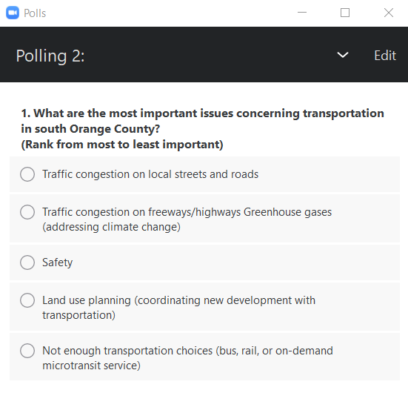
Discussion
Zoom Poll
Update image

Slide 16
Next Steps
September
October
November
December – January 2021
February
Partner and Public Input
Goals & Objectives
Purpose & Need
Identify Conceptual Strategies
Package into
Conceptual Alternatives
Initial Screening
Update to OCTA Board

Slide 17
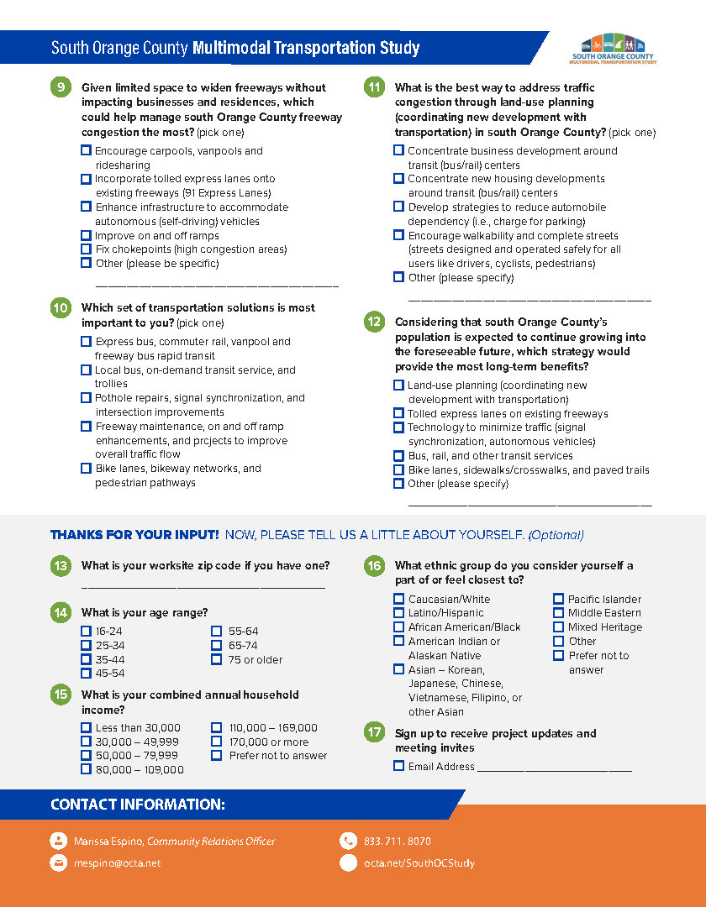
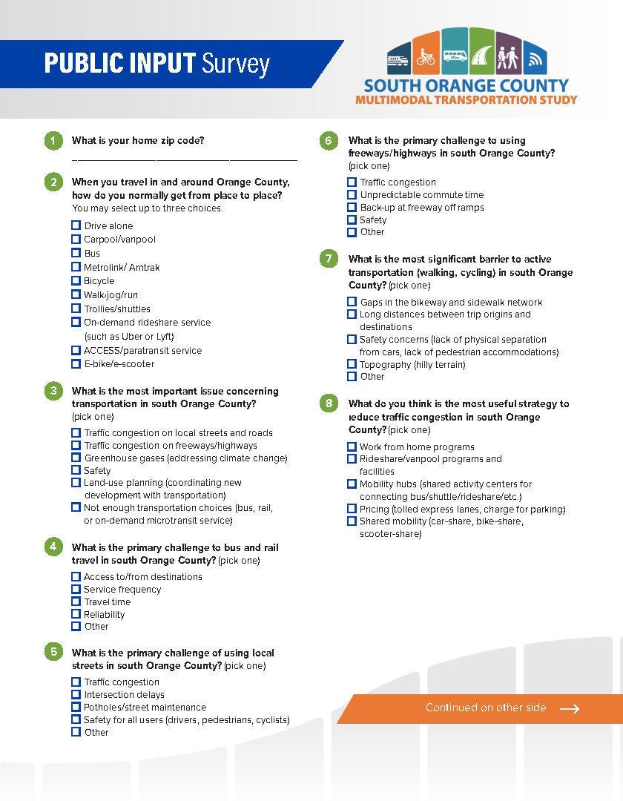
Stay Involved
Online Survey
SouthOCStudysurvey.com
Hotline: 833-711-8070

