Slide 1

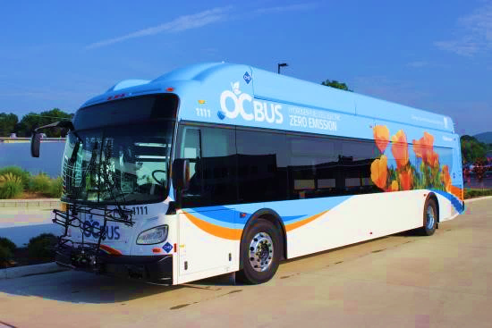
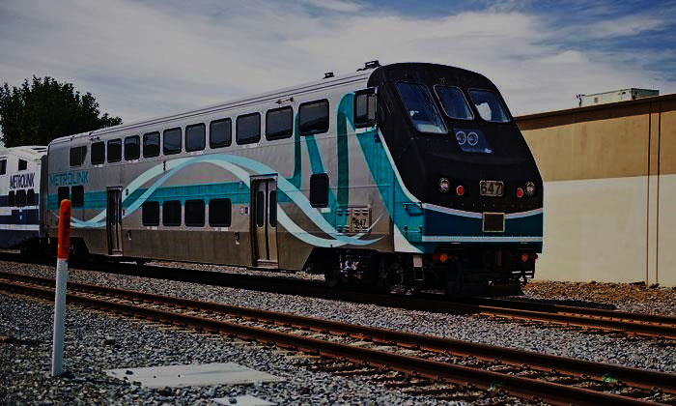

Federal Transportation
Improvement Program and OCFundtracker Database
2025 TIP Database and Amendment Guide

Slide 2
Agenda
Introductions
Informational Items
FTIP Process and Overview
New CMAQ/STBG Process
Equity Performance Metric
ATP and BCIP Projects // OCCSP
2

Slide 3
Introduction
The Federal Transportation Improvement Program (FTIP) is the primary programming and implementation component for projects identified in the Regional Transportation Plan (RTP).
The FTIP lists projects and identified funding sources for every transportation project that:
  Receives Federal funds.
  Receives State funds.
  Are Regionally Significant Projects.
3

Slide 4

Regional Transportation Plan (RTP)
4

Slide 5
What is “Regionally Significant”?
What is considered a “regionally significant” project?
Projects that impact the County and region, such as:
  Freeways / State Highways
  Expansions to Principal Arterial (8 lane)
  Expansions to Major Arterial (6 lane)
  Routes that provide access to regional shopping centers, airports, amusement parks, etc.
  Goods Movement Routes
  Transit Centers, Rail Stations, Airports, Ports
  Fixed Transit Routes
5

Slide 6
Types of FTIP Amendments
Administrative Modifications
Formal Amendments
Includes:
  That do not affect the regional emissions analysis
  That do not affect the timely implementation of the Transportation Control Measures
  In fund source, fund changes, lead agency, minor project description, and split or combined projects
  In funding less than 50% or less than $20 million of the total project cost or project phase
Includes:
  Any major change to the project that can not be made through an administrative modification
  Any change that may require new conformity determination
  Cost increases over 50% or $20 million or more of the total project cost or phase
  Requires a 10-day public review period
The 2025 FTIP covers a six-year period from FFY24/25 to FFY29/30. Projects listed in the last two years will be considered informational consistent with federal regulations.
6

Slide 7
2025 FTIP- Additional Provisions
Projects must:
Be fully funded.
  Includes approved funds only (back-up documentation)
Comply with the Southern California Association of Governments (SCAG) long-range RTP.
FTIP programming is required for Federal Highway Administration/Caltrans approval and the Authorization to Proceed (E-76) process
7

Slide 8
Roles and Responsibilities
Local Agencies
Orange County Transportation Authority (OCTA)
Southern California Association of Governments (SCAG)
8

Slide 9
Roles and Responsibilities
Local Agencies
OCTA
SCAG
Submit projects that are required in the FTIP.
  Add new projects
  Delete existing projects
  Modify existing projects
  Carry-over active projects
Ensure projects comply with FTIP guidelines.
Ensure projects comply with Transportation Control Measure (TCM) requirements.
Ensure projects are fully funded.
Provide backup documentation authorizing funding for projects.
Administers the FTIP in Orange County.
Assists with local outreach and initial project nomination screening process.
Programs OCTA related projects into the FTIP.
Reviews projects submitted from local agencies for FTIP and RTIP compliance.
Prepares final submittal to SCAG.
Prepares group project listings for:
  Complete Streets
  Regional Active Transportation Program (ATP)
  Bicycle Corridor Improvement Program (BCIP)
  Highway Bridge Program (HBP)
Maintains the regional FTIP database.
Reviews projects for FTIP compliance.
Initiates regionwide call for project nominations.
Conducts project selection process.
Submits projects to Caltrans and Federal Highways Administration (FHWA) / Federal Transit Administration (FTA) for review.
Prepares group project listings for:
  Statewide ATP
  Highway Safety Improvement Program (HSIP)
  Safe-Routes to School (SRTS/SR2S)
9

Slide 10
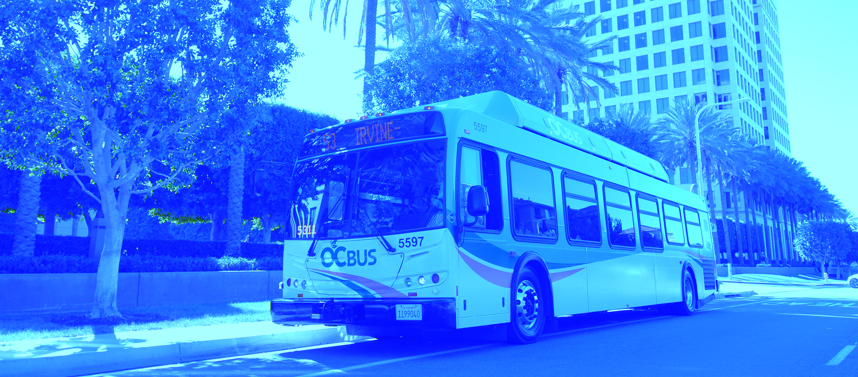
Federal Formula-Based Funding Sources
STBG: Surface Transportation Block Grant Program
CMAQ: Congestion Mitigation and Air Quality Improvement Program
Eligible Projects:
  • Highway improvements
  • Bridge construction and repair
  • Transit capital projects
  • Bicycle and pedestrian facilities
  • Safety improvements
Eligible Projects:
  • Public transit expansions
  • Traffic flow improvements
  • Bicycle and pedestrian pathways
  • Ridesharing programs
Key Features:
  • Focus on improving air quality
  • Projects must demonstrate emission reduction benefits

Slide 11
STBG/CMAQ Guideline Compliance
Previously, funds were suballocated to counties based on formula and County Transportation Commissions (CTCs) such as OCTA had the flexibility to program the funding for project selection.
However, as of July 1, 2023, SCAG is responsible for STBG/CMAQ-funded project selection as the region’s MPO.
By issuing a corrective action, the FHWA and FTA shifted project selection authority for the CMAQ program and the administration of the STBG program to SCAG to be compliant with federal regulations.
11
Notes:
Because of the corrective action by fta and fhwa that determined xyz. For more information… “These guidelines address joint Federal Highway Administration’s (FHWA) and Federal Transit Administration (FTA) compliance findings focused on the delegation of project selection authority for the CMAQ program and the suballocation and administration of the STBG program.”

Slide 12
Base FTIP Adoption Submittal
Local Agency submits projects to OCTA
OCTA reviews projects and submits to SCAG for evaluation
SCAG analyzes submitted programs / modeling activity
Adopted FTIP due to federal agencies
FTIP adopted at the state level
30-day public review period and public hearings

Slide 13
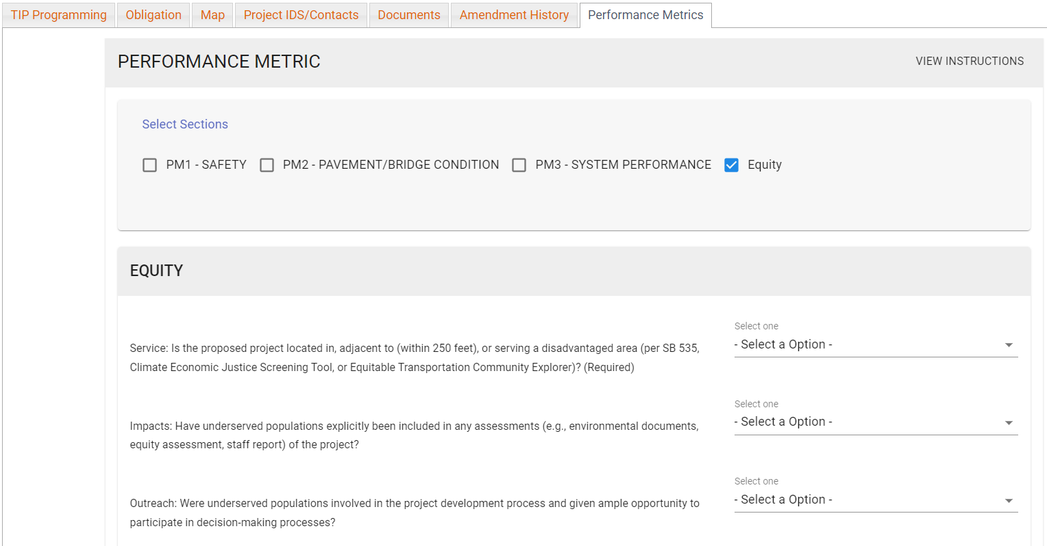
Performance Measures for 2025 FTIP
Performance metrics indicate the improvement a project has across different criteria. (Does not apply to studies or inactive projects)
New equity section in the FTIP required per SCAG.
The Equity module is embedded under the “Performance Measures” tab of each project in the FTIP database. The first question under Equity is REQUIRED.
Required!
13
Notes:
Add maybe an arrow to explain

Slide 14
SCAG’s New Equity Guidelines
This metric uses demographic data/mapping to identify affected areas and ensures equitable distribution of resources in these types of areas:
    Environmental Justice Areas
    Disadvantaged Communities
    Priority Equity Communities
    And/or Communities of Concern
In future FTIP adoptions, mapping may be required so that SCAG can assess if there are issues with the balance of transportation investments in underserved areas.

Slide 15
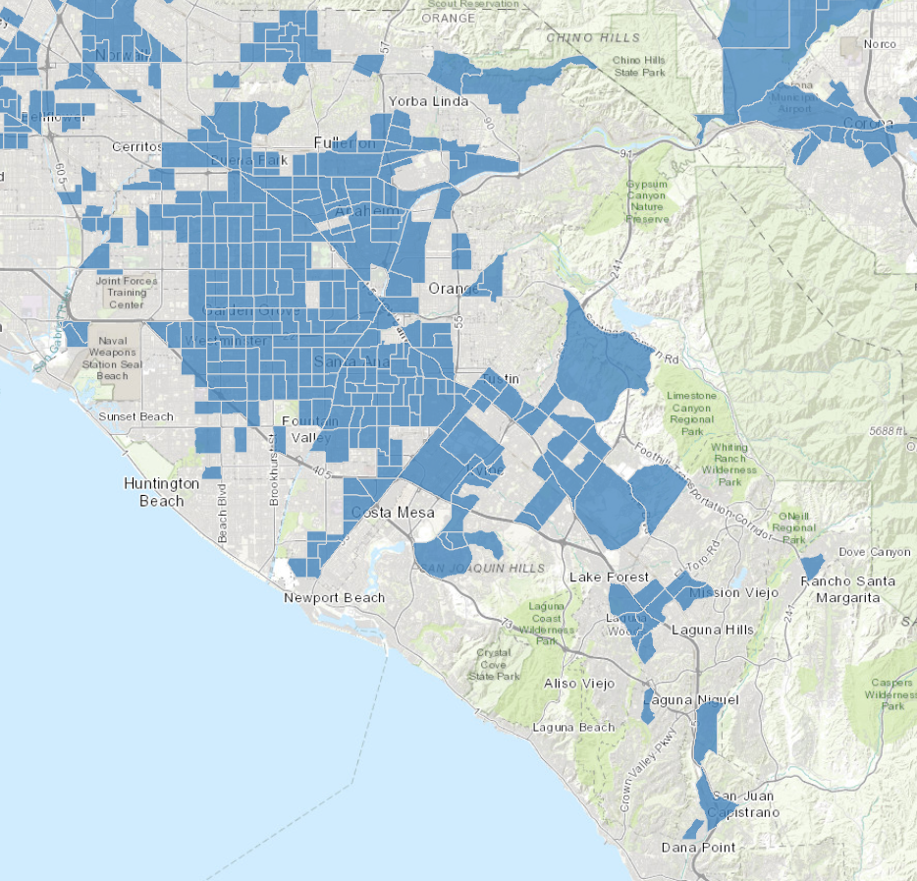
Equity for 2025 FTIP
SB 535
Priority Equity Community Boundary
Climate Economic Justice Screening Tool
Equitable Transportation Community Explorer
Pictured right: Example of one of the mapping tools that can be used to determine if a proposed project is located in, adjacent to (within 250 ft) or serving a disadvantaged area (per SB 535 Climate Economic Justice Screening Tool or Equitable Transportation Community Explorer).
Notes:
“In future FTIP adoptions, more advanced database analytics combined with spatial analysis may be utilized to evaluate investments across the region and whether they are focused in under resourced or underserved areas. In the near term, SCAG has initiated an FTIP mapping tool through the updated eFTIP database to capture the location and extent of all projects including non-modeled (exempt) projects. SCAG will collaborate with the CTCs to enhance and take advantage of this feature, including providing assistance to those agencies that do not have the resources to complete this task. This information can potentially be used to evaluate investments geographically. When fully utilized, a web map feature will provide an opportunity for the public to view project locations and assess the relationship to the different demographic groups and communities. This interactive map will plot projects and highlight major features, such as project scope, funding, and lead agency information. Potentially, SCAG can assess how and where FTIP investments are being made and if there are issues with the balance of transportation improvements in under resourced or underserved areas to analyze equity in place. Any improvements to the FTIP process must be done in collaboration with the CTCs.”

Slide 16
2025 FTIP Adoption Schedule
Tentative Schedule
January 4, 2024 | OCTA 2025 FTIP submittal due to SCAG
January 2024 | OCTA 2025 FTIP Plan to Board of Directors
August 2024 | Draft 2025 FTIP due to Caltrans
November 2024 | 2025 FTIP Adoption approved by Caltrans
December 2024 | 2025 FTIP Adoption approved by FHWA/FTA
The 2023 FTIP cycle will still be ongoing while the 2025 FTIP is being approved
  Amendments will still need to be submitted if there are project changes

Slide 17
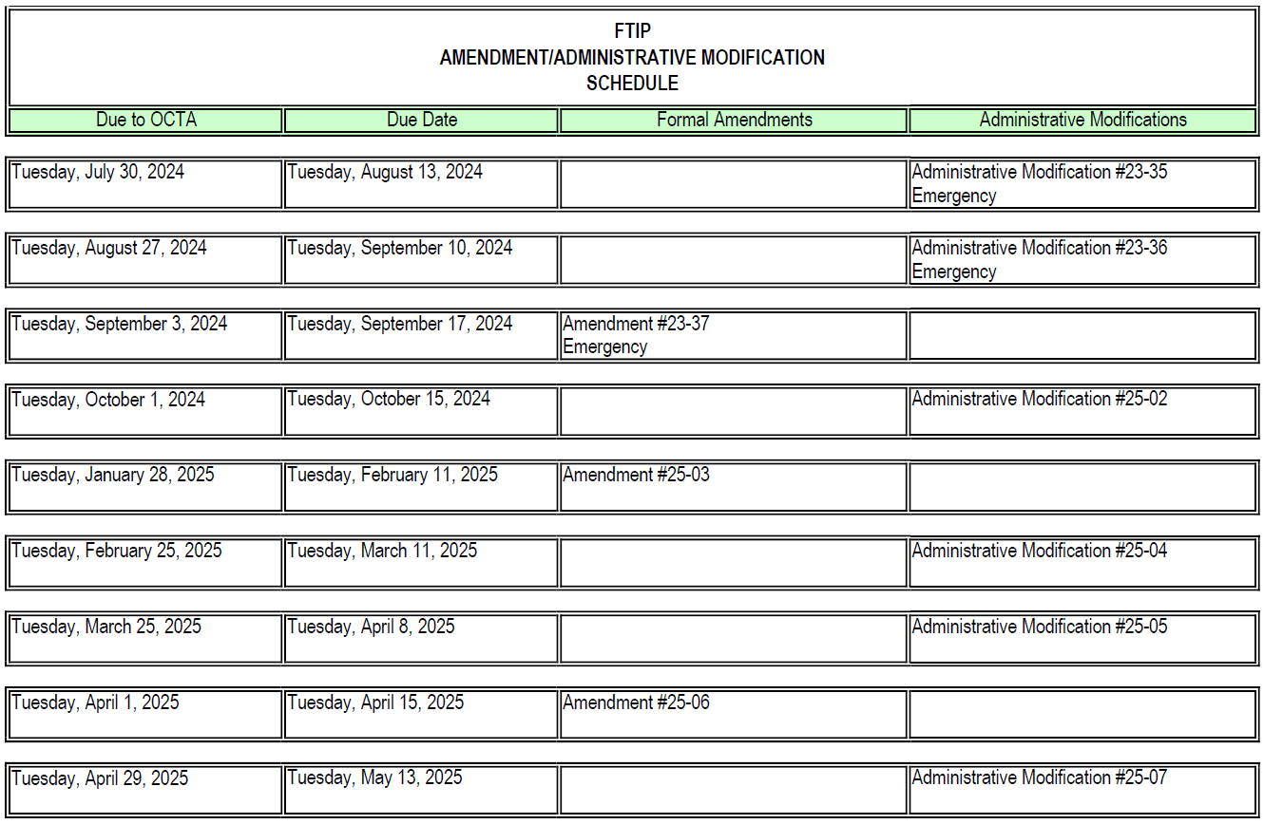
FTIP Schedule – Upcoming Amendments

Slide 18
Common Problems
Incomplete or unclear descriptions
  Sample descriptions can be found on pg. 8 of the Tutorial and Amendment Guide. Click on Guidelines next to Project Description in the TIP Program Information section for detailed information
Unidentified number and direction of existing and proposed lanes
  Ensure the number of lanes proposed and existing is accurately identified.

Slide 19
Common Problems
Missing local match amounts
  List local funding match sources in the Programming Information section. A list can be found on pg. 39 of the Tutorial and Amendment Guide.
Missing completion dates
  Ensure project has an accurate future completion date.
  Additionally, TCM projects have strict requirements regarding completion dates.
Missing environmental documents type and dates
  Select the appropriate Environmental Document type. Enter the completion date (or anticipated completion date) of the associated document. More information can be found on pg. 12 of the Tutorial and Amendment Guide.

Slide 20
Complete Streets/ATP/BCIP
The Complete Streets/Active Transportation Program (ATP) and Bicycle Corridor Improvement Program (BCIP) are programmed into certain group projects and managed in the FTIP by OCTA
  Local agencies are responsible for maintaining accuracy in group project listings and providing backup documentation while OCTA will review for compliance.
If an ATP or BCIP project is a Transportation Control Measure (TCM) they require their own FTIP sheet
  Local agencies are responsible for managing FTIP sheets and providing backup documentation while OCTA will review for compliance.
TCMs are strategies that reduce transportation-related air pollution, GHG emissions, and fuel use by reducing vehicle miles traveled and improving roadway operations.
  Bicycle and pedestrian facilities more than 1 mile.

Slide 21
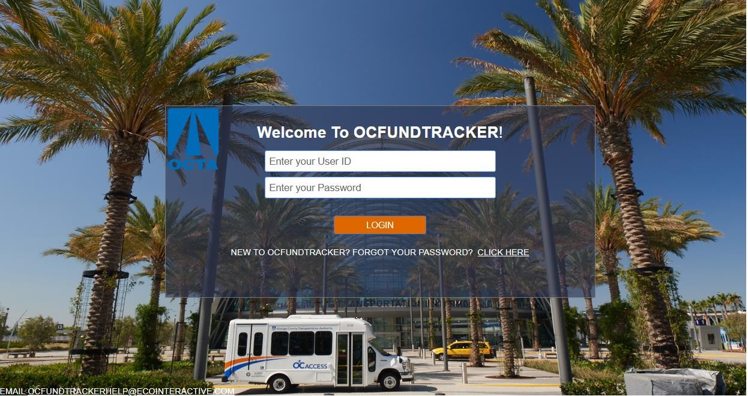
OCFundtracker
OCFundtracker is the online database for the TIP in Orange County and the means by which project revisions are processed.
An updated system has been released, and major changes are reviewed in the Tutorial and Amendment Guide.

Slide 22
Questions / Contact
Ben Ku
Section Manager Formula Funding
bku@octa.net
714-560-5473
Mina Kim
Transportation Funding Analyst
mkim@octa.net
714-560-5705
https://octa.net/programs-projects/programs/funding-programs/federal-funding/federal-transportation-
improvement-program/

