Slide 1
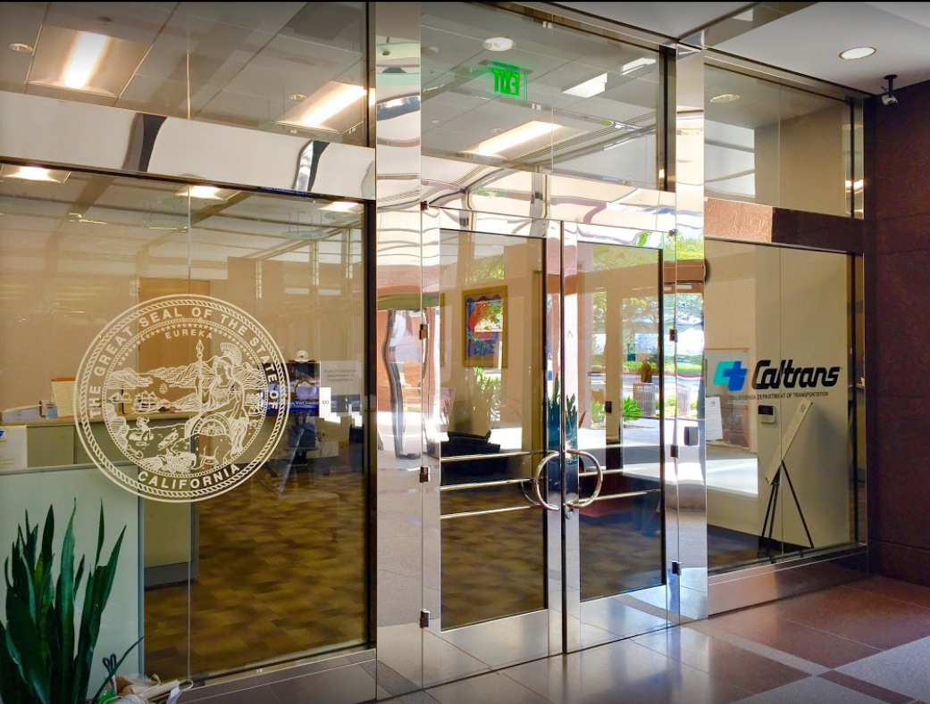

TECHNICAL ADVISORY COMMITTEE MEETING
LOCAL ASSISTANCE UPDATE
Jonathan Lawhead Kathleen Nguyen
D12 Local Assistance Branch Chief (DLAE) D12 Local Assistance Program Manager
Caltrans District 12 Caltrans District 12
Jonathan.Lawhead@dot.ca.gov Kathleen.Nguyen@dot.ca.gov
(424) 413-1124 (805) 732-9777
June 26, 2024

Slide 2
TECHNICAL ADVISORY COMMITTEE MEETING
LOCAL ASSISTANCE UPDATE
TABLE OF CONTENTS
PAGE | UPDATE ITEM
1 E-76 Obligation Deadlines - FFY 23/24
2 CTC Meetings
3 Inactive Invoices
4 ATP
5 HSIP
6 Clean California
7 LTCAP
8 DBE/QAP
9 PED Extensions
10 Title VI
11 References and Training Opportunities
12 Staff Assignments/Contacts

Slide 3
E-76 Obligation Deadlines - FFY 23/24
E-76 deadlines for federal-aid projects with funds programmed to be obligated this FFY 23/24 are summarized below:
  De-Obligations:
    Complete De-Obligation E-76 packages, with all reviews completed and comments resolved, must be submitted to the District by June 21, 2024.
  FTA Transfers:
    FTA Transfer requests must be submitted to the District by June 21, 2024.
  E-76 Deadlines:
    Request for Authorization (RFA) packages must be submitted to the Districts by June 21, 2024.
Please share these deadlines with your team and work with your assigned Local Assistance Area Engineer (LAAE) to ensure these deadlines are met. If there is a potential for a project with funds programmed this FY 23/24 to not meet these deadlines, please notify your LAAE as soon as possible to determine a project delivery action plan. Feel free to reach out to your assigned LAAE and myself with any questions.
1

Slide 4
CTC Meetings
Deadlines to submit allocations and time extensions to District 12 Local Assistance:
  June 17, 2024 for the August 2024 CTC Meeting
  August 19, 2024 for the October 2024 CTC Meeting
2

Slide 5
Inactive Invoices
Deadline to submit inactive invoices for next quarter is August 23, 2024
New inactive quarter will begin on July 1, 2024
Reminder letters will be sent out after the new quarter begins
Inactivity may prevent E-76s from being processed
The official inactive list can be viewed here:
  https://dot.ca.gov/programs/local-assistance/projects/inactive-projects
If you have questions or issues with submitting invoices, please contact your assigned Local Assistance Area Engineer for further assistance
3
Notes:
We have had several cases statewide and even in the district where E-76s were rejected last FFY because there were ongoing inactives.

Slide 6
Active Transportation Program (ATP)
CalSMART Reporting Requirements:
  Open for reporting June 16, 2024
  Quarterly progress reports due July 15, 2024
  Quarterly progress reports are required once a project is accepted into the ATP
  Completion Reports (CR) must be finalized and approved before the District can process your Final Report of Expenditures (FROE)
  Final Delivery Reports (FDR) will only be approved after the FROE has been processed
Caltrans’ ATP webpage: https://dot.ca.gov/programs/local-assistance/fed-and-state-programs/active-transportation-program
4
Notes:
Completion Report is due to Caltrans within six months of construction contract acceptance or the project becoming operable (open to the public), whichever comes sooner.
Final Delivery Report is due within 180 days of the conclusion of all remaining project activities beyond the acceptance of the construction contract.
All reports are due to the CalSMART online reporting tool and can only be submitted during an open reporting period.

Slide 7
Highway Safety Improvement Program (HSIP)
HSIP Cycle 12
  Call-for-Projects – May 6, 2024
  Application deadline – September 9, 2024
  Cycle 12 funds will be either state or federally funded
Information may be subject to change. For more info and guidance, please see Caltrans’ HSIP webpage: https://dot.ca.gov/programs/local-assistance/fed-and-state-programs/highway-safety-improvement-program
5

Slide 8
Clean California Local Grant Program (CCLGP)
Cycle 1 delivery deadline is June 30, 2024, without an extension
  If an extension will be required, please reach out to your assigned Local Assistance Area Engineer ASAP
Please see the Clean CA webpage for more info and application guidelines: https://cleancalifornia.dot.ca.gov/local-grants/local-grant-program
6

Slide 9
Local Transportation Climate Adaptation Program (LTCAP)
LTCAP Cycle 2
  Call for Projects: June 27-28, 2024 - August 30, 2024
    Call for Projects closes August 30, 2024 by 11:59pm
Information may be subject to change. For more info and guidance, please see Caltrans’ LTCAP webpage: https://catc.ca.gov/programs/local-transportation-climate-adaptation-program
7
Notes:
Caltrans HQ Local Assistance, CTC, and Caltrans Budgets are performing a reconciliation effort to address the various challenges resulting from the passing of the Fiscal Responsibility Act of 2023 and to develop a complete fiscal plan related to this effort. An update will be provided to all Districts, MPO’s, and RTPA’s once more information is available.

Slide 10
DBE/QAP
Quality Assurance Program (QAP) forms need to be updated and approved every 5 years
QAP forms and annual DBE Forms need to be up to date and on file with Caltrans D12 Local Assistance in order to process E-76s and receive federal funding
If you have questions or issues with submitting DBE/QAP forms, please contact your assigned Local Assistance Area Engineer for further assistance
8

Slide 11
PED Extension
New way to request extensions for Project End Dates (PED)
  Entirely online and replaces old E-76 system
  Link: https://app.smartsheet.com/b/form/dd8ec43edae54b8aad35159cacec011a
Work done after a PED cannot be reimbursed!
More info and a report listing upcoming PED expirations can be found here: https://dot.ca.gov/programs/local-assistance/projects/projects-with-expiring-end-dates
9

Slide 12
Title VI
Title VI of the Civil Rights Act of 1964 prohibits discrimination by recipient of Federal assistance on the basis of race, color, and national origin, including the denial of meaningful access for limited English proficient (LEP) Persons.
Requirements include but are not limited to:
  Title VI nondiscrimination statement
  Assurances (as part of the Master Agreement and Program Supplement Agreement.
  Designation of a Title VI Coordinator.
  Complaint Procedures.
  Data Collection.
  Training.
  Dissemination of Information.
  Contracts and Agreements.
  Environmental Justice.
  Public Hearings and Meetings.
  Right of Way activities.
  Construction contract compliance.
  Monitoring.
Caltrans has also recently updated our webpage on Filing a Complaint, and it provides guidance to local agencies on how to process Title VI complaints.
10

Slide 13
References and Training Opportunities
Cooperative Training Assistance Program:
  https://ca-ctap.org/
California LTAP training:
  https://caltap.org/training.aspx
Local Assistance Blog:
  https://www.localassistanceblog.com/local-assistance-training/
Local Assistance Procedures Manual (LAPM)
  https://dot.ca.gov/programs/local-assistance/guidelines-and-procedures/local-assistance-procedures-manual-lapm
11

Slide 14
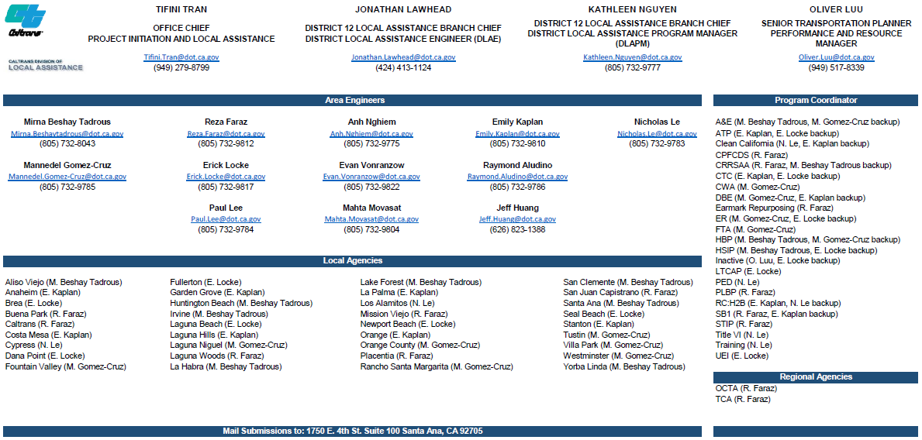
12

