Slide 1
Active Transportation Counts Program Update
CAC Bicycle/Pedestrian Subcommittee
March 26, 2019

Slide 2
Project Overview – Accomplishments
The Active Transportation Count Program:
Built from existing efforts to collect bicycle and pedestrian counts throughout the County
Consolidated all counts into a single location
Developed a guide for future active transportation investments
Support for regional active transportation efforts
Developed Orange County’s first bicycle flow map

Slide 3
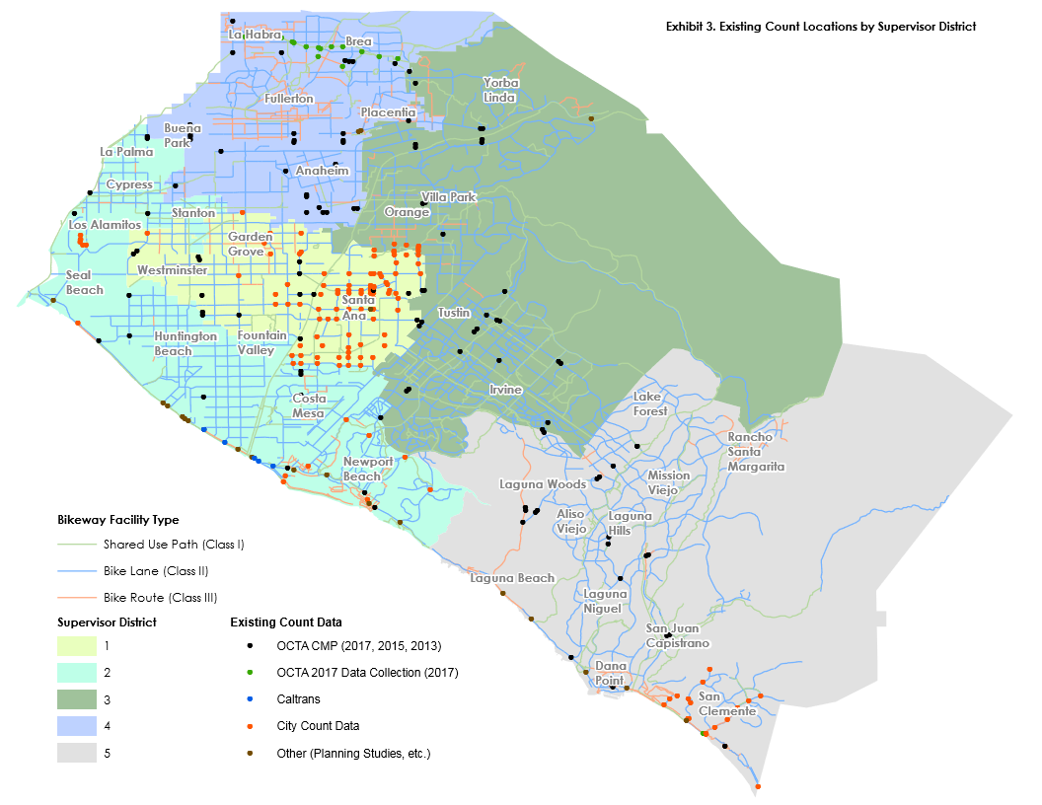
Pre-Count Program
Count locations:
Concentrated
Higher order roadways
Ramp locations

Slide 4
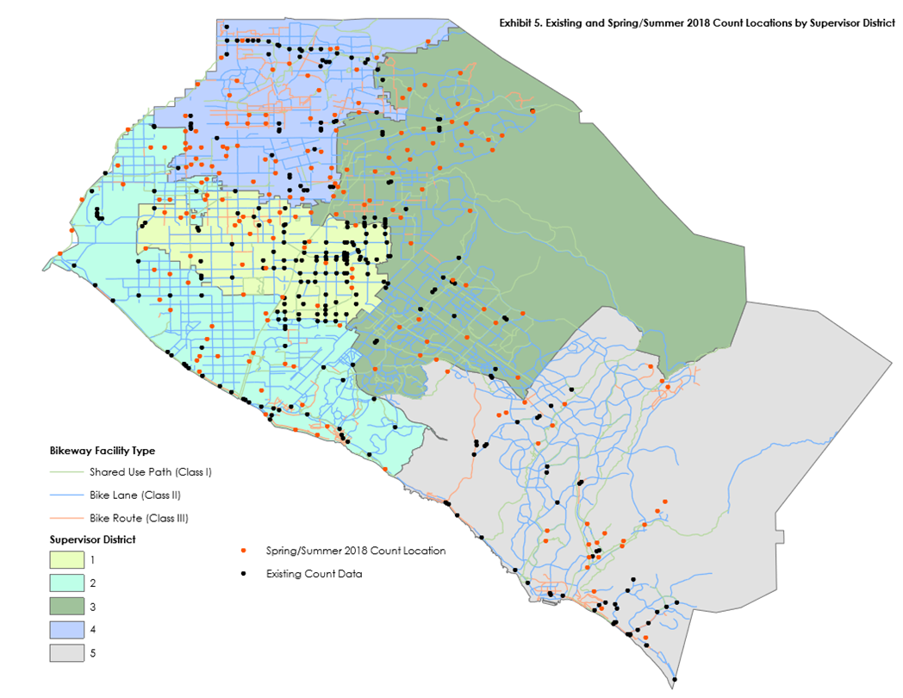
Post-Count Program
Count locations:
541 unique locations
Geographic spread
Varying facility types

Slide 5
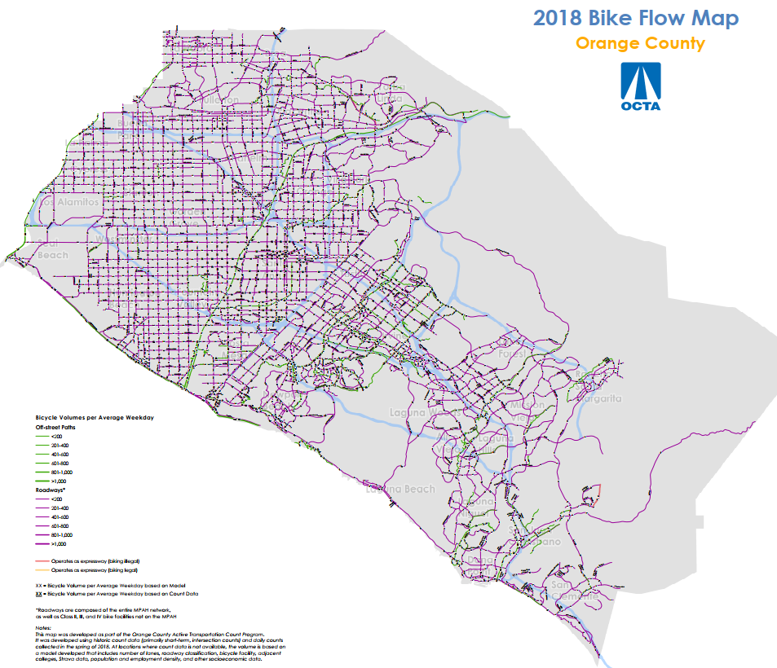

Slide 6

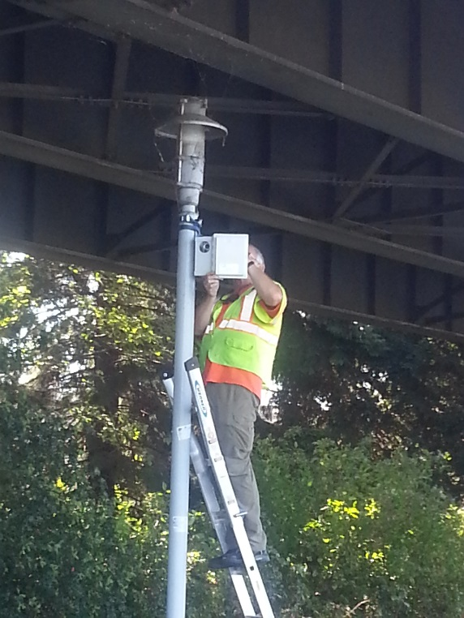
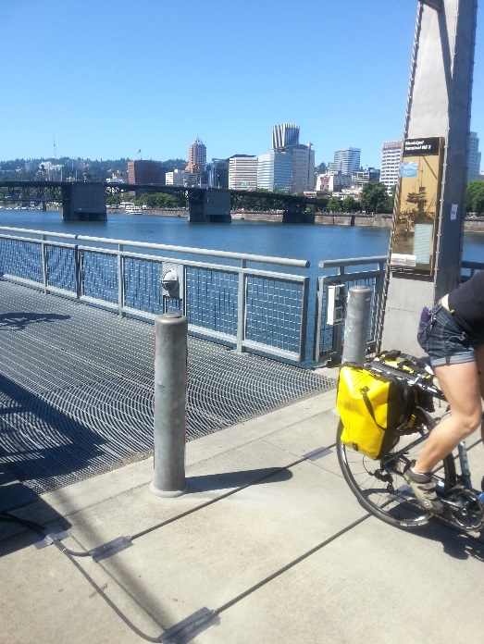
Recommendations - Program Elements
1. Continuous Counts
Temporal trends
Based on travel patterns
Automatic counter
2. Cyclic Counts
Distributed across County
Collected periodically
Portable counter
3. Specific Purpose Counts
Based on specific needs
Example: before-and-after counts

Slide 7
Recommendations – Agency Roles
OCTA
Manages and collects all data
Purchases, installs, and maintains equipment
Cities
Provide supplemental data
University / Consultant
Provide program support
Update bike flow map
Coordinates
Conduct research
Build on OCTA efforts
7

Slide 8

Next Steps
Establish data management network
Begin programmatic data collection
Refine bike flow map
Guidance and coordination for cities

Slide 9
Contact Information
Sam Sharvini, Project Manager
(714) 560-5769
ssharvini@octa.net

