Slide 1
Draft Fiscal Year 2019-20 Bus Service Plan

Slide 2
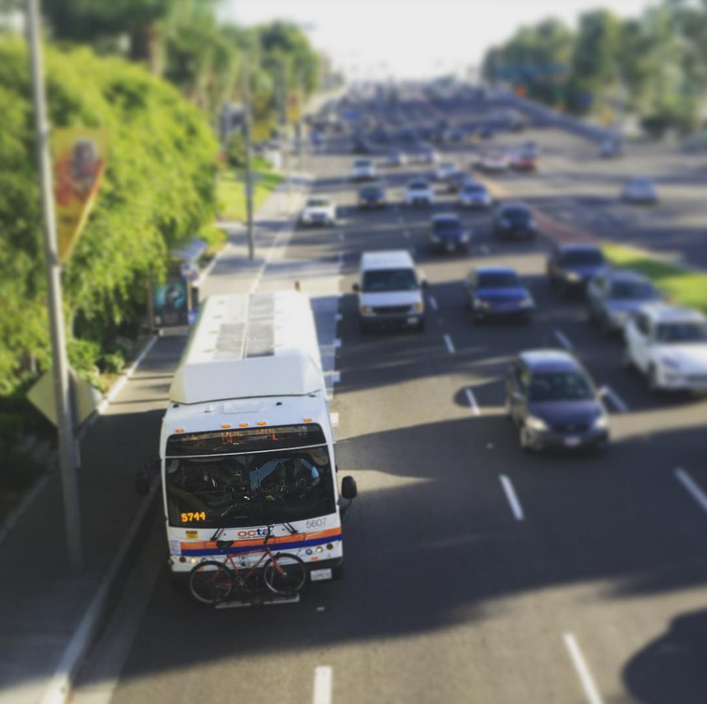
Overview
OC Bus 360º Background
Service Design Framework
“Major Service Change” requires public hearing
Seeking Board of Directors’ (Board) input before public outreach

Slide 3
OC Bus 360º
Action plan endorsed by the Board in 2015 to address ridership decline
Redeployment of bus service
Comprehensive review of current and former rider perceptions
Peer review of the Orange County Transportation Authority’s performance and plans
New branding and marketing tactics tied to rider needs
Upgraded bus routes and services to better match demand and capacity
Technology changes to improve the passenger experience

Slide 4
Service Design Framework
Reallocation of 40,000 annual revenue hours to improve ridership and productivity
Implement OC Streetcar Bus Rail Interface routing changes
Stay within existing resources for service hours and buses
“Major" changes require public hearing
Final recommendations subject to Title VI analysis

Slide 5
Improvements
Route 54: Extend all short trips from Chapman Avenue and Beach Boulevard to Chapman Avenue & Valley View Street
Route 56: Improve weekend frequency from 70 to 45 minutes
Route 59: Extend midday short trips to The District
Route 72: Improve weekend frequency from 65 to 45 minutes
Route 79: Add weekday southbound trips between Michelson Drive and University of California, Irvine to address high passenger loads
Route 60: Operate all trips to Long Beach during peak and midday / implement more direct routing for Bravo! 560

Slide 6
Mixed Changes
Route 21: Terminate south end of route at Goldenwest Transportation Center and combine with Route 24 at 60 minute headway (new Route 123) / OC Flex covers deleted portion / add midday service
Route 24: Combine with Route 21 and cut back to Anaheim Canyon Metrolink (new Route 123) / new routing on Miraloma Avenue
Route 26: Extend route to Yorba Linda Boulevard / Imperial Highway and reduce peak service to 20/40 minutes and keep 30 minutes midday / add morning trip from Metrolink to California State University, Fullerton

Slide 7
Mixed Changes
Route 560: New non-stop routing from Westminster Avenue and Goldenwest Street to the City of Long Beach every 36 minutes / reduce midday to 18 minute frequency
Routes 129 and 143: Combine into new Route 153 “North County Circulator” with service between Brea Mall, Beach Boulevard, and Fullerton Transportation Center at 50 minute frequency
Routes 129 and 153: Combine into new route serving highest ridership segments between Anaheim Regional Transportation Intermodal Center and Brea Mall at 60 minute frequency
Route 213: Simplify routing for direct service between Brea Mall, Santa Ana Depot, and University of California, Irvine with faster travel time

Slide 8
Reductions
Route 53: Reduce AM peak frequency from 20 to 30 minutes / reduce midday service from 24 to 36 minutes
Route 86: Cut route back to Laguna Hills Transportation Center / improve frequency to 60 minutes all day
Route 89: Reduce from 30 to 45 minutes midday
Route 206: Eliminate route and offer OC Vanpool
Route 211: Eliminate route and offer OC Vanpool

Slide 9
OC Streetcar Route Changes
Route 55: Implement OC Streetcar routing in Santa Ana Civic Center
Route 83: Implement OC Streetcar routing in Santa Ana Civic Center, cut Walnut Loop in the City of Anaheim, and terminate route at Anaheim Gardenwalk / improve weekday and weekend frequency
Route 462: Eliminate and replace with Civic Center Shuttle
New Route 662: New Civic Center Shuttle replacing Route 462 and deleted portion of Route 83 during OC Streetcar construction

Slide 10
Next Steps
Approve Public Outreach
Transit Committee: April 11, 2019
Board: April 22, 2019
Conduct Public Outreach
Public Workshops: May 2019
Conduct Public Hearing:
Board: June 10, 2019
Approve Final Service Plan:
Transit Committee: July 11, 2019
Board: July 22, 2019
Implement Changes
October 2019 and February 2020

