Slide 1
Orange County Coronavirus Travel Trends

Slide 2

Orange county Covid-19 travel impacts
Unprecedented nationwide, statewide, regional, and local travel changes
Today's presentation focuses on unemployment and work-from-home as key drivers
Use publicly available
“big data” and surveys to describe current conditions in Orange County
COVID-19 - Coronavirus

Slide 3
Unemployment: a key driver of travel changes
January to August 2020, unemployed workers and rate
Trending downward since May 2020
Service sector hit the hardest
Source: State of California, Employment Development Department, data accessed 9/21/20

Slide 4
Job losses: not evenly distributed
Between August 2019 and August 2020, employment decreased by 11.3 percent
Key changes
  Leisure and hospitality decreased the most, losing 75,400 jobs
  Professional and business services decreased by 28,900 jobs over the year
  Trade, transportation, and utilities posted a loss of 19,600 jobs
Source: State of California, Employment
Development Department, data accessed 9/21/20

Slide 5
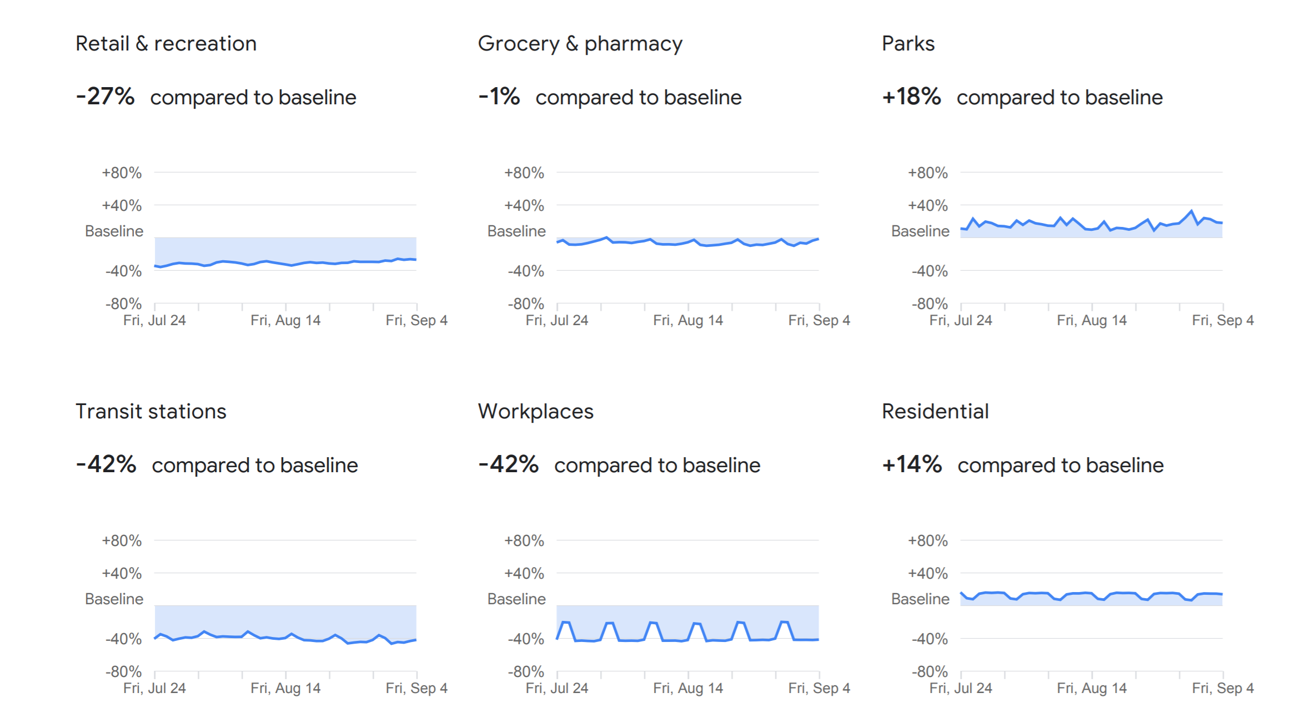

Google maps: most Activities down IN OC with some exceptions
Source:
Google, Inc.
Baseline = the corresponding day of
the week, during the
five-week period,
Jan 3 – Feb 6, 2020, compared to Sep 4, 2020

Slide 6
OCTA survey: some activities up, others down
Source: OCTA Travel and Employment Survey,
July 2020. The survey compared February and June 2020.
N= 2,548 randomly-selected residents representing a sample of all Orange County adults
OCTA – Orange County Transportation Authority

Slide 7
results: total Travel is DOWN (person-trips; all modes)
Average daily person trips by month from January 2019 to
July 2020
Peak travel occurred in August 2019 @ 15.48 million daily trips
Low point in
July 2020
Source: Bureau of Transportation Statistics

Slide 8
OC Freeways: demand/delay down but trending upward
OC freeway demand (vehicle miles traveled) down by 10.3 percent
Delay (hours) down by over 62 percent
Demand and delay trending upward
July 2020 to January 2020 comparison
California Department of Transportation (Caltrans),
PeMS version 20, Orange County, weekdays,
January to July 2020, data accessed 9/17/20

Slide 9
Oc Freeways: delay shifting in time (delay in hours)
Delay in hours. Bars indicate higher values.
Source: Caltrans, PeMS version 20, Orange County, weekdays, January to July 2020,
data accessed September 17, 2020

Slide 10
Oc freeways: Delay increases exponentially as traffic grows
Example using all OC freeway delay and vehicle miles traveled for
June 2020
(all weekdays and all hours)
Caltrans, PeMS version 20, Orange County, weekdays, June 2020, weekdays, all hours of the day; data accessed September 17, 2020

Slide 11
Oc Work-from-home: Five-fold+ increase
OC work-from-home has increased from about six percent to nearly 32 percent of jobs (January to August 2020)
Maryland Transportation Institute (2020)
University of Maryland COVID-19 Impact Analysis Platform, accessed August 31, 2020

Slide 12
Work-from-home: likely to continue but lessen
Source: OCTA Travel and Employment Survey, July 2020

Slide 13
Summary
Work-from-home a larger factor in daily commute changes than unemployment (32 percent versus 9.9 percent of jobs)
Work-from-home directly and indirectly benefits all travelers, and likely to continue in the future but at lower levels, subject to employer policies and other factors
Rise in unemployment hit service sectors the hardest, a travel market served by local bus transit
Future transit growth likely with increase in service sector employment
Relatively small changes in demand can significantly increase freeway delay

Slide 14

Next steps
Continue to monitor travel and traffic trends using publicly available data
Evaluate timing of future employment and travel survey(s) to gauge changes since June 2020
Use data and surveys to inform future short- and long-term planning and policy decisions

