Slide 1
Options for Future Express Lane Corridors in Orange County

Slide 2
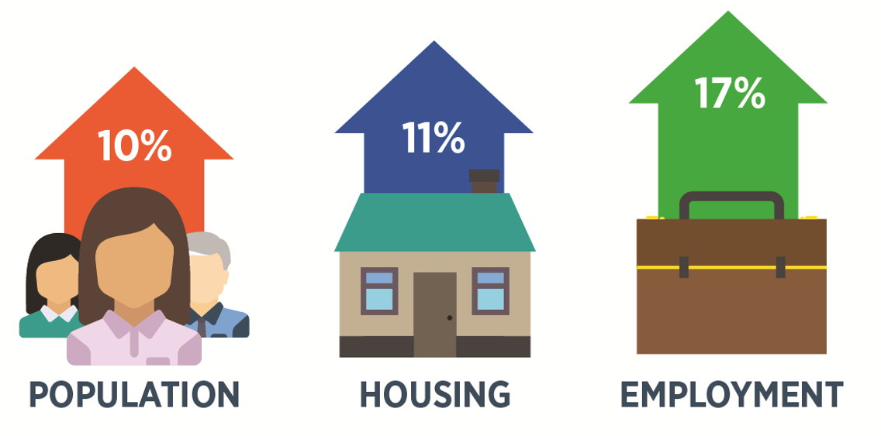
Intercounty Travel Demand
In-bound workers
  About 650,000 workers commute to OC
Out-bound residents
  Over 490,000 OC residents commute to jobs in other counties
By 2040, in-bound commuters will increase by 25 percent
  OC – Orange County
Source: U.S. Census Bureau, Center for Economic Studies and Center for Demographic Research, California State University, Fullerton

Slide 3
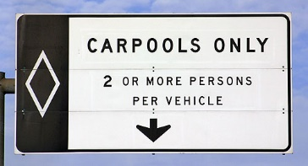
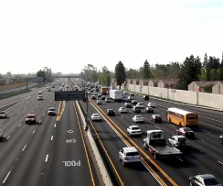
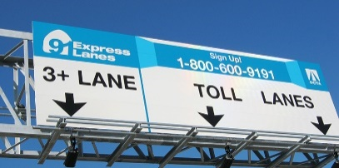
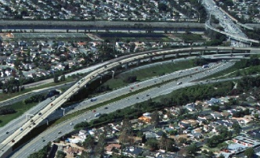
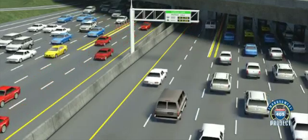
Freeway Development
Managed Lanes History
1980s – First carpool lanes
1990s – Buffered carpool lanes and
91 Express Lanes
2000s – Direct connectors
2010s – Dual HOV/priced managed lanes
HOV – High-Occupancy Vehicle
M1 – Measure M1
M2 – Measure M2

Slide 4
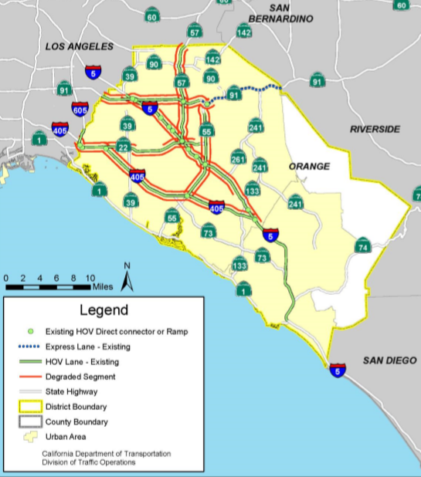
Federal Performance Standards
Federal regulations require HOV lanes to operate at 45+ mph during weekday peak periods at least
90 percent of the time over a consecutive 180 day period
Today, approximately 77 percent of Orange County’s HOV lanes do not meet this standard
MPH – Miles Per Hour
Source: Caltrans 2017 HOV Facilities Degradation Report and Action Plan

Slide 5
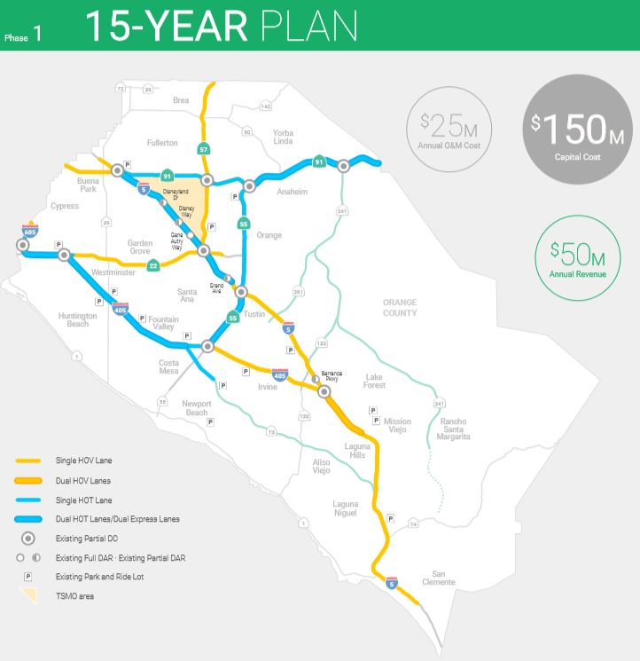
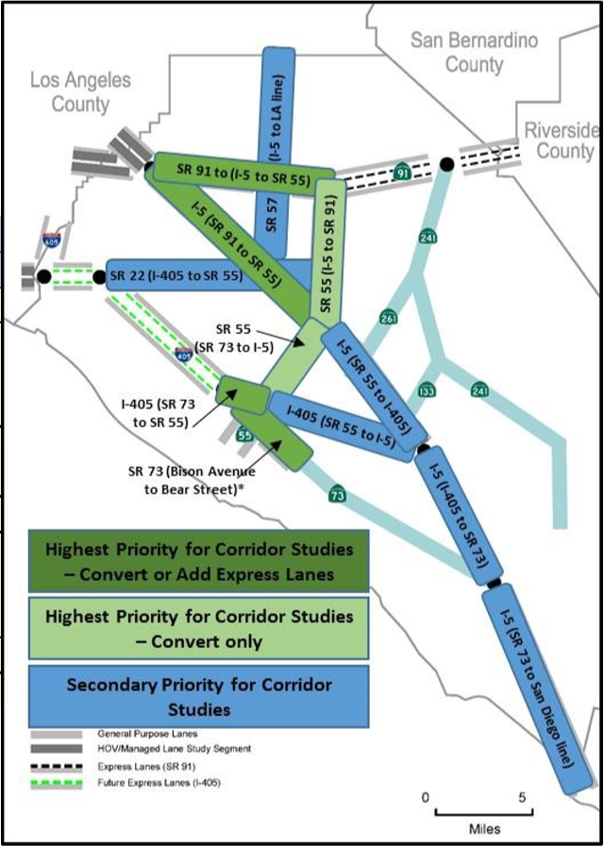
Caltrans District 12 Plans
Draft presented to OCTA Board in December 2016
District 12 developed a Managed Lanes Feasibility Study (2017) to identify a strategy for compliance with federal standards
Caltrans is currently developing
project-level studies on I-5
Plans and projects require OCTA approval
  CA PUC §130252, §130300 and §130303(d)
OCTA – Orange County Transportation Authority
Board – Board of Directors
Caltrans – California Department of Transportation
HOT – High-Occupancy Toll
I-5 – Interstate 5
CA PUC – California Public Utilities Code
Notes:
In response… D12 planning/project activity
Additionally Caltrans, in coordination with TCA, is working on the South County Traffic Relief Effort study.

Slide 6
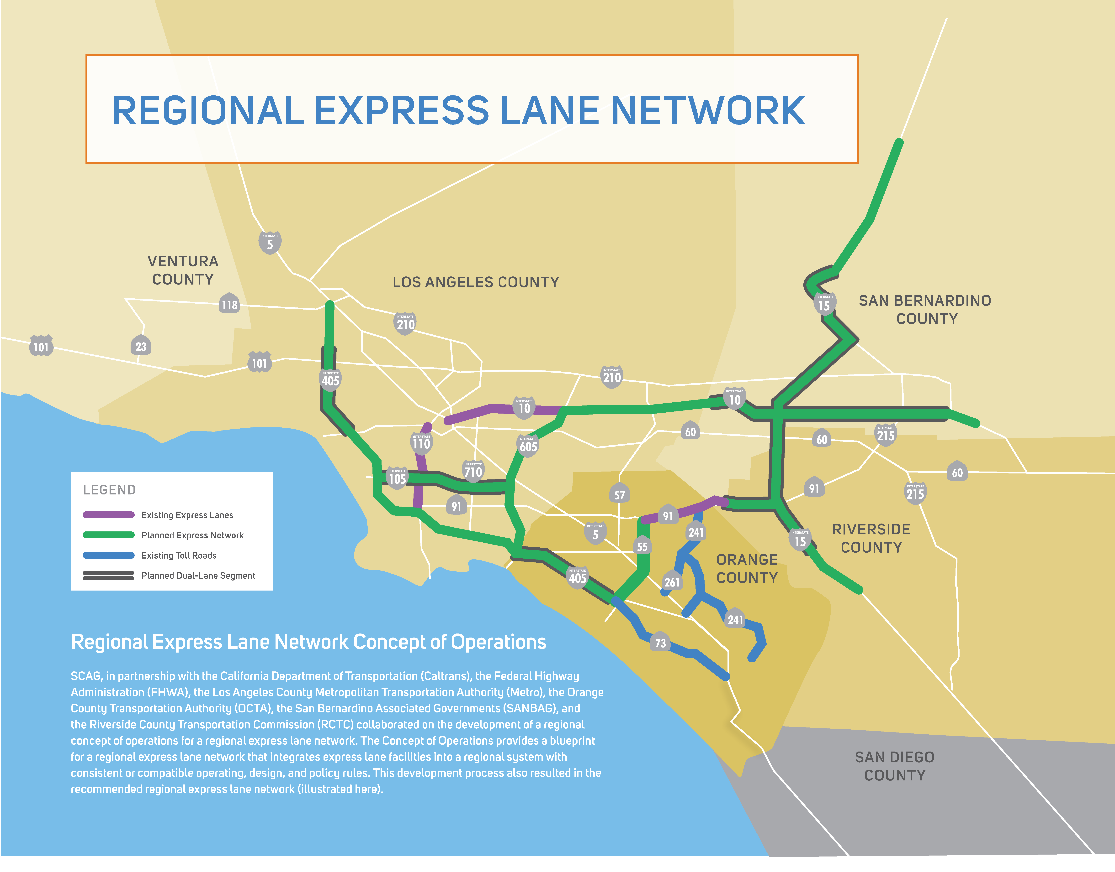
Regional Perspective
2003 - OCTA purchased SR-91 Express Lanes
2012-2013 - LA Metro I-110 and I-10 Express Lanes projects opened
2017 – RCTC Express lanes opened
2017 – OCTA began Design-Build on I-405 Improvement Project
2017 - LA Metro Countywide Express Lanes Strategic Plan
2018 – RCTC I-15 Express Lanes Project begins construction
2018 - SCAG Region Value Pricing Project – Regional Concept of Operations Technical Report
2019 - RCTC Next Generation Toll Feasibility Study
SR-91 – State Route 91
LA Metro – Los Angeles County Metropolitan Transportation Authority
I-110 – Interstate 110
I-10 – Interstate 10
I-405 – Interstate 405
RCTC – Riverside County Transportation Commission
I-15 – Interstate 15
SCAG – Southern California Association of Governments

Slide 7
Long-Range Transportation Plan

Slide 8
Express Lanes Network Study Goals
Goal | Objective
Identify opportunity corridors | Identify high-demand commute sheds Identify available capacity Leverage existing and planned express lanes Consider useful life of local tax measure projects
Improve corridor operations and reliability | Reduce corridor daily delay from congestion Improve mainline peak period speeds Maintain free-flow speeds in express lanes Identify benefits to adjacent facilities
Ensure financial feasibility and corridor maintenance | Demonstrate that revenues cover annual debt payments, financing requirements, and operations and maintenance costs Identify potential for excess revenues (subsequent studies to determine strategies for reinvestment in the transportation system)
Support local and regional goals | Support community and economic development goals Address social equity/environmental justice Improve air quality and reduce greenhouse gas emissions

Slide 9
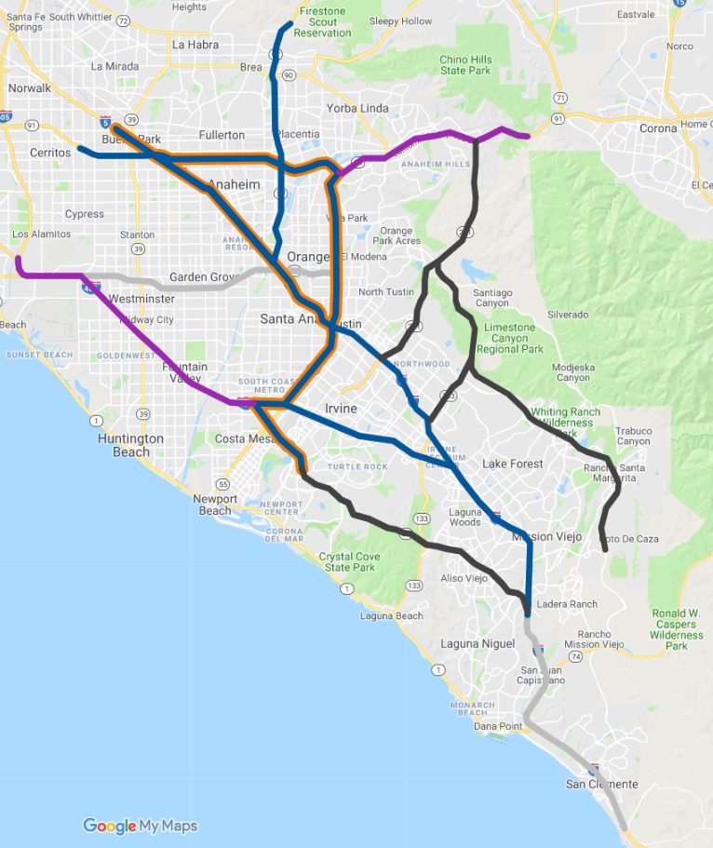
Concept A: Caltrans District 12’s 15-Year Plan
Represents the Caltrans District 12
15-Year Plan for tolled express lanes implementation
Tier I Priorities
  I-5 from SR-55 to LA County line
  SR-91 from SR-55 to I-5
  SR-55 from I-405 to SR-91
  SR-73 from I-405 to tolled portion of SR-73
Tier I (2030)
Tier II (2045)
Tier III (post-2045)
OCTA Express Lanes
TCA Facilities
Planned/Built Direct Connectors
SR-55 – State Route 55
SR-73 – State Route 73
TCA – Transportation Corridor Agencies

Slide 10
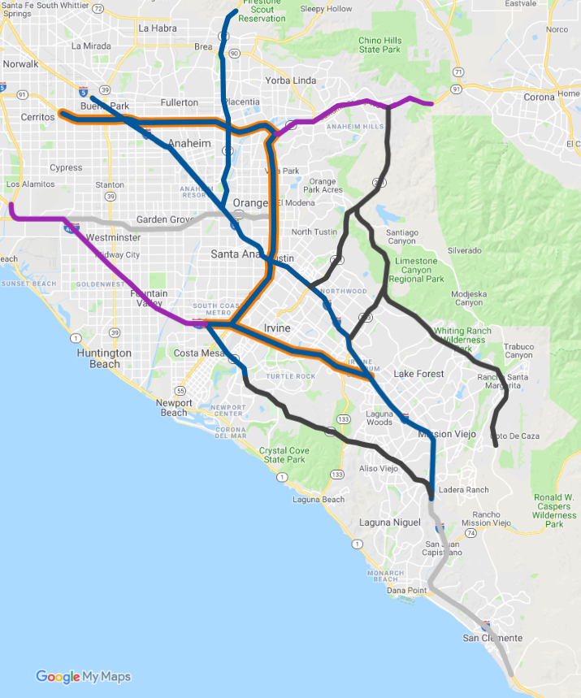
Concept B: Express Lanes Extensions
Extends existing/planned express lanes
Tier I Priorities
  SR-91 from SR-55 to LA County line
  SR-55 from I-405 to SR-91
  I-405 from SR-73 to I-5
Tier I (2030)
Tier II (2045)
Tier III (post-2045)
OCTA Express Lanes
TCA Facilities
Planned/Built Direct Connectors

Slide 11
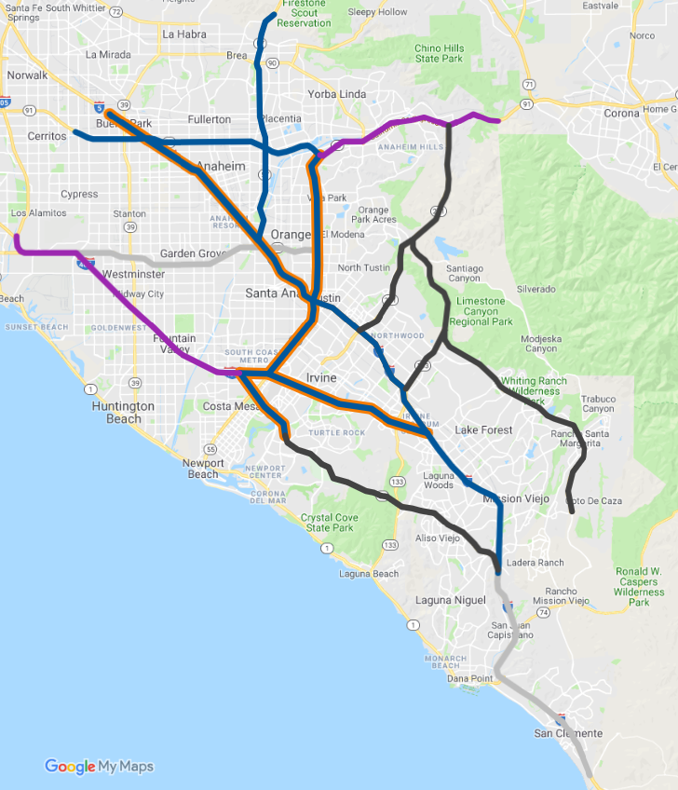
Concept C: Direct Connectors
Leverages existing direct connector ramps, providing users with a seamless tolled express lanes experience
Tier I Priorities
  I-5 from SR-55 to LA County line
  SR-55 from I-405 to SR-91
  I-405 from SR-73 to I-5
  SR-73 from I-405 to tolled portion of SR-73
Tier I (2030)
Tier II (2045)
Tier III (post-2045)
OCTA Express Lanes
TCA Facilities
Planned/Built Direct Connectors

Slide 12
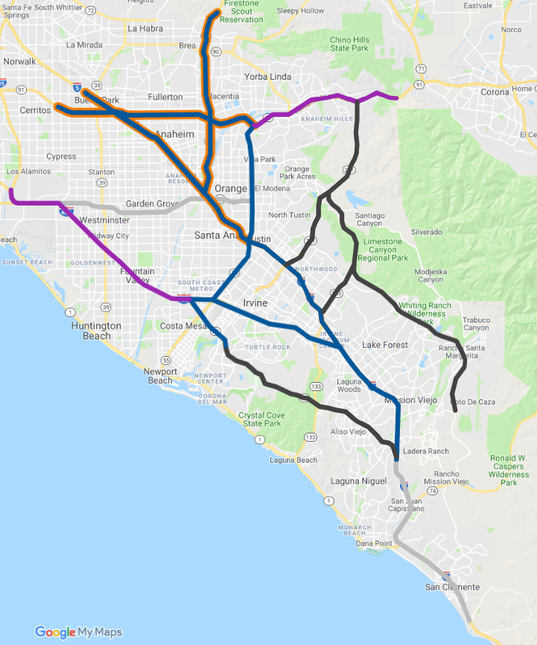
Concept D: Intercounty Connections
Prioritizes a network that serves
intercounty commuters
Tier I Priorities
  SR-57 from I-5 to LA County line
  SR-91 from SR-55 to LA County line
  I-5 from SR-55 to LA County line
Tier I (2030)
Tier II (2045)
Tier III (post-2045)
OCTA Express Lanes
TCA Facilities
Planned/Built Direct Connectors

Slide 13
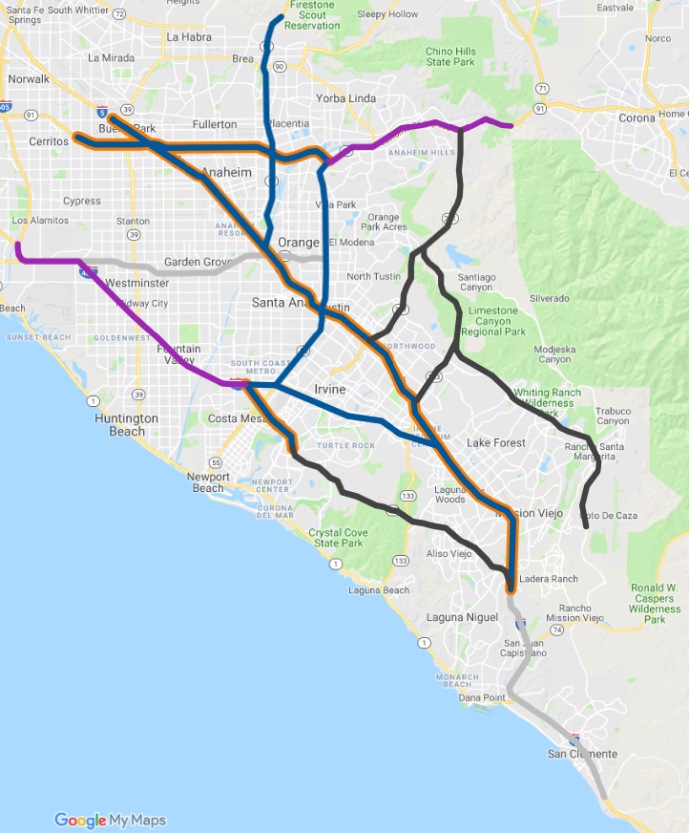
Concept E: Core Facilities
Provides continual tolled express lanes on I-5 and SR-91, and extends I-405 express lanes on SR-73
Additional time savings for longer trips
Tier I Priorities
  SR-91 from SR-55 to LA County line
  I-5 from SR-73 to LA County line
  SR-73 from I-405 to tolled portion of SR-73
Tier I (2030)
Tier II (2045)
Tier III (post-2045)
OCTA Express Lanes
TCA Facilities
Planned/Built Direct Connectors

Slide 14
Next Steps
Stakeholder engagement
  One-on-one meetings with thought leaders
  Roundtable workshops with elected officials, city staff, and key stakeholders
Staff will return to Board in 2020 with an update of the results and recommendations for next steps

