Slide 1
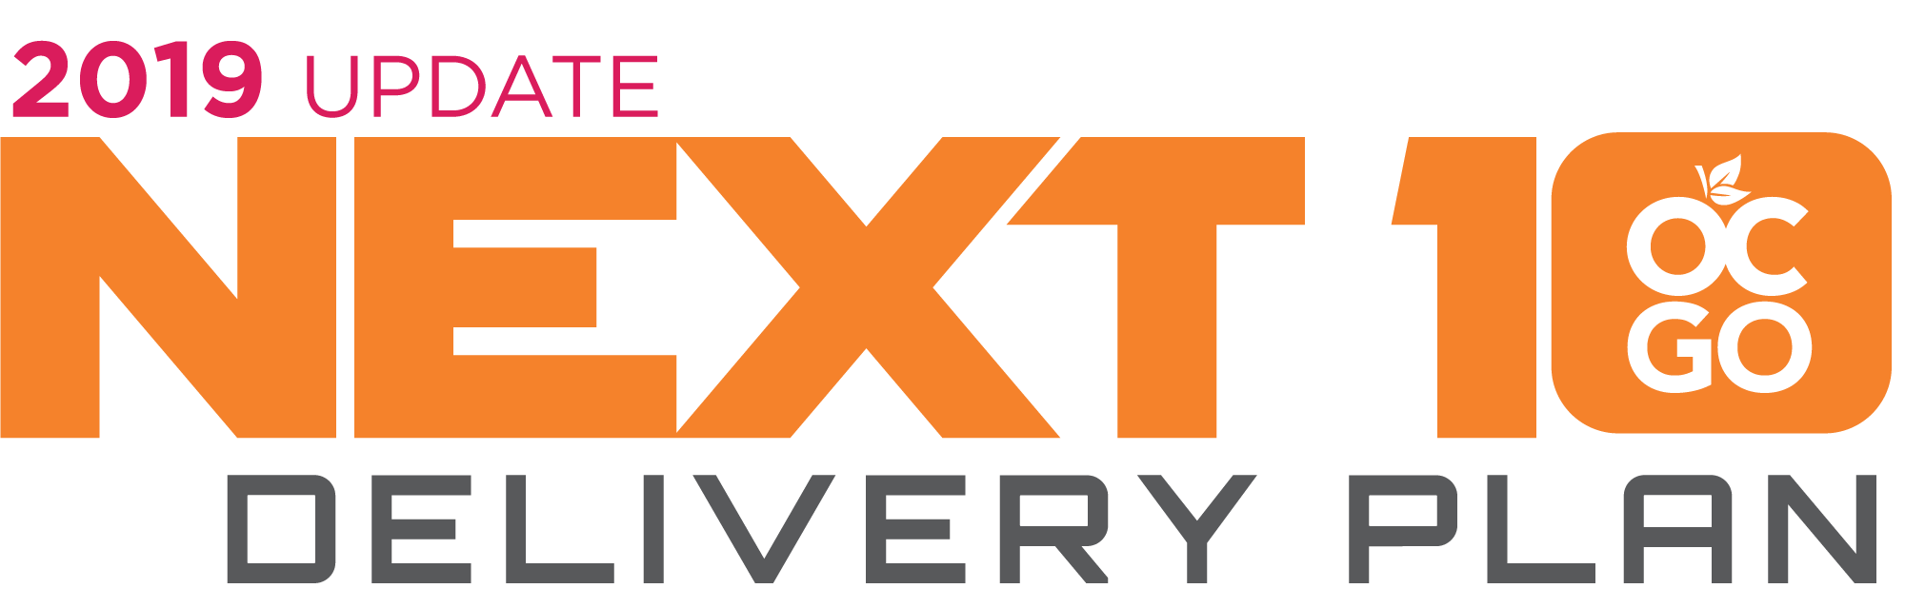
Measure M2

Slide 2
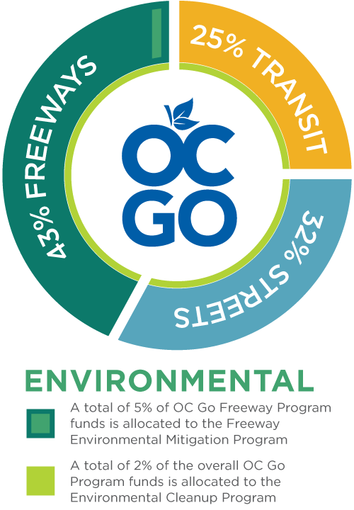
M2 - Balanced Plan
Renewed by voters in 2006 for 30 years
Began collection April 1, 2011
Rebranded externally as OC Go in September 2017
Includes a large suite of multi-modal transportation improvements
More than 50 percent of M2 funds support
  rail and community transit options
  synchronizing signals across jurisdictions
  environmental enhancements
  infrastructure preservation goals
M2 – Measure M2

Slide 3

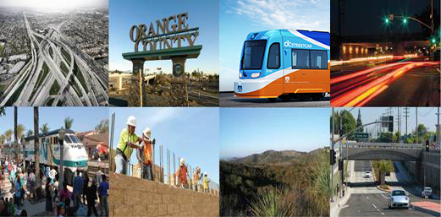
M2 Delivery Plan - Goals
Accelerates projects and programs
Delivers improvements sooner and realizes savings
Utilizes debt financing to minimize escalation impacts
Readies projects to capture external funding

Slide 4

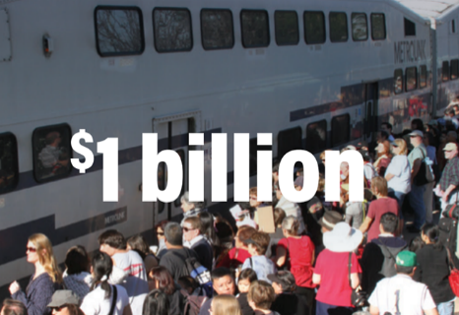


Next 10 Delivery Plan - 2026
Environmental
Annual calls for water cleanup projects intended to prevent the flow of trash and debris into waterways
Streets and Roads
Metrolink service expansion
Implementation of the OC Streetcar
Expand mobility choices and enhance bus stops
Transit
Streets and Roads
Annual calls for road improvements & signal synchronization
Flexible funding for transportation to local agencies
26 of 30 total freeway projects complete
Ensures ongoing preservation of open space and comprehensive mitigation of environmental impacts
Freeway
Calls – Call for Projects

Slide 5
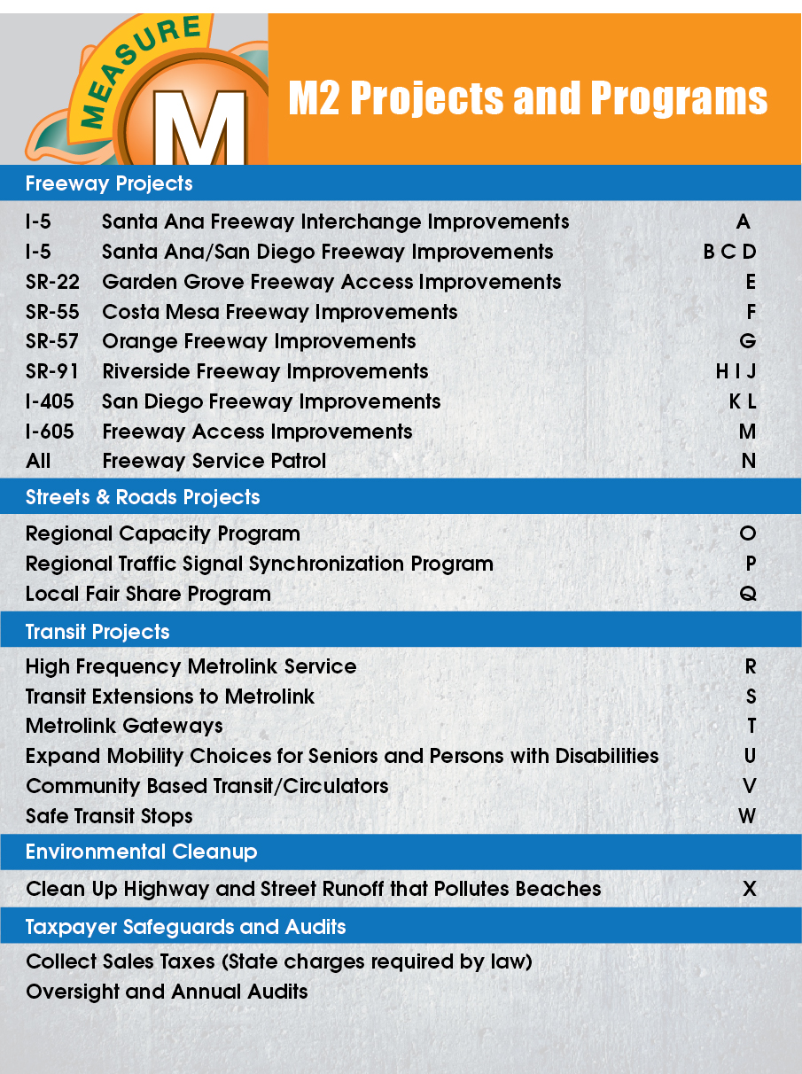
M2 Sales Tax Revenue Forecast
Updated 2019 forecast is $13.4 billion
  $300 million more than the 2018 forecast
First increase in M2 sales tax revenue since 2014
Great news for all M2 programs
Most programs scale to available revenue

Slide 6
Freeway Deliverable Breakdown
Deliverable 1 – $3.5 billion of freeway improvements
Notes:
The first two deliverables are for the freeway program. Deliverable one specifically identified or named the projects to be delivered in the Next 10 Timeframe.
Deliverable 1 included the Nine –prior completed projects and also included 12 additional projects specifically named to be completed or in progress during the Next 10 timeframe.

Slide 7
Freeway Deliverable Breakdown
Deliverable 2 - $715 million more, bringing total to $4.3 billion
Advance to Construction |  | Construction Complete | Cost
Project M | I-605 Katella Avenue Interchange | 2025 | $ 28.6
2. Project G | SR-57 NB Orangewood Ave. to Katella Ave. | 2026 | $ 67.8
3. Project B | I-5 between I-405 and Yale Avenue | 2028 | $234.4
4. Project B | I-5 between Yale Avenue and SR-55 | 2028 | $204.3
5. Project F | SR-55 between I-5 and SR-91 | 2028 | $122.4
Deliverable 2 Total $657.5
Remaining Projects |  | Environmentally Clear Shelf-Ready | Cost
6. Project L | I-405 between I-5 and SR-55 | 2018 | $238.8
7. Project D | I-5 El Toro Road Interchange | 2020 | $112.3
8. Project G | SR-57 NB Lambert Road to County Line | 2026 | $167.5
9. Project J | SR-91 between SR-241 and I-15 | 2026 | $292.5
Remaining M2 Freeway Projects Total $811.1
Results in 26 of 30 total M2 freeway project segments completed
Notes:
Deliverable 2 is different in that it identified a commitment of $715 million more bringing the total funding commitment to $4.3 billion, but didn't identify the projects.
All of the projects were identified to be cleared environmentally but projects to move forward following environmental clearance were not named since the environmental phase is necessary to know what project improvements are ultimately able to be built and to refine the actual project cost for the selected alternative.
Looking at the nine remaining projects. Five of these (top table) are recommended to be included for completion or near completion in the Next 10 Time Frame.
The four remaining in the bottom table are not ready to move forward at this time for various reasons such as project sequencing, connectivity, readiness, public support, but are still slated for completion by 2041.
Project L on the 405 between the 5 and the 55 is a parallel facility to Project B. These projects need to be staggered to avoid creating excessive inconvenience to the traveling public. Utilizing Board approved Guiding Principles – project sequencing and connectivity and project congestion relieve and demand - Project B is designated a higher priority project. Congestion levels on I-5 in the Project B project area are more than twice that of the in the Project L - I-405 project area . The I-5 project area is highly constrained due to right of way and is therefore technically challenging, requiring design variations. The I-5 project is also a higher cost project (twice as high) and therefore delay can lead to a high risk of cost escalation.
Project D is in the environmental phase and is experiencing challenges determining a build alternative that has local support. This project will need more time to come to consensus on an alternative that can be agreed to from the stakeholder cities, (Guiding Principles - readiness and public support)
Project G – is scheduled to be environmentally cleared during the Next 10 timeframe. Through SB1 funding Trade Corridor Enhancement Program - An initial phase of the project is currently in construction which includes reconstruction of the Lambert Interchange. The next phase of the project will build on those improvements and staff will be seeking additional trade corridor funding to advance this project.
Project J – is part of a bigger package of improvements in the 91 corridor that has been designated and coordinated with RCTC. The westbound portion of this project is being accelerated and will be implemented to add but the eastbound lanes will require additional study to navigate some engineering challenges in the project area. The feasibility study will take place next year and until completed this project will need to wait.

Slide 8

Next 10 Plan Progress
Freeways
  3 projects complete, 3 in construction, 3 in design, 8 underway
Streets and Roads
  $160 million made available through 4 calls
  $162 million provided by formula to local jurisdictions
  7 OC Bridges projects complete
Transit
  Metrolink service expanded into Los Angeles
  OC Streetcar in construction
  4 of 6 Metrolink station improvements complete
  $55 million made available to expand mobility choices and improve bus stops
Environmental
  $8.4 million made available through 3 water quality calls
  $9.5 million in endowment to protect open space and streamline permitting
Notes:
Deliverables
1 and 2 Freeway – with 9 of the 30 segments completed prior to the Next 10 – current progress is as follows
3 – Streets and Roads – To date – 7 all of the OC bridges projects are complete
4, 5, 6, 7 and 8 are Transit Deliverables
9 and 10 focus on the environmental programs.
$31 million for U
$21 million for V available
$3 million for W
20 currently active

Slide 9
Next Steps
    A copy of the 2019 updated Next 10 Plan can be found online at : https://www.octa.net/About-OC-Go/next-10-delivery-plan/
    Work with our transportation partners on delivery of the Next 10 Plan of projects and programs
    Monitor the risk associated with the changing environment and return with updates as appropriate

