Slide 1
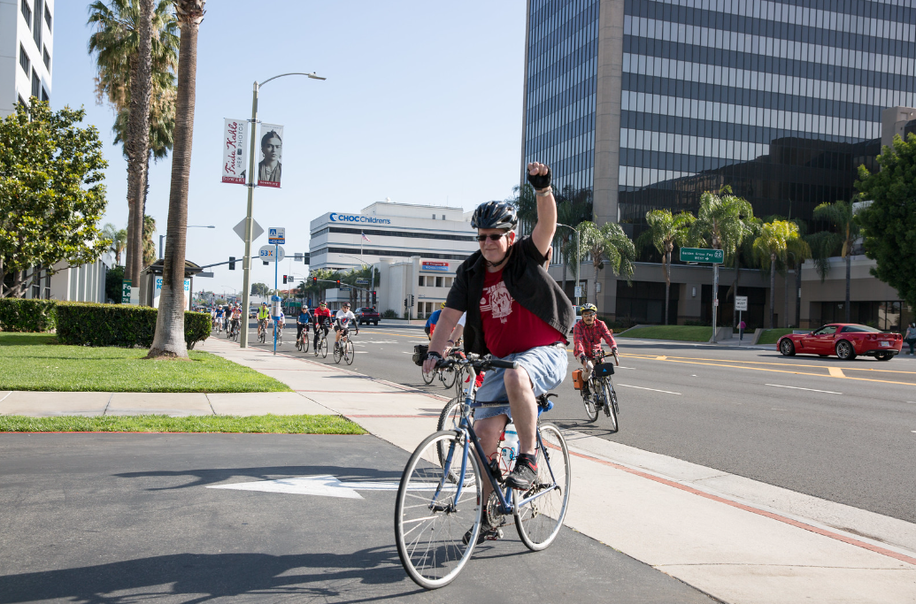
BIKE TO WORK
WEEK 2020
CAC Bike / Ped Subcommittee Update – 9/15/2020

Slide 2
SITUATION ANALYSIS
Bike to Work Week typically celebrated in Bike Month (May) but postponed due to pandemic
Encourage participation in week of 9/21 to 9/27
Alternate daily challenges available for those not biking to worksite
Highlight biking for fun and fitness
One prize drawing entry received per day of participation

Slide 3
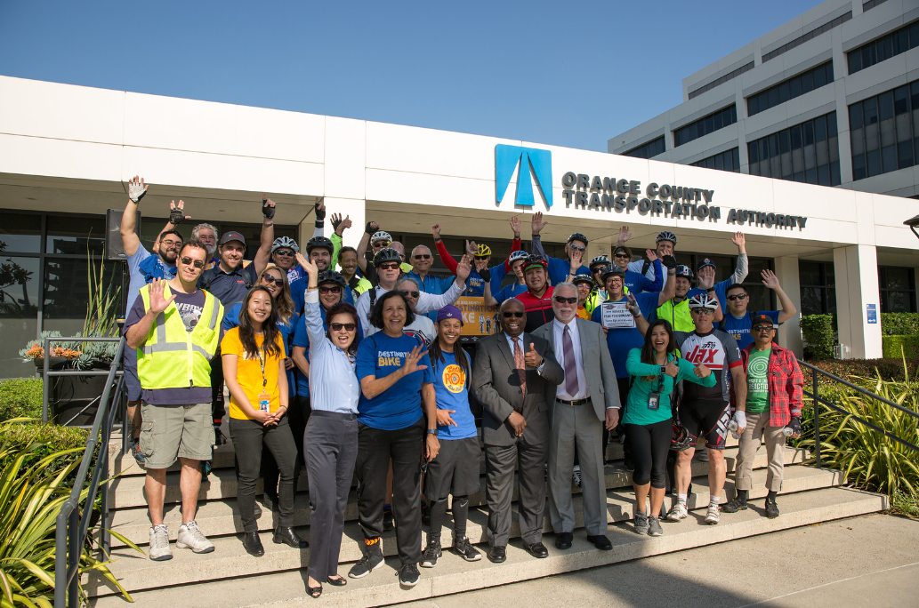
OVERVIEW
Increase pledges from last year
Goal of having participation in as many days as possible
Two prizes will be awarded – Trek 2 Bike and Saris Bones 2-Bike Bike Rack
Sponsors: Jax Bicycle Center and Spectrumotion
Updated 9/9/2020

Slide 4
GOALS & OBJECTIVES
Goals:
Increase bicycle commuting in Orange County
Increase awareness of bicycle safety best practices
Objectives:
Increase number of participation pledges by 10%
Increase social media reach by 10%
Updated 9/9/2020

Slide 5
TACTICS
Use an online pledging form to track participation
Utilize various marketing channels
Digital
Social Media (including animated gif ads)
Email
Updated 9/9/2020

Slide 6
SOCIAL MEDIA GIFS
Updated 9/9/2020

Slide 7
PLEDGE
Updated 9/9/2020

Slide 8
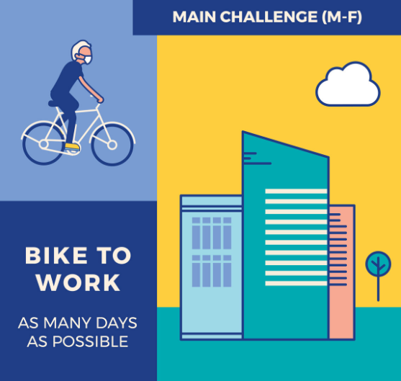
MAIN CHALLENGE
Updated 9/9/2020

Slide 9
ALTERNATE CHALLENGES
Updated 9/9/2020

Slide 10
SPREAD THE WORD
OCTA.net/BikeToWorkWeek
Updated 9/9/2020

