Slide 1
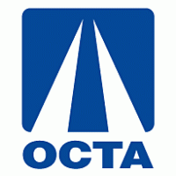
Interstate 405 Improvement Project Update
Notes:
Good evening.
I’m Jeff Mills, OCTA’s program manager for the I-405 Improvement Project.
Joining me is Chris Boucly from OCTA’s public outreach team.
We will provide an update regarding what has been recently accomplished on the project and also look forward to what is anticipated in 2020.

Slide 2
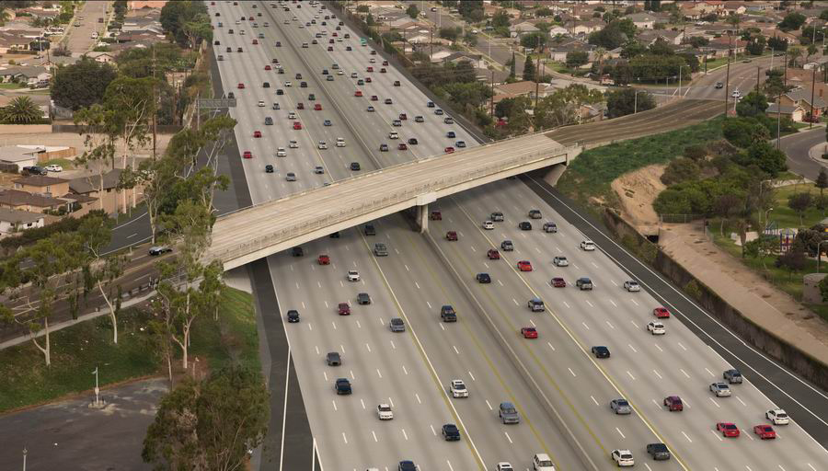
Project Location and Key Features
Notes:
As shown on the left, the project limits are from approximately SR-73 in Costa Mesa to I-605 in Seal Beach, a length of approximately 16 miles.
As shown on the right, one regular general purpose lane will be added in each direction of the 405, consistent with Measure M, as depicted in yellow.
An additional lane will be added in each direction that will combine with the existing carpool lane to provide dual express lanes from SR-73 to I-605, as depicted in green.
The overall cost of the project is $1.9 billion.

Slide 3
Project Funding/Financing
Funding/Financing Source | Amount
OC Go (M2) Funds | $1,135,651,000
TIFIA* Financing | $ 628,930,000
Federal and State Funds | $ 135,419,000
Total | $1,900,000,000
* Transportation Infrastructure Finance and Innovation Act
Notes:
The slide represents the sources of funding for the project.
Approximately 60% of the funding for the project is local OC Go funds.
OCTA successfully obtained a loan from the federal government, called in TIFIA loan, in the amount of almost 629 million dollars.
The TIFIA loan will be paid back solely using toll revenue from the 405 Express Lanes.
And lastly, we have approximately 135 million dollars in other federal and State funding.
We do have firewalls in place to ensure no local funds are used to pay for the Express Lanes portion of the project.

Slide 4
Background
Milestone | Completion Date
Environmental clearance | May 2015
Orange County Transportation Authority Board of Directors (Board) awards design-build contract to OC 405 Partners | November 2016
Notice to Proceed (NTP) No. 1 issued | January 2017
TIFIA loan executed | July 2017
NTP No. 2 issued | July 2017
Construction began | March 2018
Notes:
The project was environmentally cleared in May 2015
In July, 2017, shortly after the TIFIA loan was executed, OCTA issued Notice to Proceed No. 2 to our design-builder, OC 405 Partners.
NTP 2 was a full notice to proceed for all activities, including construction.
Construction began almost 2 years ago in March of 2018.

Slide 5
Project Update
Construction
Construction approximately 25 percent complete
Design
Project design approximately 95 percent complete
Right-of-Way
288 parcels impacted – on schedule overall
281 parcels in possession (98 percent of total parcels needed)
288 offers presented
60 resolutions of necessity adopted by the Board
Wall design to be complete in 2020
Design-builder has approximately 700 workers involved in Project
Roadway and bridge design complete
Notes:
Overall, the design portion of this design-build project is approximately 95% complete.
The roadway and bridge design is generally complete and the design of the walls on the project is anticipated to be complete in 2020.
Regarding the status of right of way acquisition, 288 properties are impacted in some way by the project.
Offers have been presented to all 288 property owners.
OCTA is in possession of 281 properties, which is 98% of the total properties needed.
Acquisition of right of way, including the remaining 2% needed, continues to go well and is on schedule.
In mid-2020, OCTA will be in possession of all property needed for the project and this will eliminate a significant construction risk for OCTA.
Construction is approximately 25 percent complete and our design-builder has about 700 workers actively involved in the Project.

Slide 6
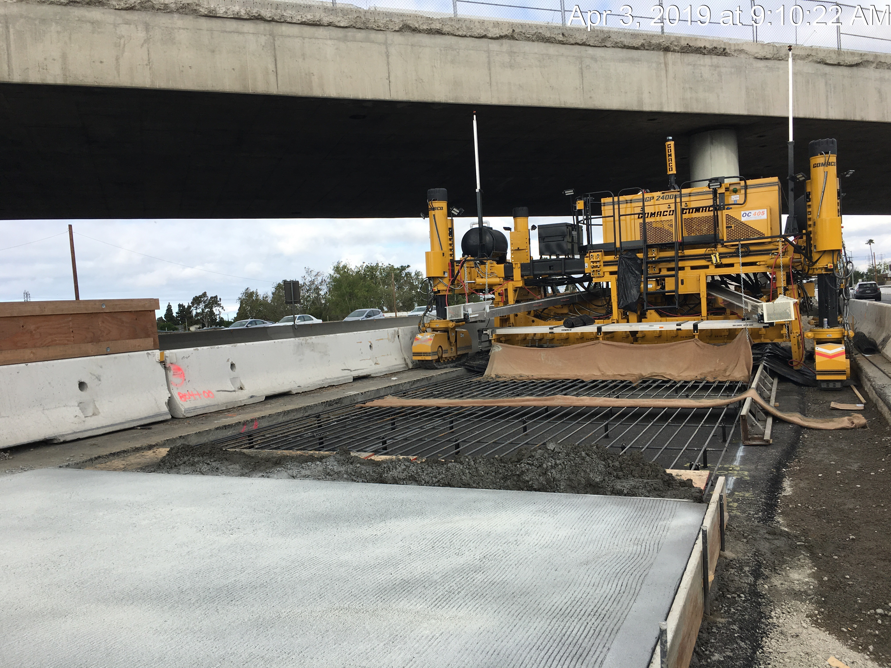
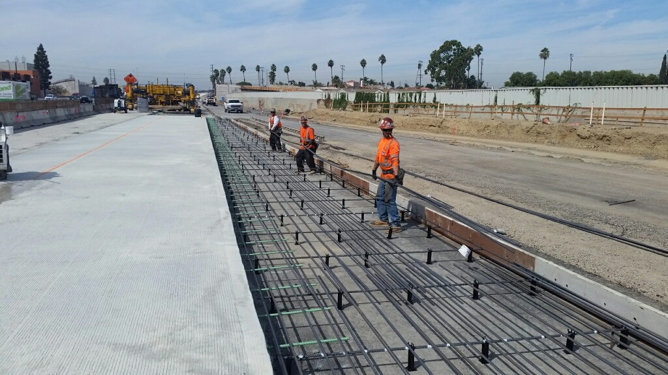
Construction Update
Concrete paving operations
Notes:
The next several slides show construction activities from the last few months.
To start, significant concrete paving is underway.
As we are generally adding two lanes in each direction for 16 miles and rebuilding on and off-ramps, you will see a lot of paving over the next few years.

Slide 7
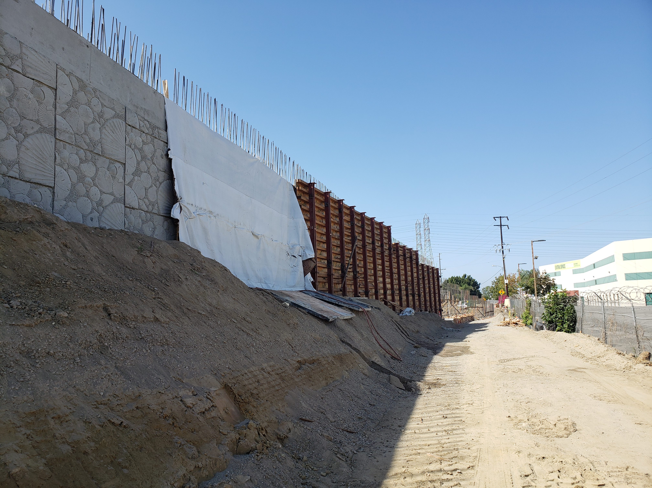
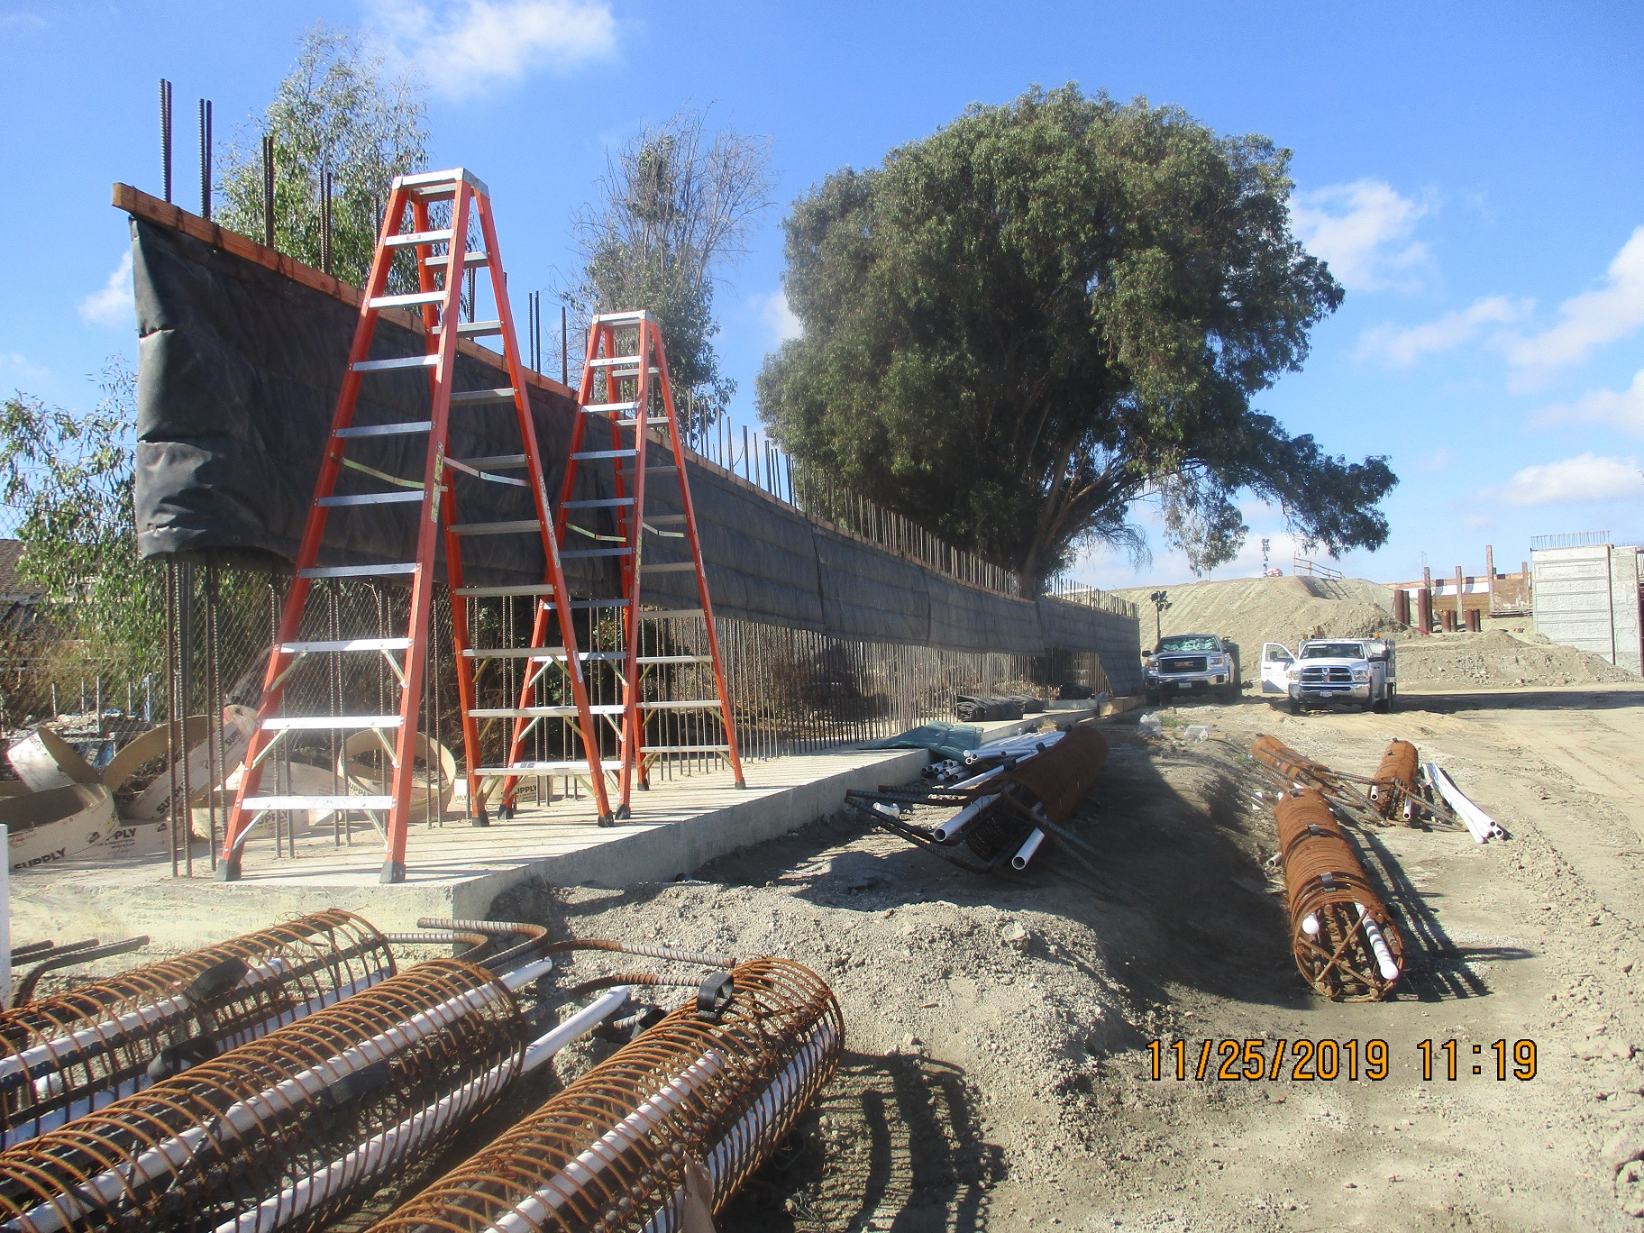
Construction Update
Retaining wall and soundwall construction
Notes:
Over 40 walls are under construction or complete.
In the photo on the left, a retaining wall is being constructed along one of the ramps.
You can see part of the aesthetic pattern on the left side of this wall.
And in the photo on the right, a sound wall is being built near a community at the Bolsa Chica bridge.

Slide 8
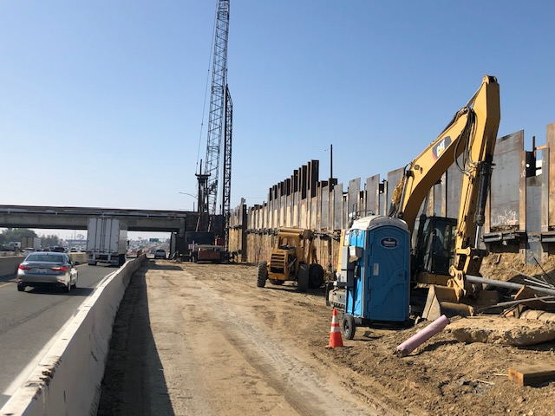
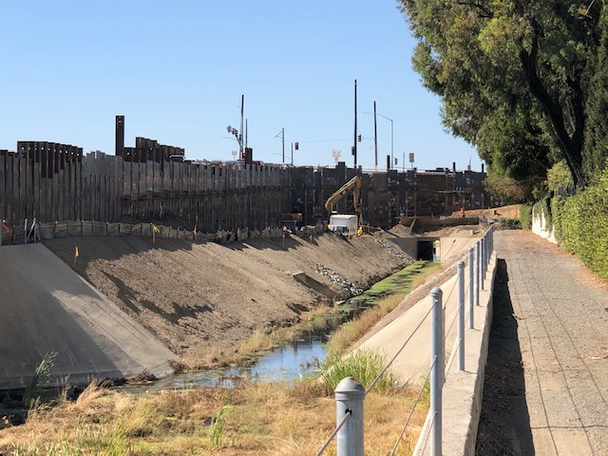
Construction Update
Fairview Road bridge and ramp construction
Notes:
In the photo on the left, you can see the Fairview bridge in the background and temporary shoring is installed to hold up the existing northbound off-ramp while the bridge and freeway improvements are being constructed.
In the photo on the right is the area on the other side of the northbound off-ramp, where improvements are being built while the existing drainage channel is protected.
These types of measures reflect the efforts being undertaken to keep ramps open to traffic during construction as much as possible in order to minimize impacts to the traveling public.
Would be much easier to close ramps for years, but we are trying to minimize impacts to the traveling public.

Slide 9
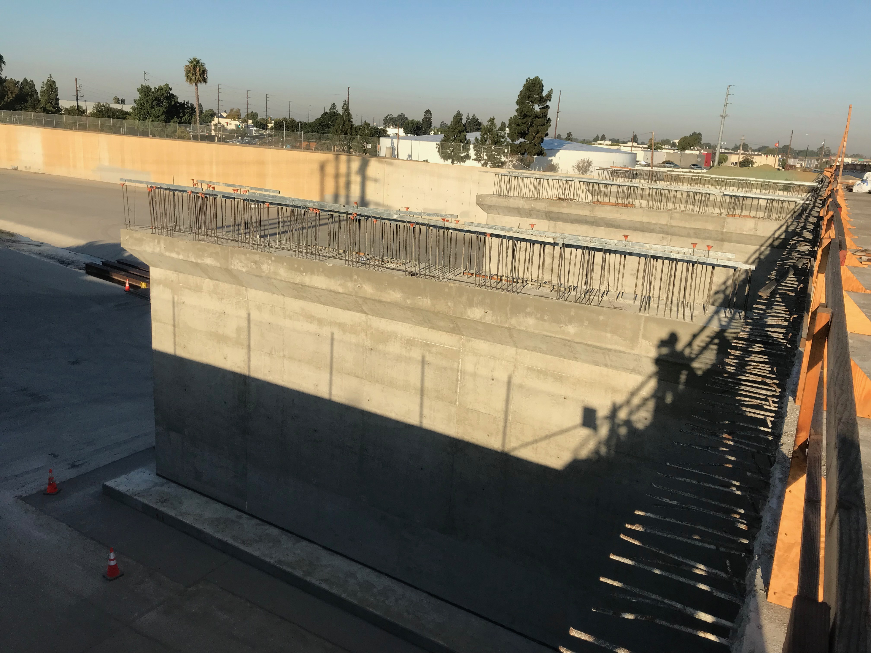
Construction Update
Santa Ana River bridge construction
Notes:
In this photo of the freeway bridge widening over the Santa Ana River, you can see the existing bridge on the right and you can get a sense of how much we are widening the freeway over the river.
A similar widening over the river is happening on the other side of the freeway.
Due to the rainy season, we are out of the river until April of this year.

Slide 10
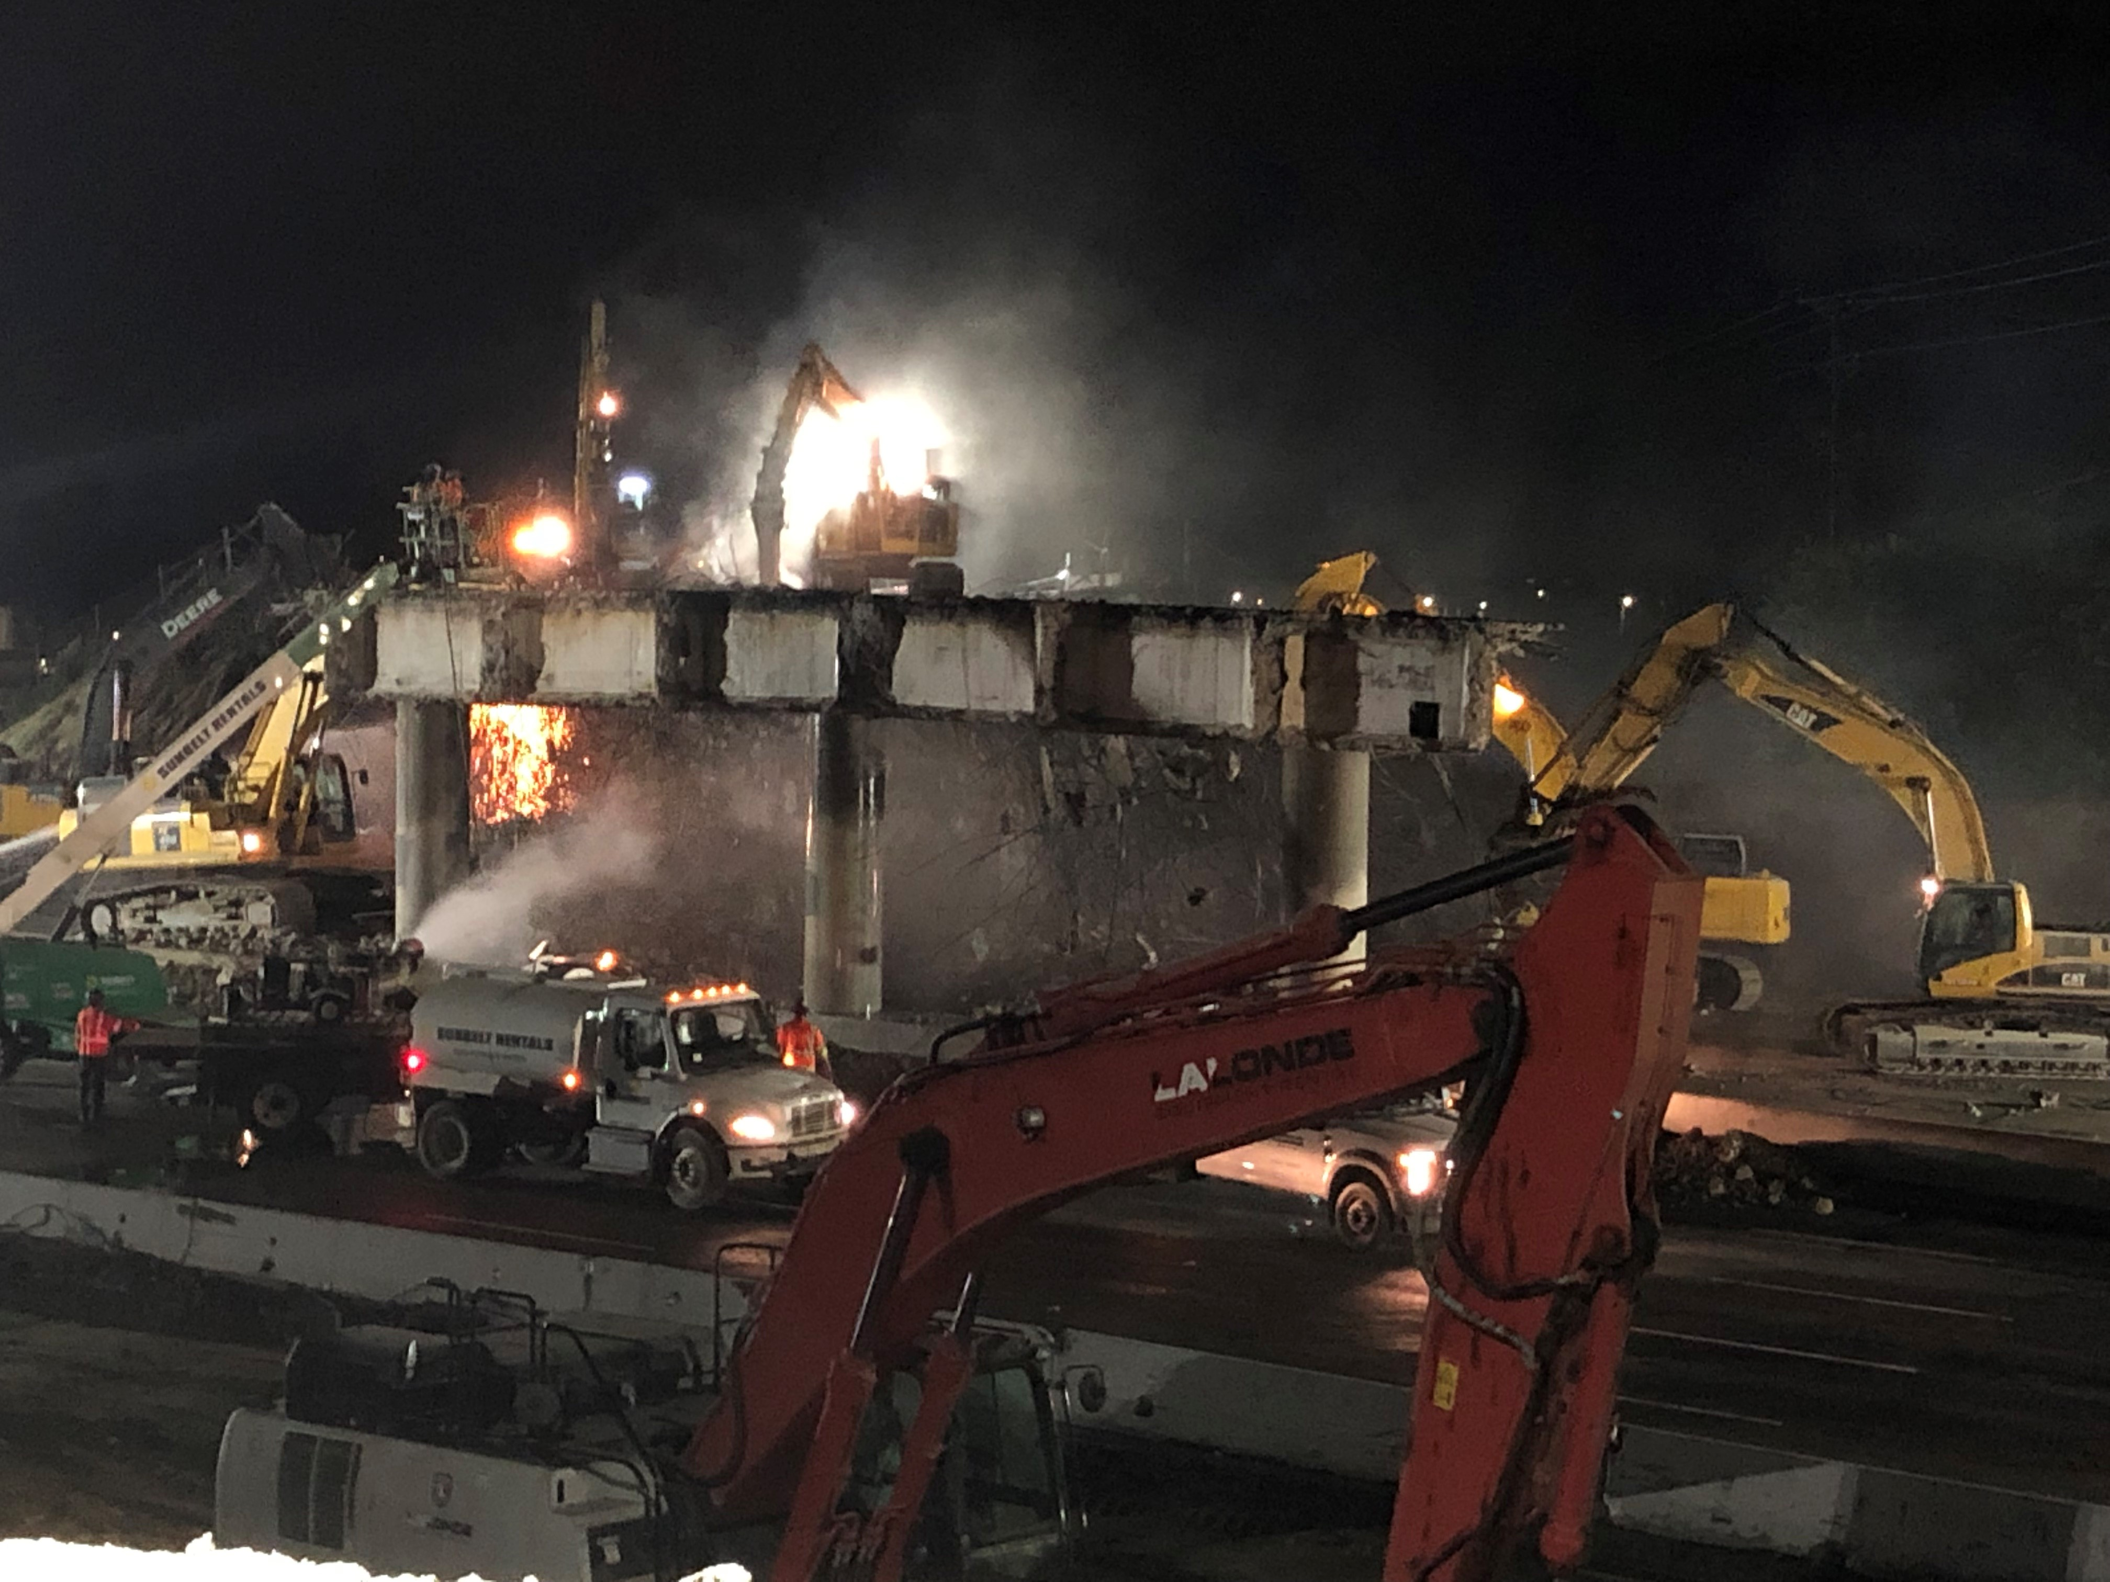
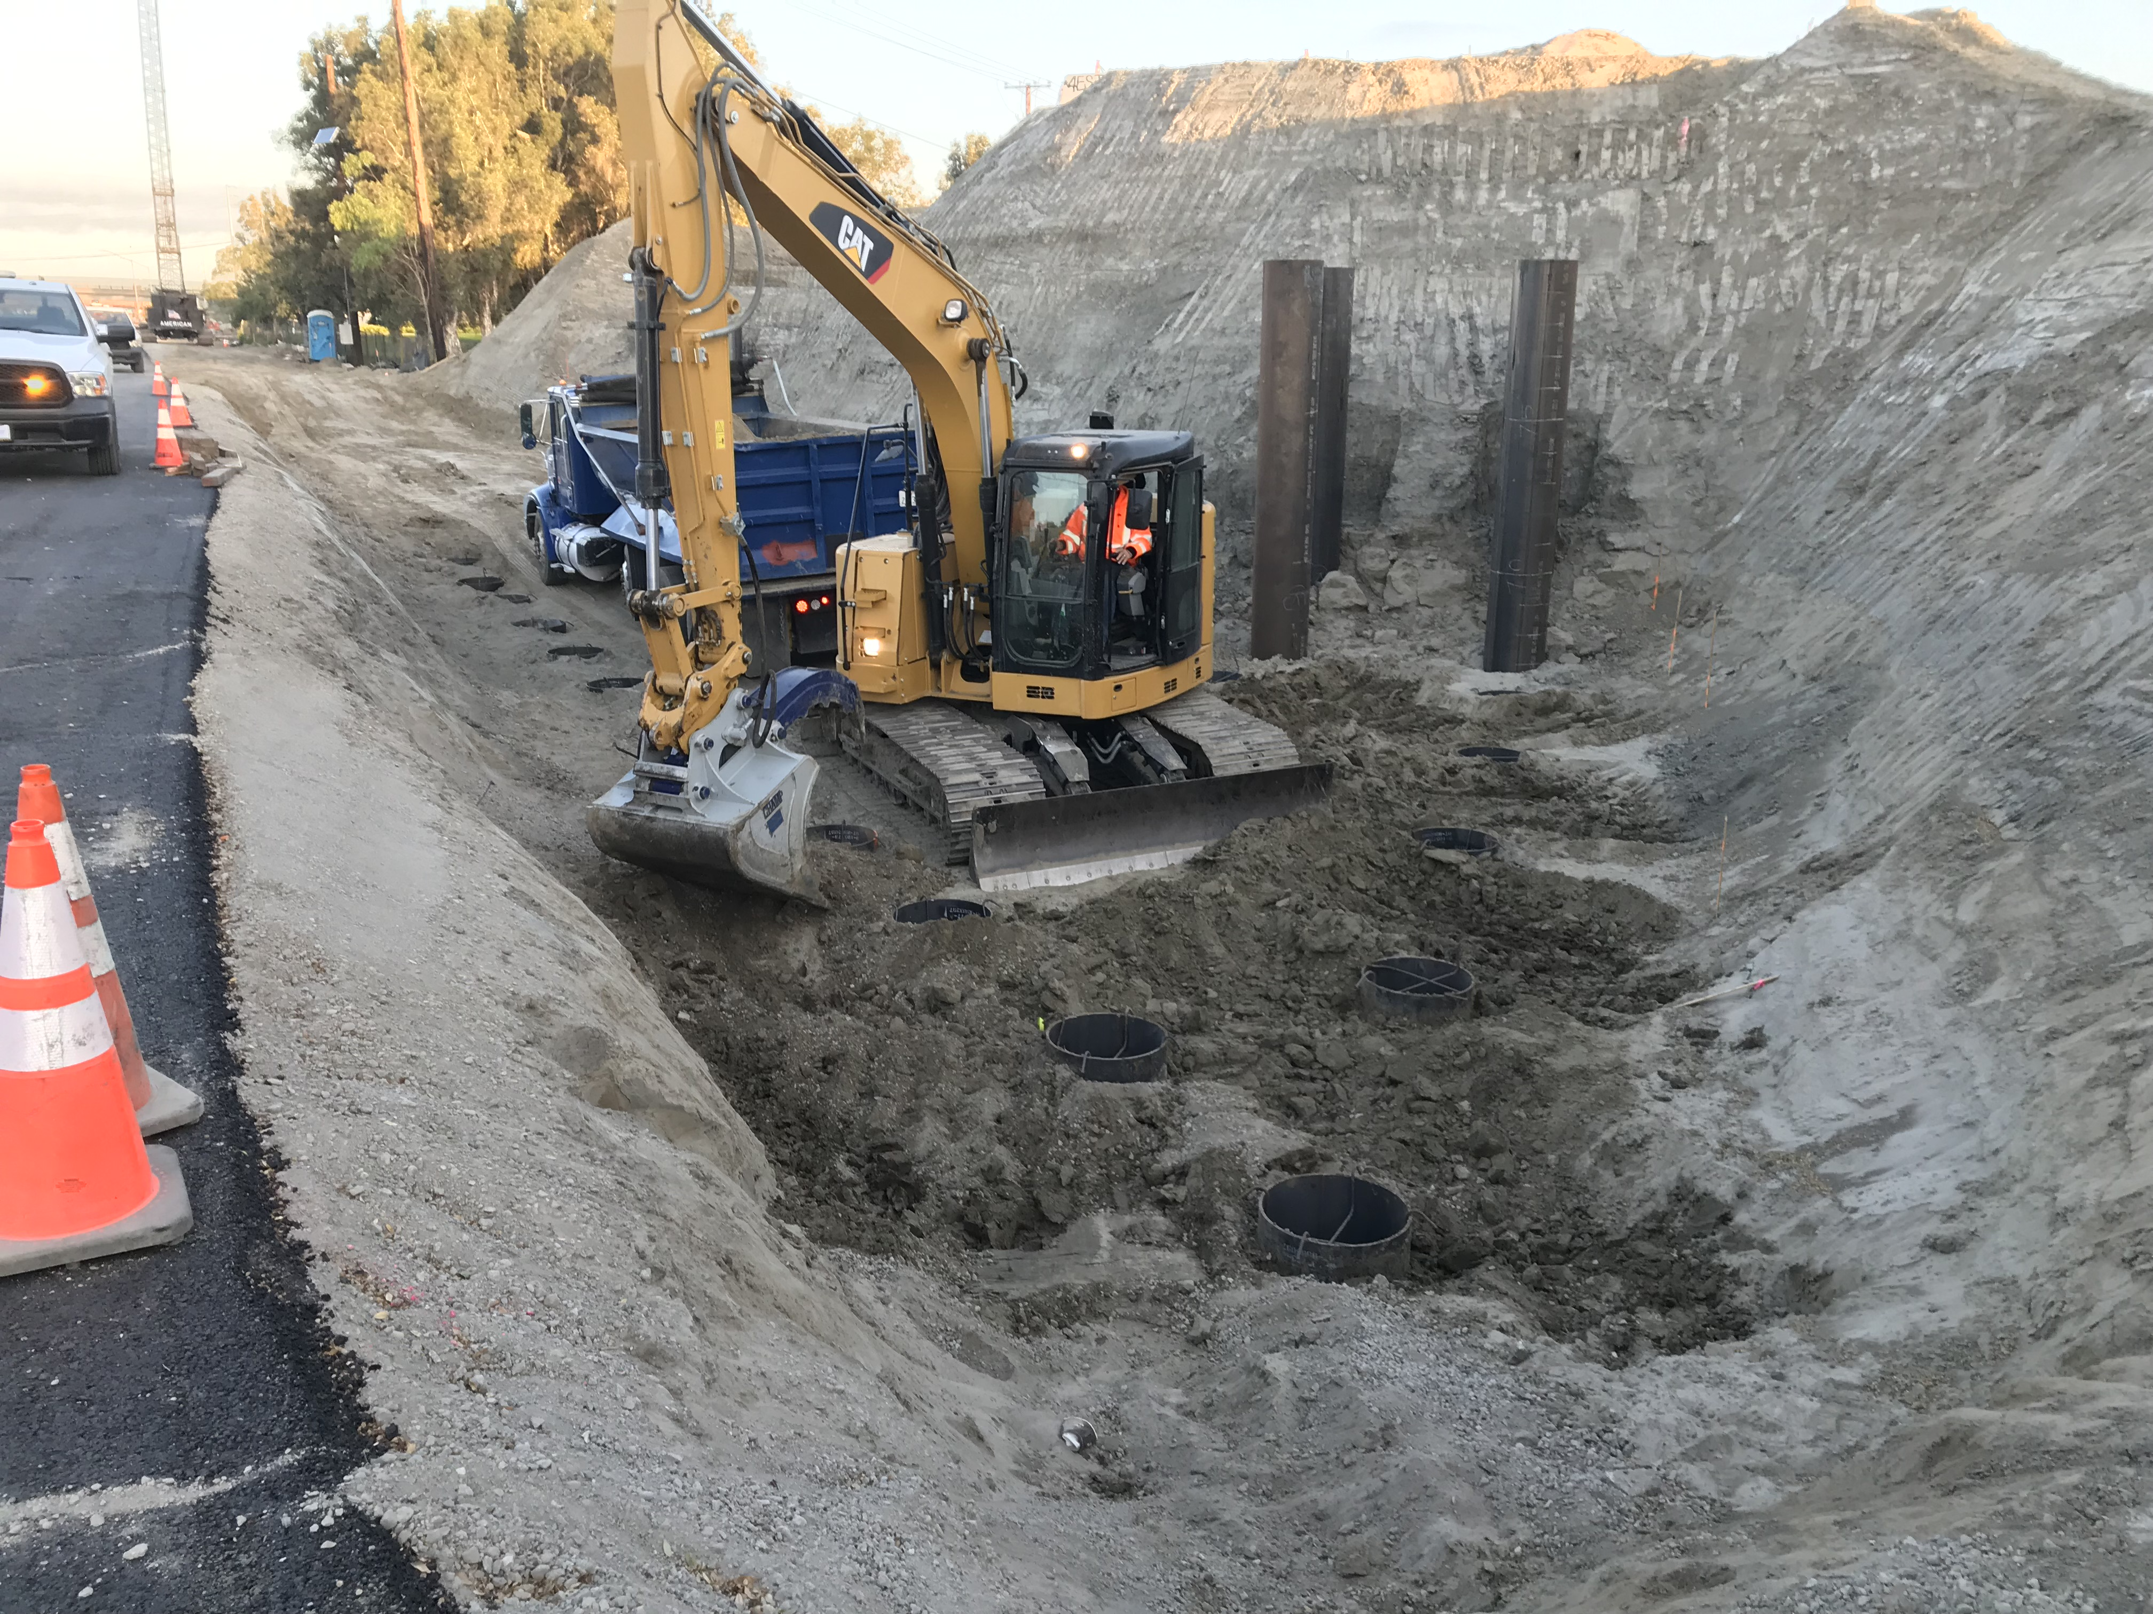
Construction Update
Bushard Street bridge demolition and construction
Notes:
As you may recall, the Slater bridge was the first new bridge opened to traffic in late August of last year.
This allowed OC405 to demolish and start reconstructing the Talbert and Bushard bridges.
The photo on the left is the Bushard bridge being demolished.
A demolition viewing event for elected officials was held at the Bushard bridge where we had many City Council members from the corridor Cities in attendance, as well as Director Delgleize and Director Jones.
The photo on the right is construction of one of the undergound bridge foundations that will support the new bridge.

Slide 11
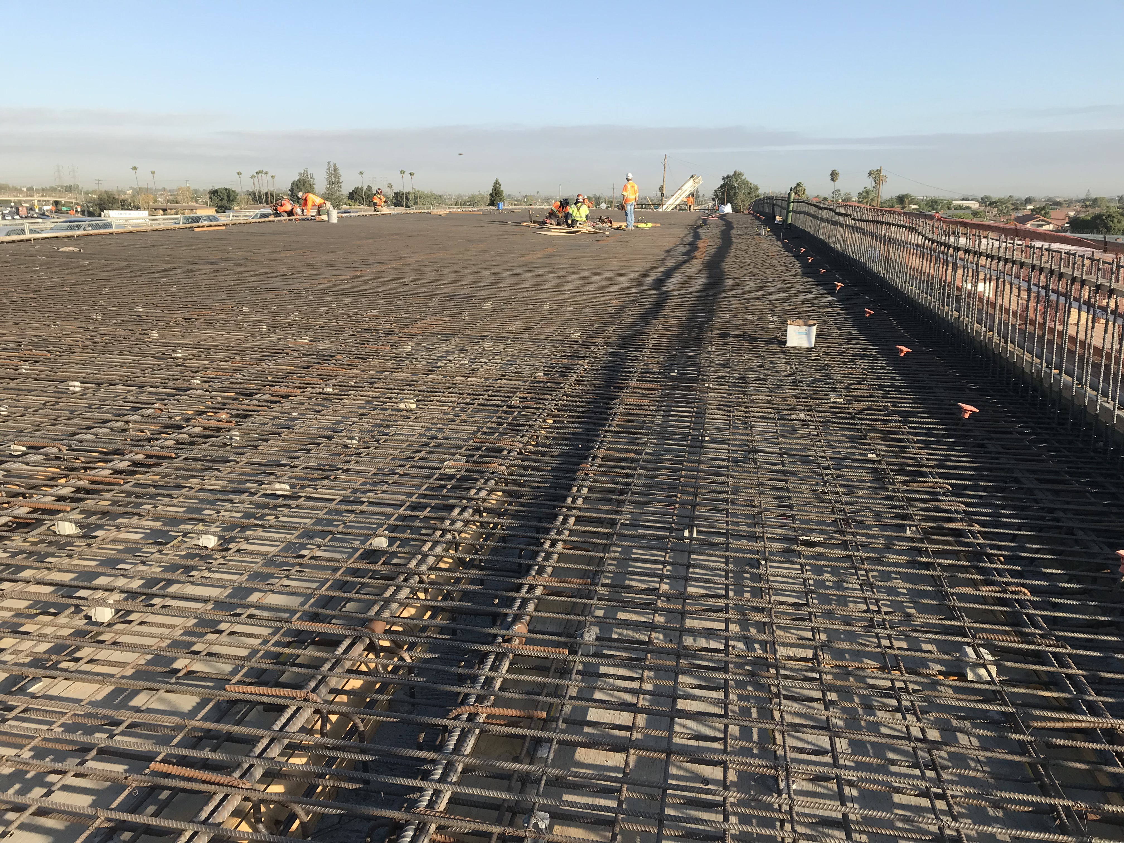
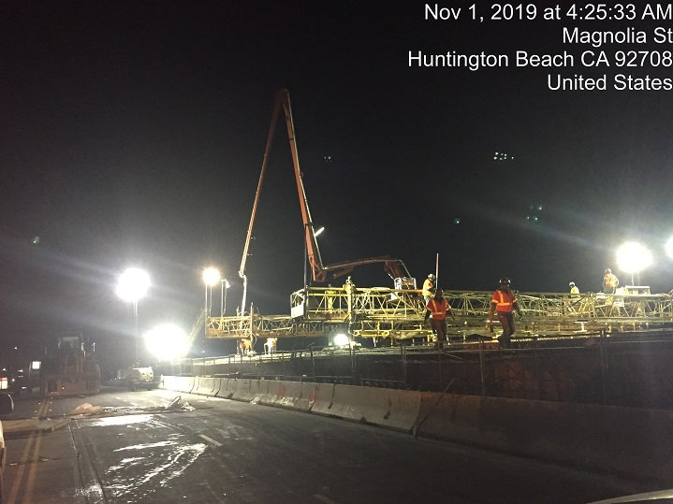
Construction Update
Magnolia Street bridge construction
Notes:
The photo on the left shows the reinforcing steel that was placed in the Magnolia bridge prior to pouring the concrete for the bridge deck.
This significant amount of reinforcing steel is in a bridge in large part to withstand an earthquake.
And on the right, the contractor is pouring the concrete bridge deck for the Magnolia bridge.

Slide 12
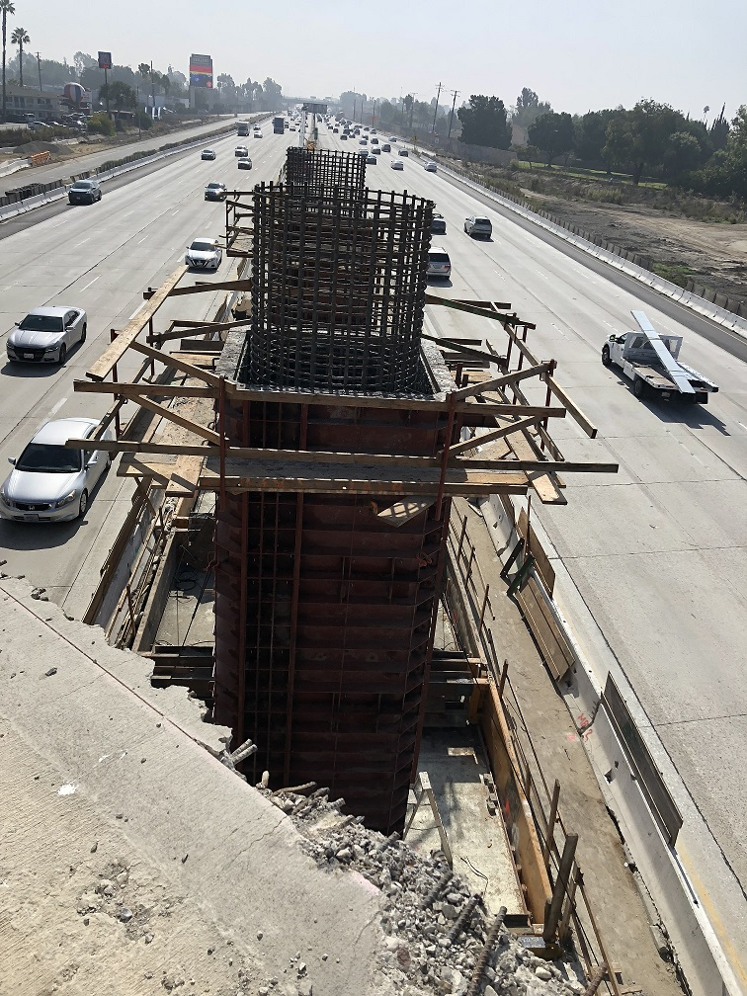
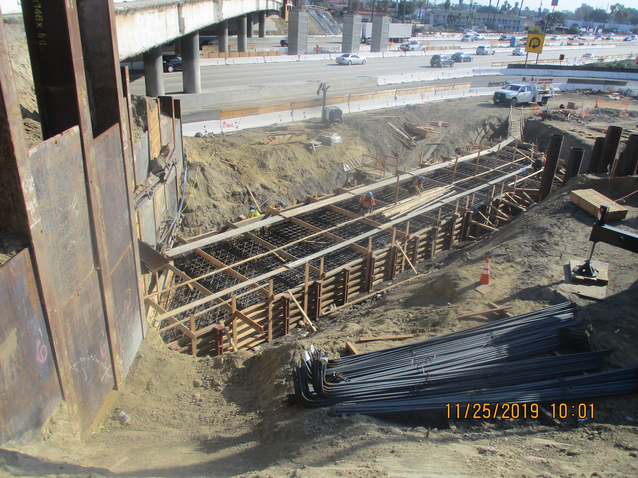
Construction Update
Westminster Boulevard bridge construction
Notes:
The photo on the left on this slide shows the columns in the middle of the freeway that will support the new Westminster bridge.
And on the right, the contractor is constructing the bridge foundation that will ultimately be underground.
In this photo, you can see the existing bridge to the left that remains open to traffic during construction.

Slide 13
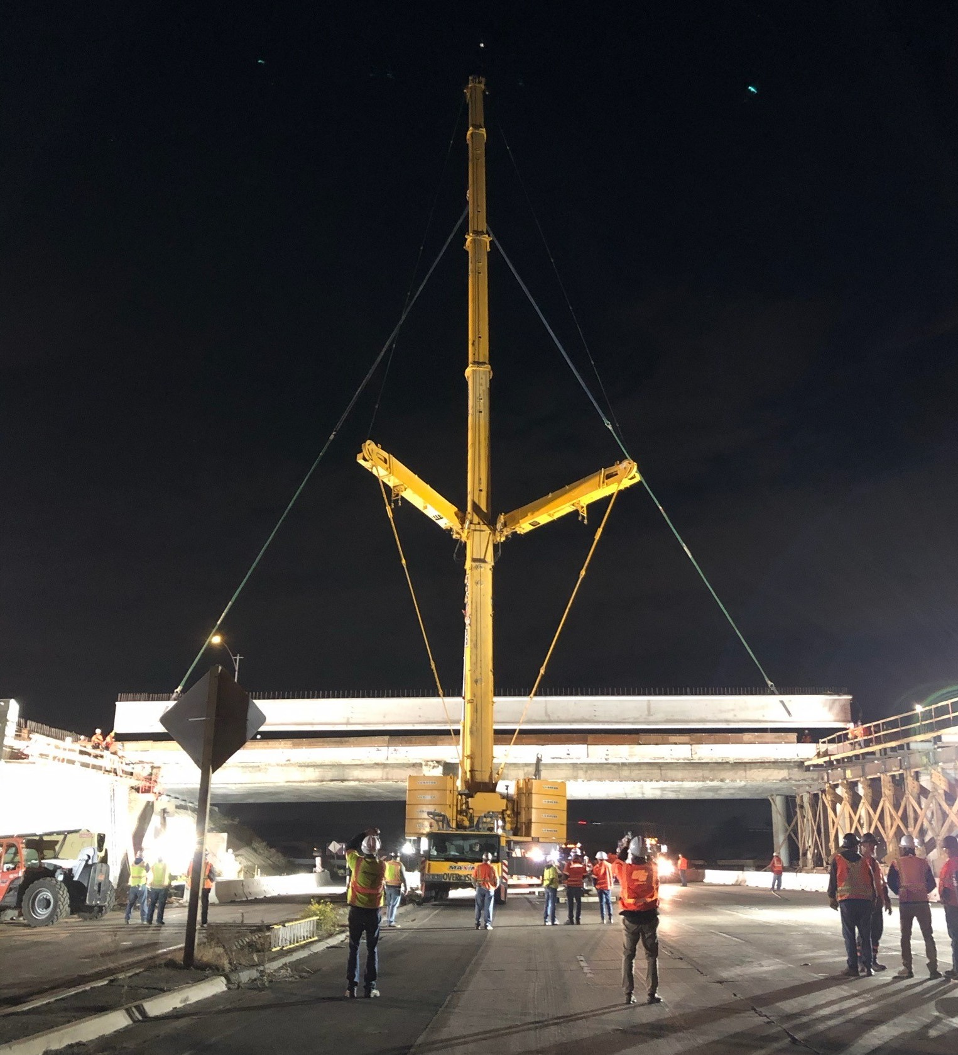
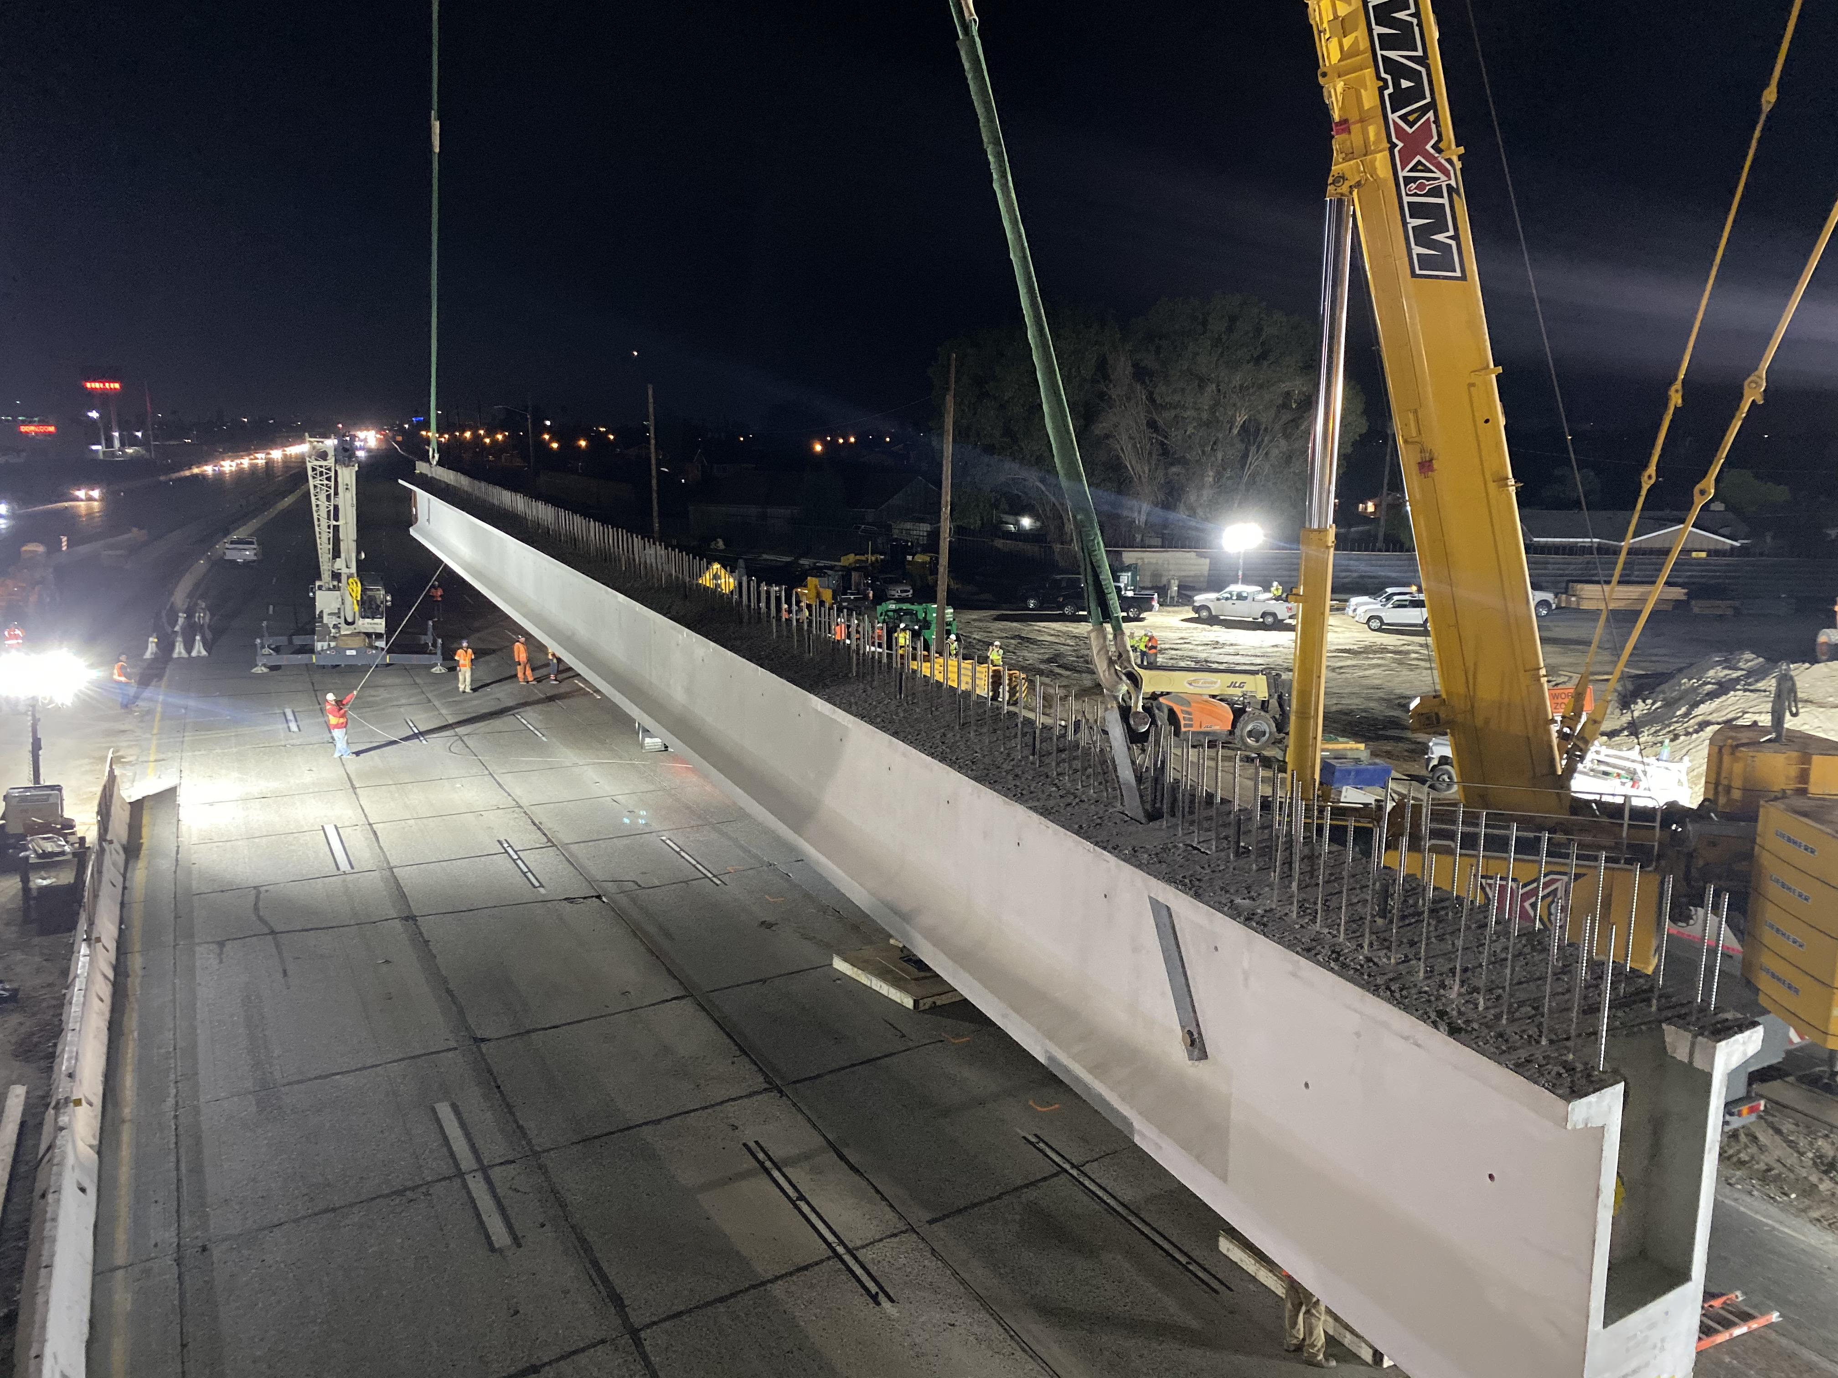
Construction Update
Bolsa Chica Road bridge construction
Notes:
This slide shows the construction of the Bolsa Chica bridge.
The crane shown in these two photos is lifting the girders into place that will support the new bridge.
This type of work is done at night under a full freeway closure.

Slide 14
Look Ahead for Bridge Construction
July – December 2020
Bolsa Chica Road bridge (first half) opens to traffic
January – June 2020
McFadden Avenue bridge fully opens to traffic
Magnolia Street bridge (first half) opens to traffic
Start Heil Avenue pedestrian overcrossing
Westminster Boulevard bridge (first half) opens to traffic
Fairview Road bridge (first half) opens to traffic
Freeway bridge widening over Harbor Boulevard complete
Goldenwest Street bridge (first half) opens to traffic
Notes:
Looking ahead, 2020 will continue to be a busy time for bridge, wall and pavement construction.
This slide shows some of the upcoming bridge milestones that we anticipate in 2020.
In the first two quarters of 2020, the first half of the bridges at Bolsa Chica and Magnolia will be opened to traffic.
This summer, we look forward to opening the McFadden bridge to traffic.
The McFadden bridge has faced many challenges that have resulted in a longer than expected construction duration – so it will be an important milestone to get this bridge back open to traffic.
Later this year, the first half of the bridges at Westminster, Goldenwest and Fairview will be opened to traffic.
In addition to the bridges noted on this slide, the Bushard and Talbert bridges are anticipated to open in late 2020 and early 2021, respectively.

Slide 15
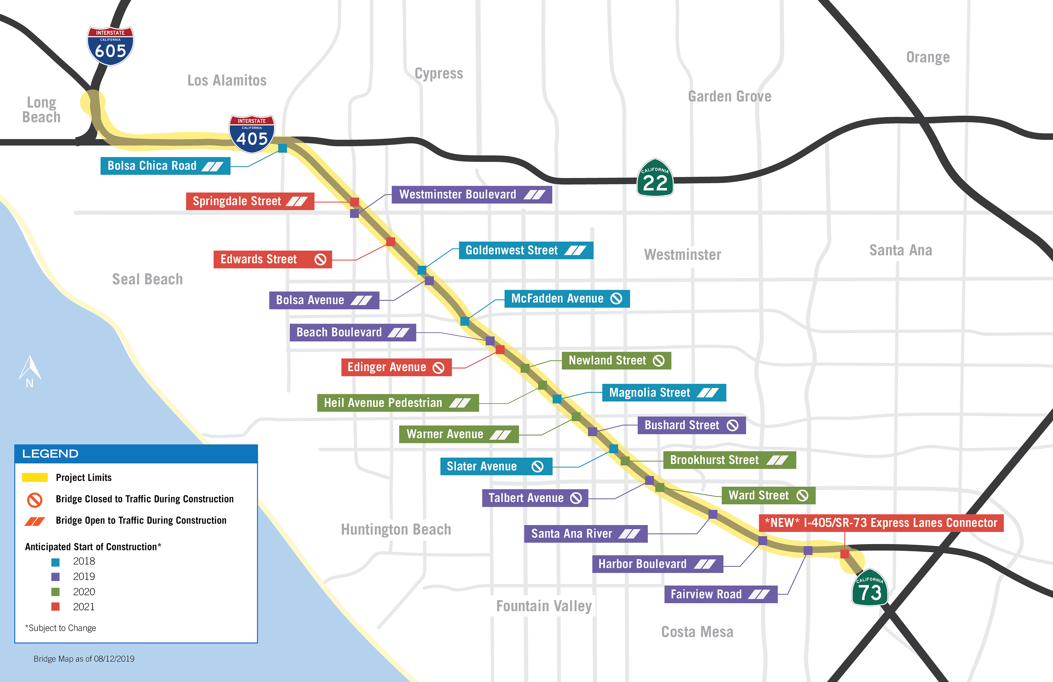
Bridge Construction Map
Notes:
This graphic represents what year construction is anticipated to begin for each bridge within the project limits and whether that bridge will be open to traffic during construction.
At this point, we have begun construction on the bridges shown in blue and purple.
Notes:
13 that are blue and purple – 1 done (Slater) – Of 12 left, 3 are one stage, 3 are widenings and 6 are two stage

Slide 16
Project Challenges
Oversight and approvals from many different agencies and third parties
Cost and availability of construction resources in this active construction market
Change management
Minimizing impacts and disruptions to the public
Schedule impacts and mitigations
Notes:
As would be expected on a project of this magnitude, certain challenges have been encountered.
Some of those challenges are included in the staff report and on this slide.
OCTA is focused on all of these project challenges, but for the purposes of today, I would like to focus on the last bullet regarding schedule impacts and mitigations.

Slide 17
Schedule Mitigations Implemented
Previously Implemented |  | Recently Implemented
Slater Avenue bridge from two-stage to one-stage construction | Edwards Street bridge from two-stage to one-stage construction | Longer ramp closure durations
Improvements to staging of Oceanview Channel construction | Long-term closure of one of two northbound off-ramps to Westminster Boulevard | Extended and/or multiple night closures
Mitigations for archeological discovery within Project site being explored
Mitigations intended to maintain Project completion date
To be balanced with minimizing traffic impacts
Notes:
OCTA has worked closely with OC405 and our partners, particularly Caltrans and the Cities, to mitigate schedule delays when identified.
Previously implemented schedule mitigations include building the Slater and Edwards bridges in one stage instead of two stages, improvements to the construction staging at Oceanview Channel, and the long-term closure of one of the two off-ramps from northbound I-405 to Westminster Boulevard.
More recent schedule mitigations that have been incorporated include longer ramp closure durations and extended nightly lane closure durations in order to increase the productivity of the contractor.
The objectives of the schedule mitigations are to maintain the original Project completion date while balancing the minimization of traffic impacts.
Additionally, in September 2019, there was a discovery of archeological resources within the Project site.
OCTA is following established state procedures for this type of discovery and is working with the appropriate parties to ensure appropriate and respectful procedures are followed.
This discovery has impacted construction at a specific location and mitigations are being explored to minimize the impacts to the overall Project schedule.
Next, Chris is going to discuss some of the ongoing public outreach efforts.

Slide 18
Community Engagement
Category | Average per month
Public comments and questions | 140 constituents
Flyers | 16,000 addresses
Social media reach | 150,000 users
Construction emails | 8 (10,600 recipients)
Interactive map | 1,965 users
Mobile app | 1,636 users
Website closures list | 504 downloads
18
Notes:
Chris

Slide 19
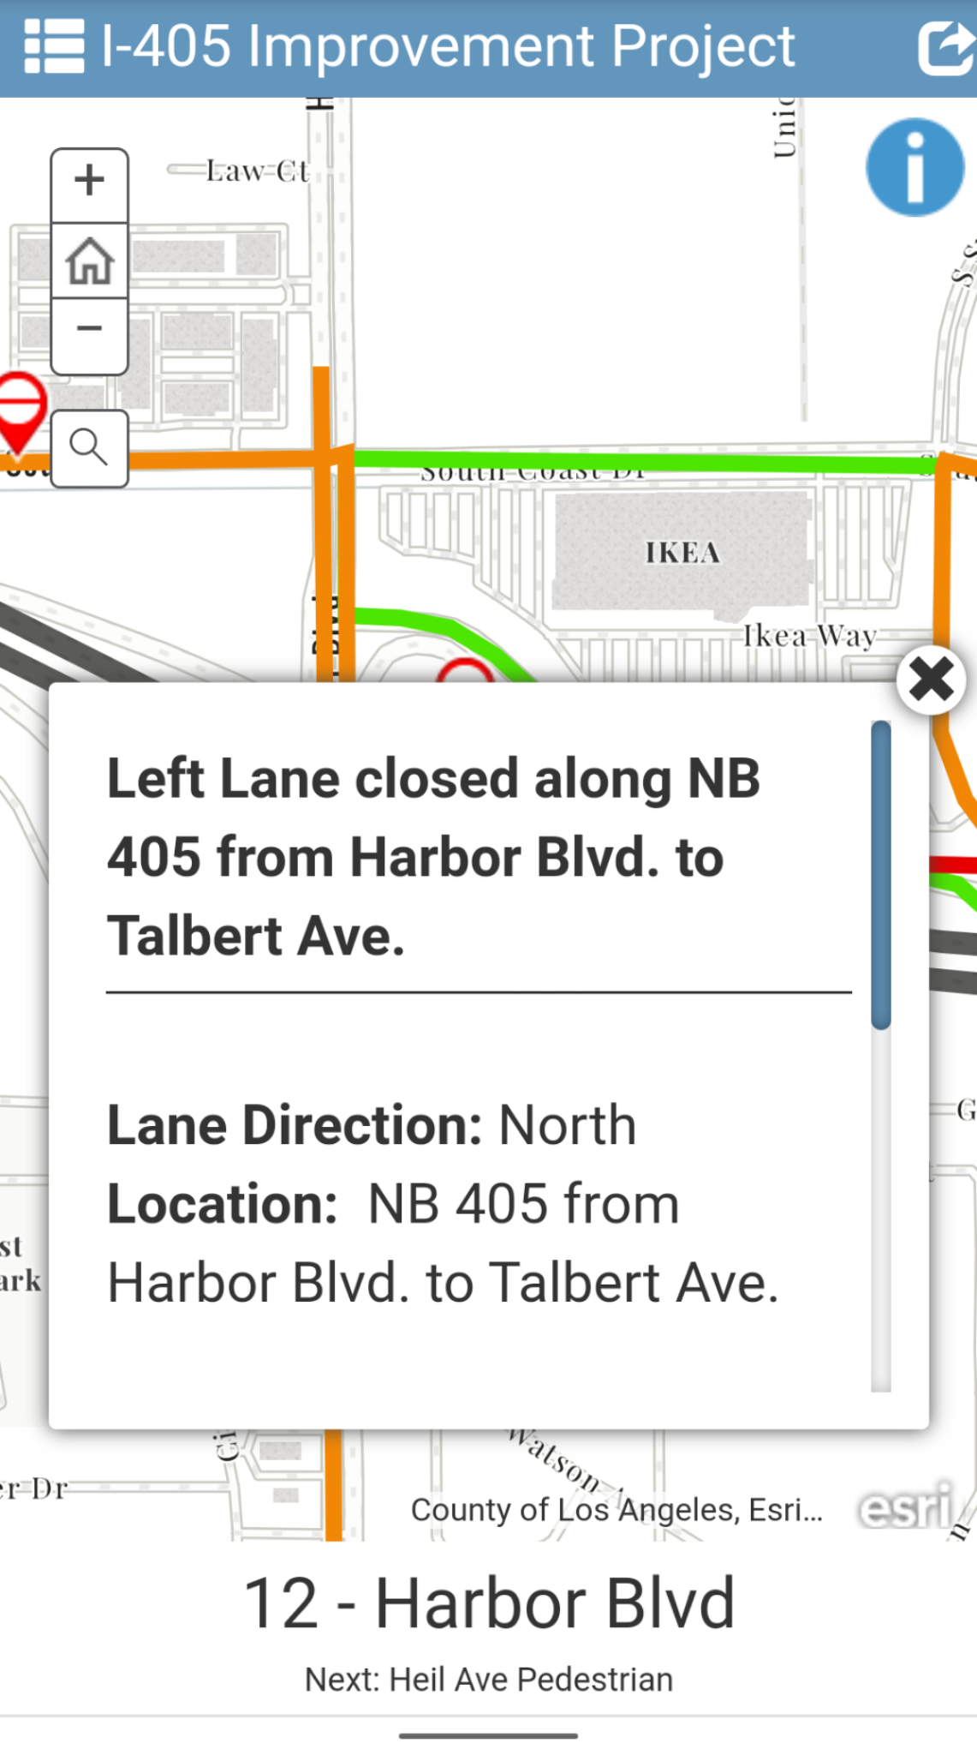
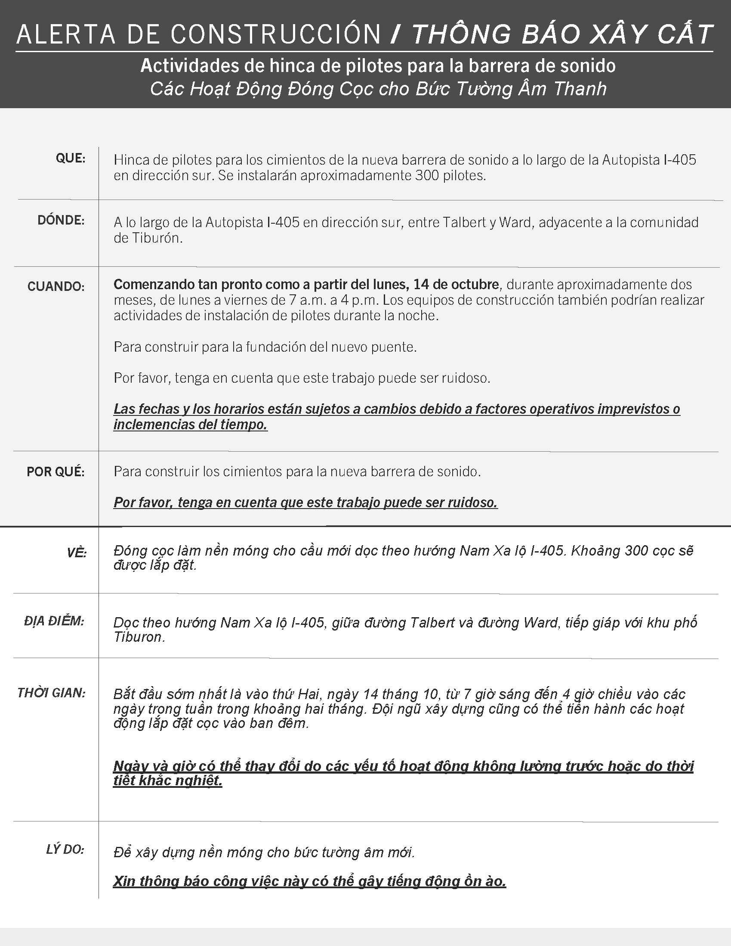
Upcoming Outreach
Phase 2 bridge neighborhood meetings
Bolsa Chica Road
Magnolia Street
Milestone events
McFadden Avenue bridge
City council updates
Key stakeholder briefings
Exclusive insider tours
Culturally relevant outreach
Community event participation
Notes:
Chris

