Slide 1
UPDATE ON DIVERSITY OUTREACH AND INCLUSION EFFORTS

Slide 2
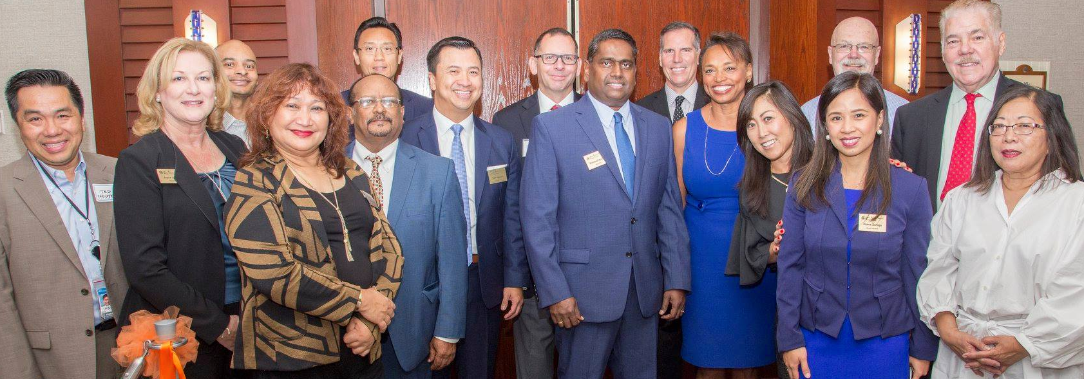
Beyond Business and Translations
2

Slide 3
Delivering for Dynamic Demographics
2
3

Slide 4
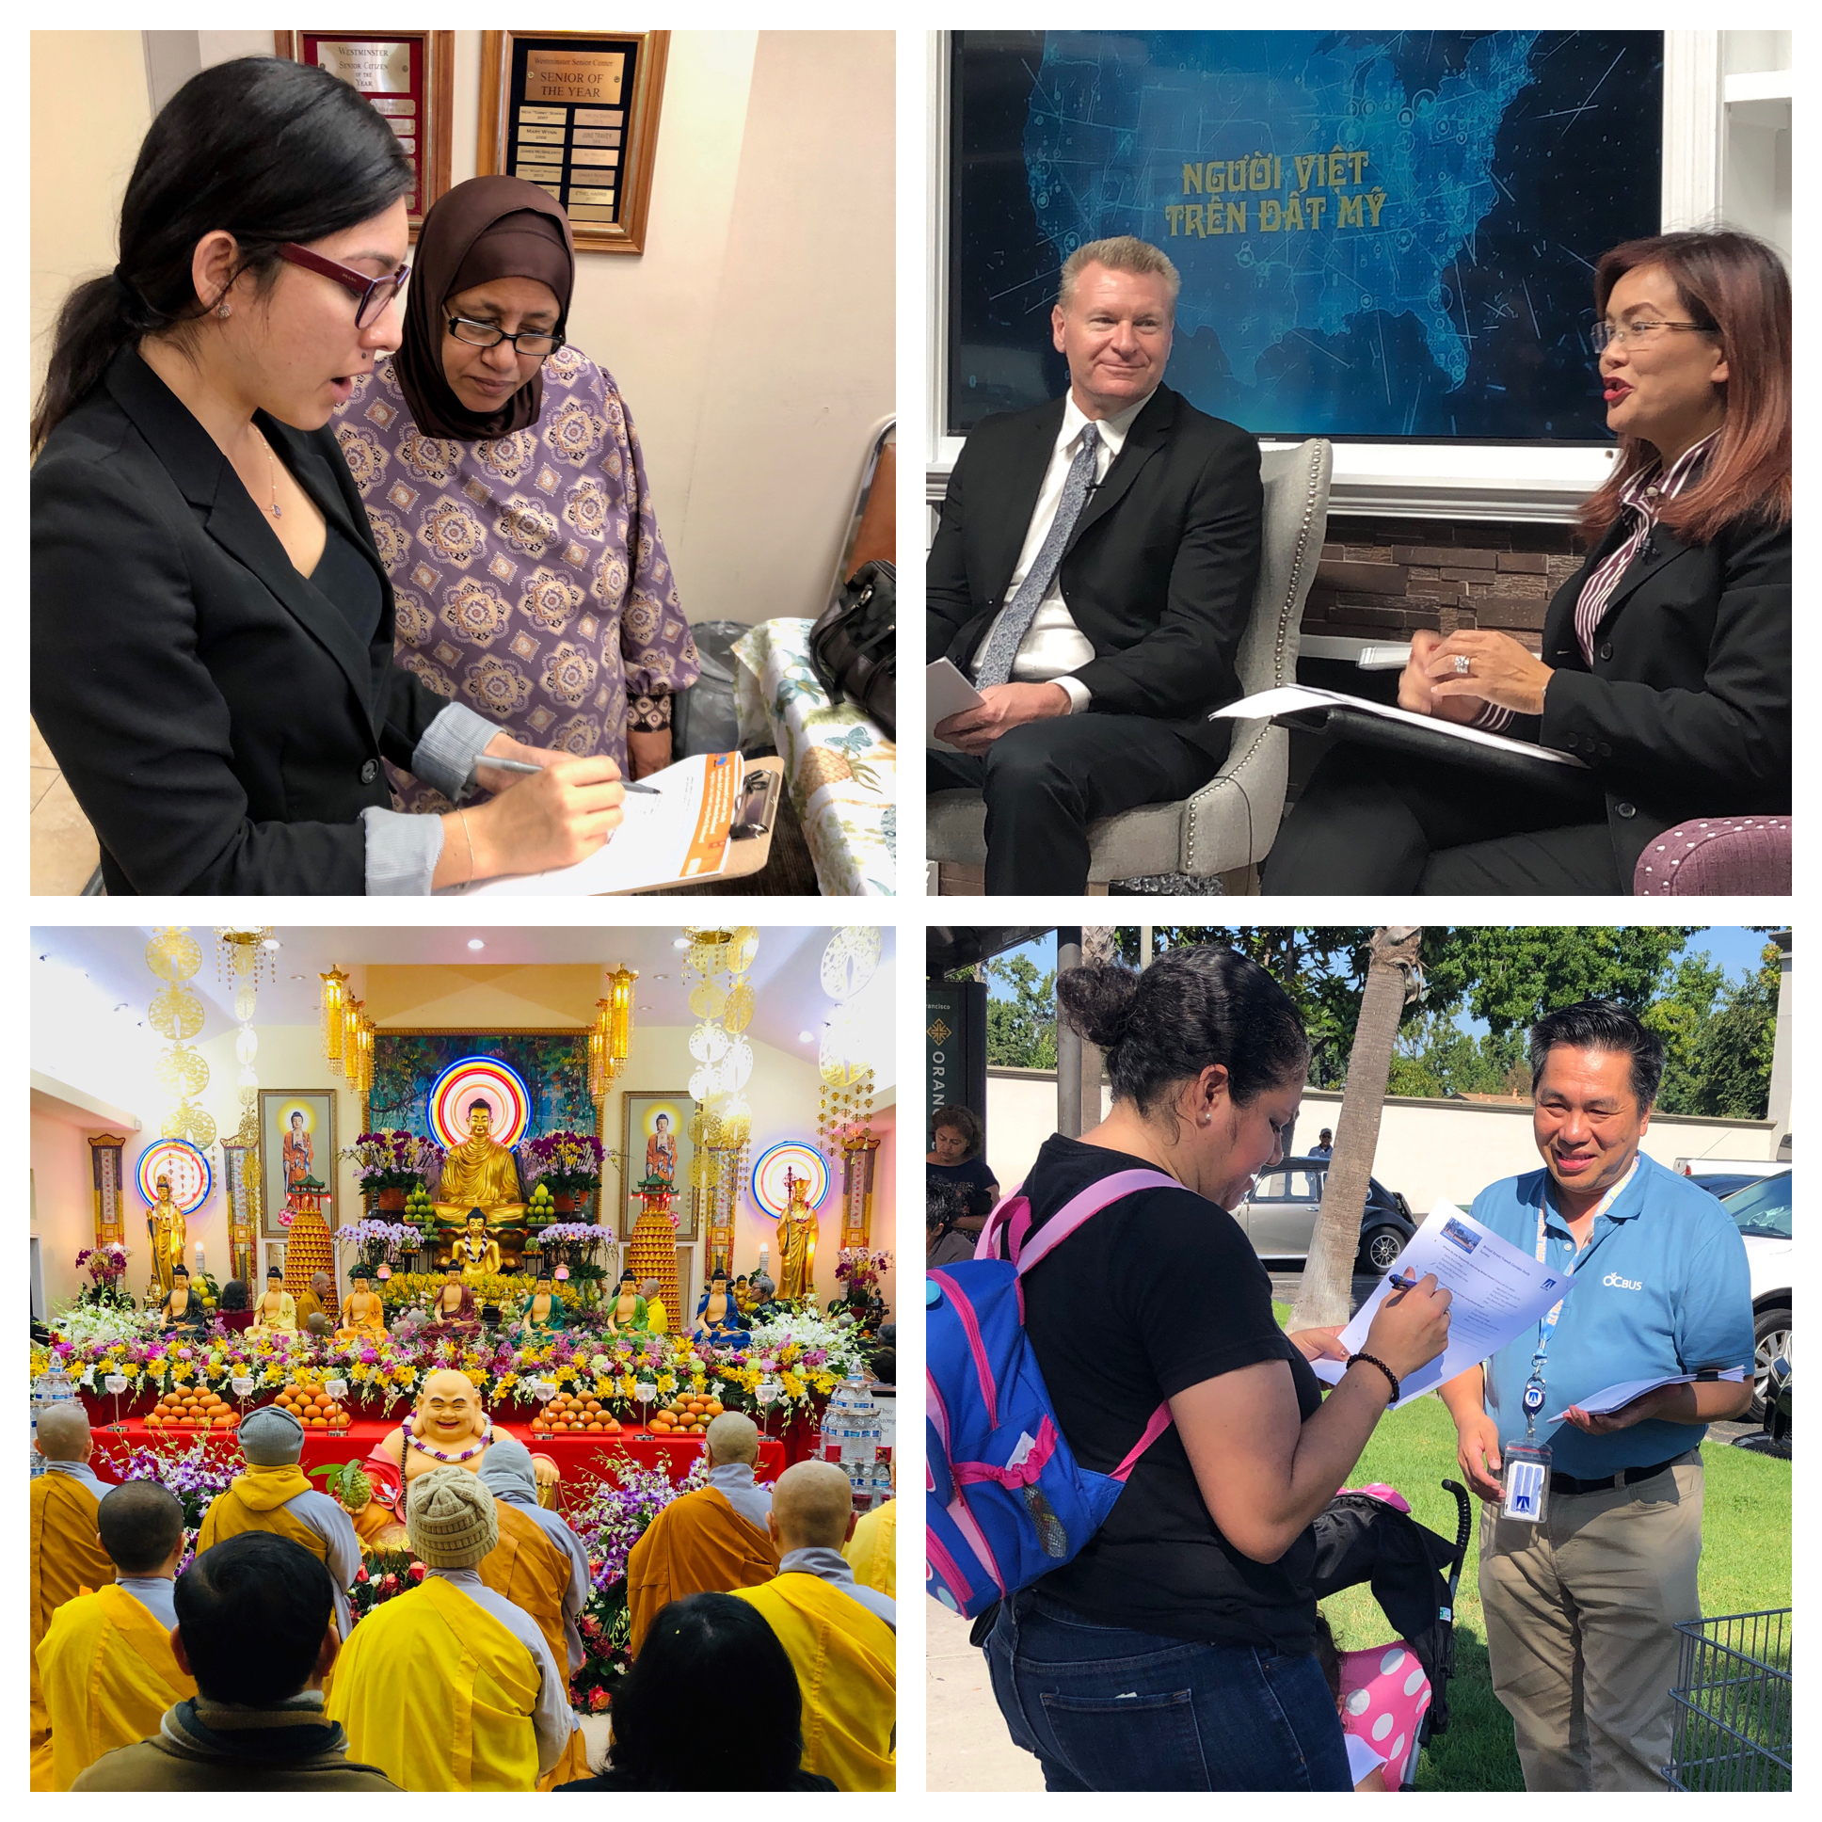
Engagement Activities for Transportation
4

Slide 5
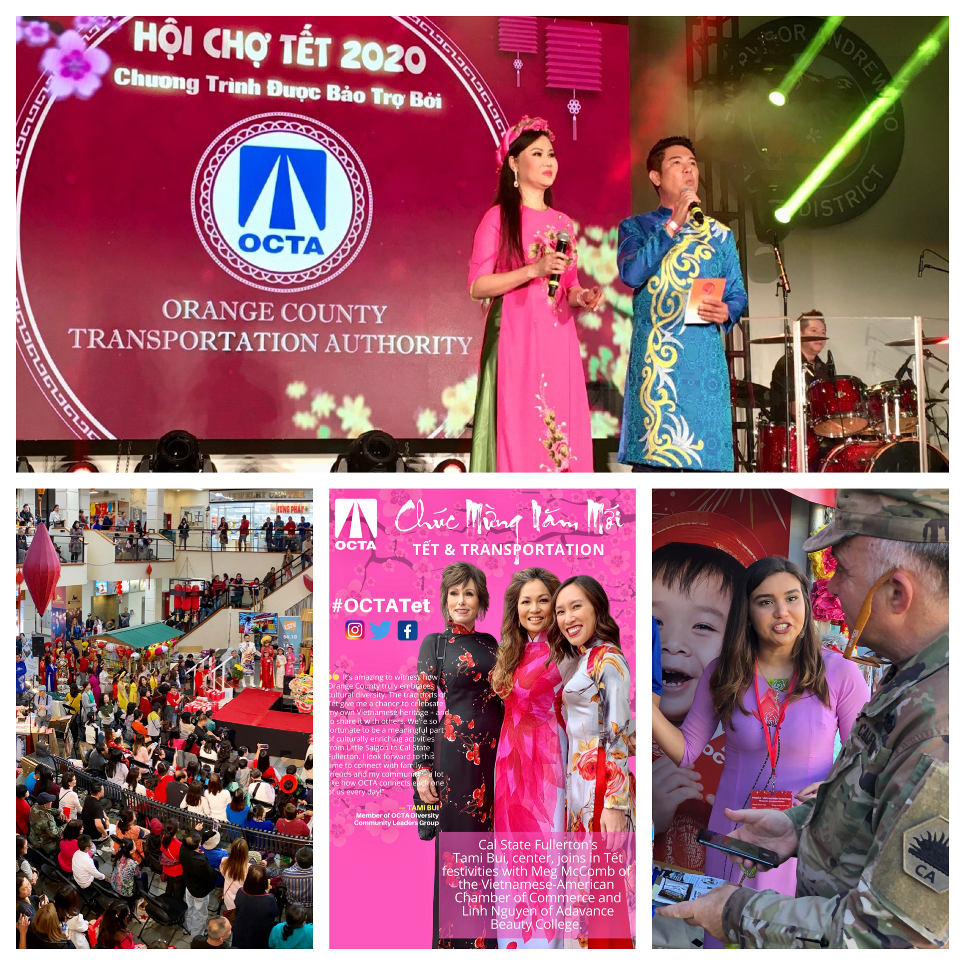
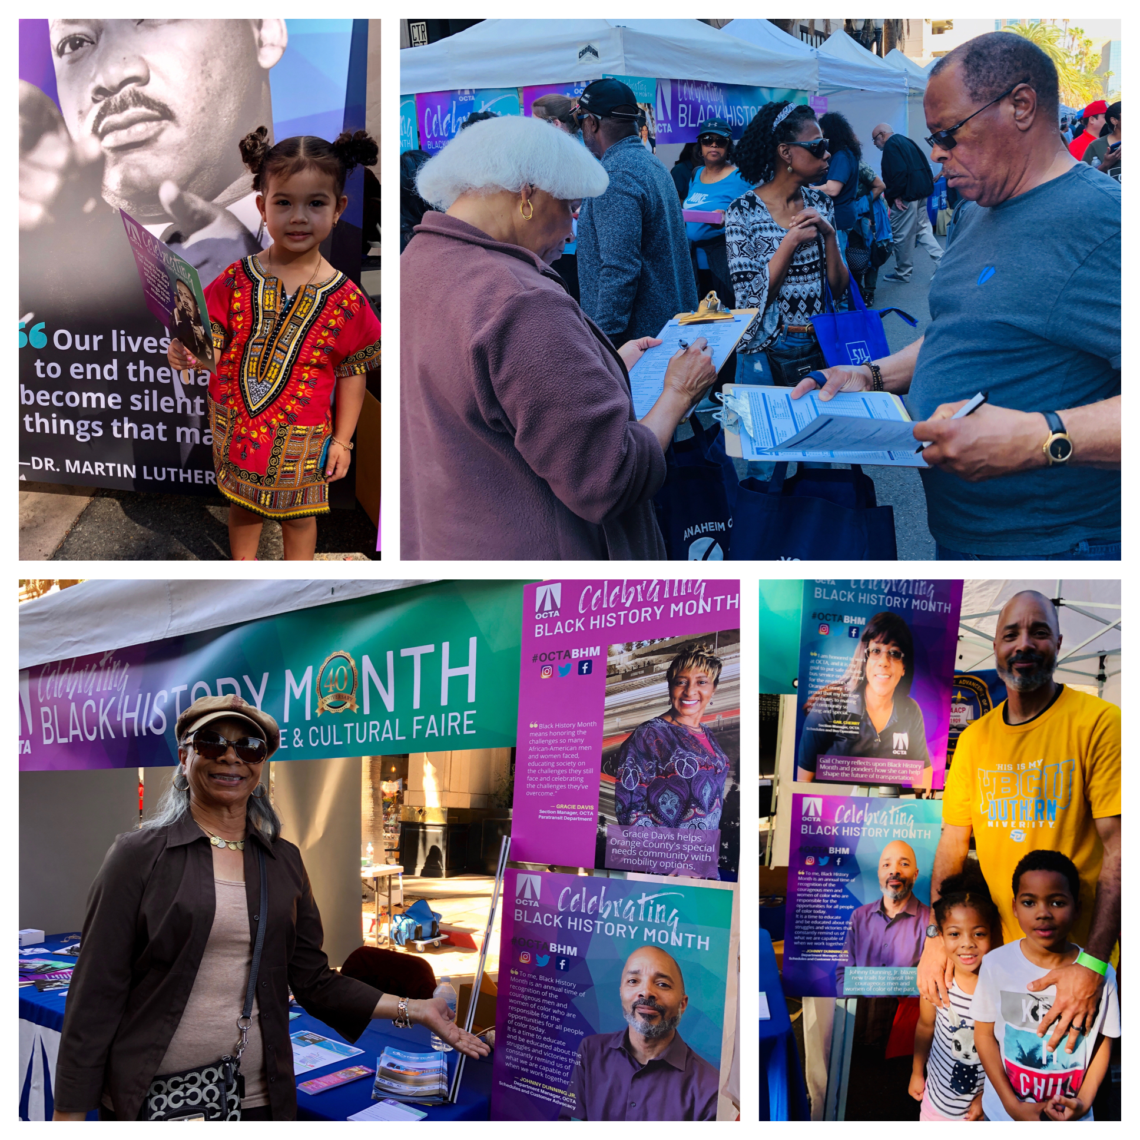
Cultural Celebrations
5

Slide 6
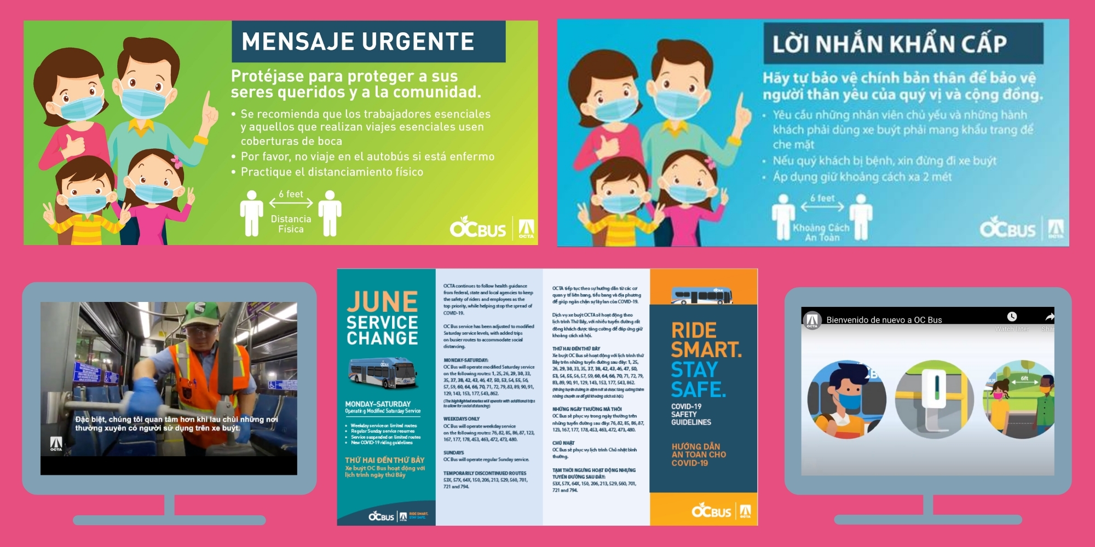
Multilingual COVID-19 Rapid Response
6

Slide 7
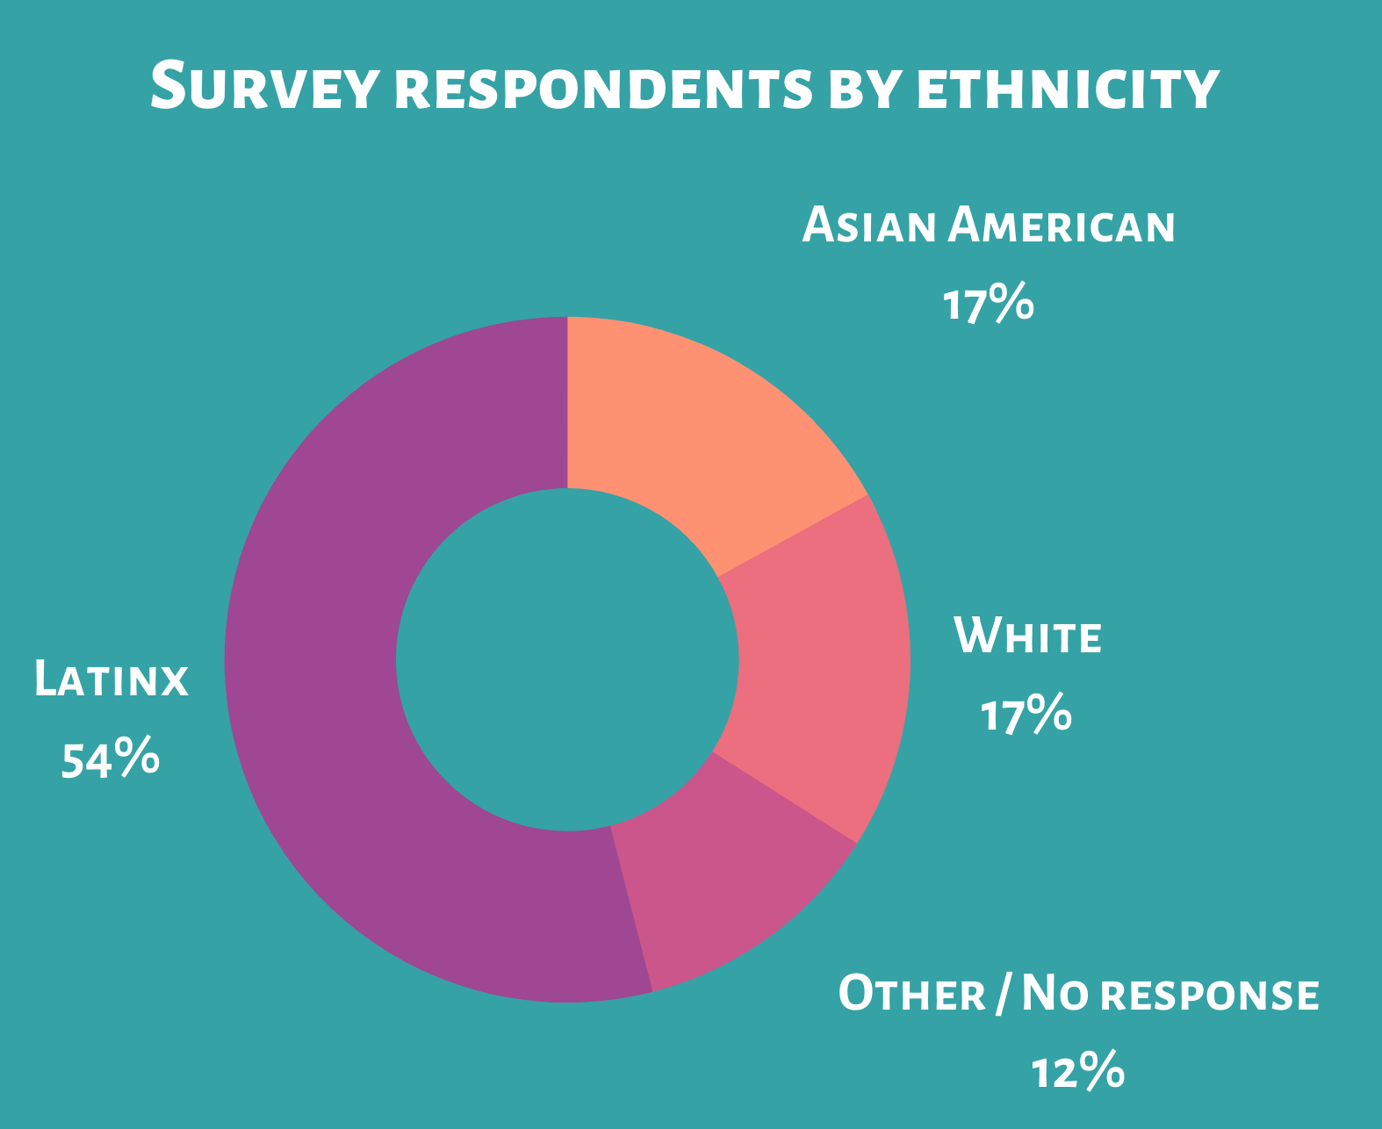
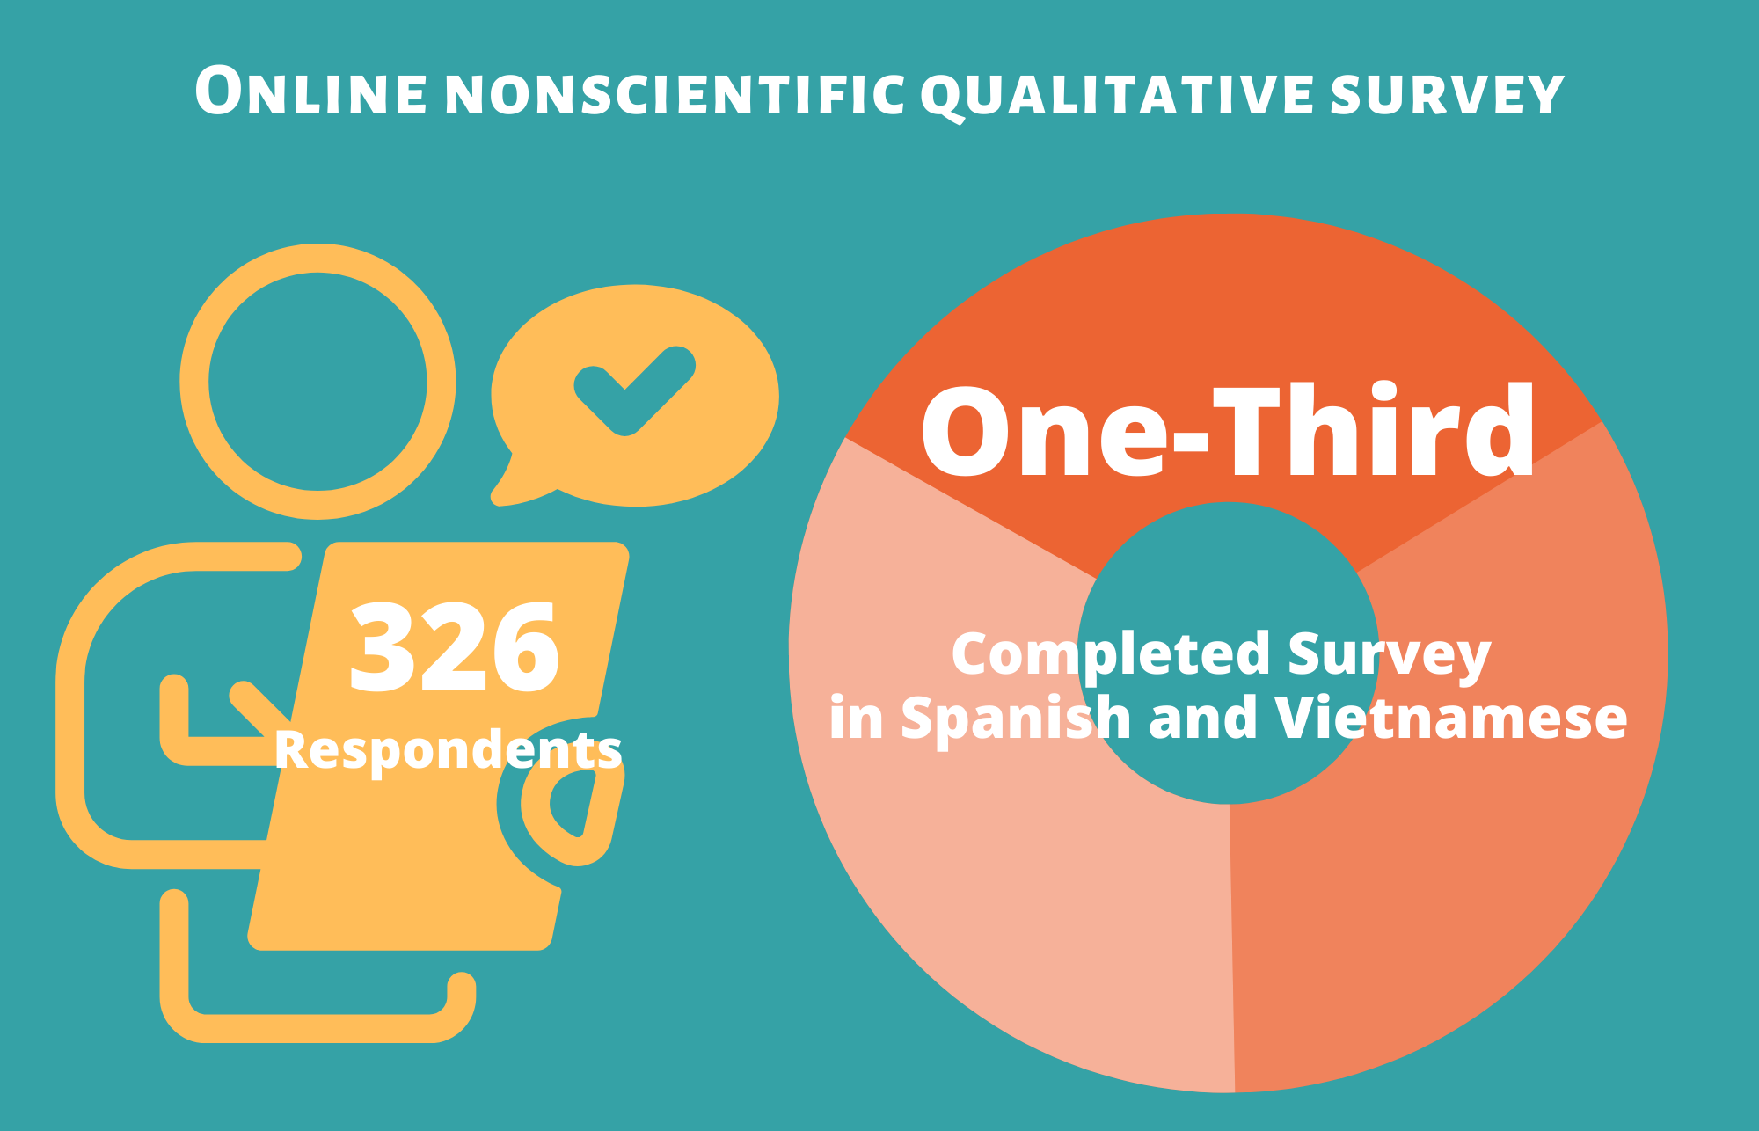
Surveying Hard-to-Reach Audiences
7

Slide 8
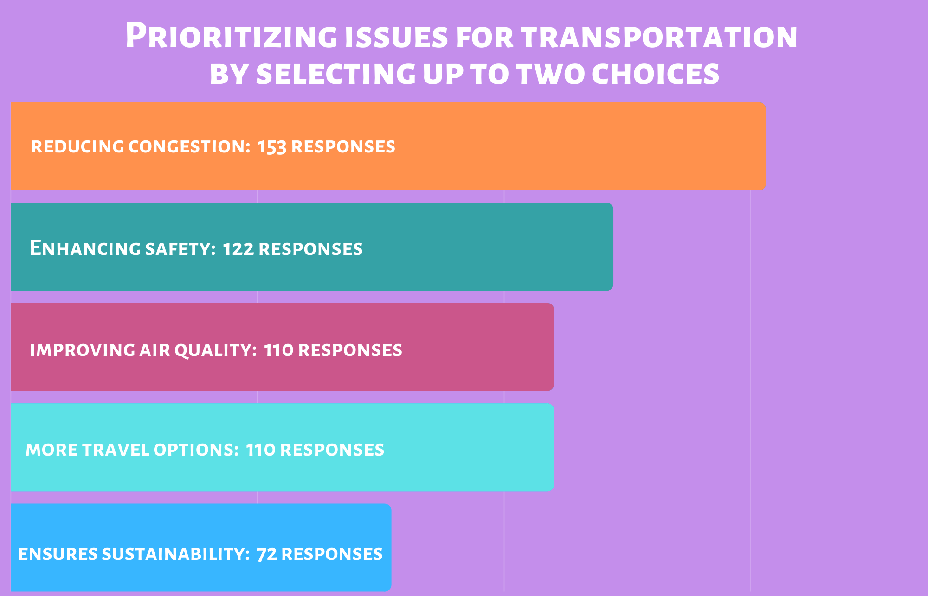
Surveying Hard-to-Reach Audiences
8

Slide 9
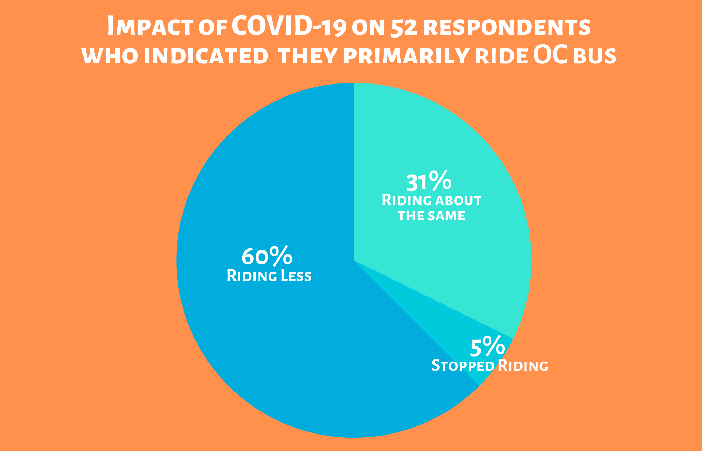
Surveying Hard-to-Reach Audiences
9

Slide 10
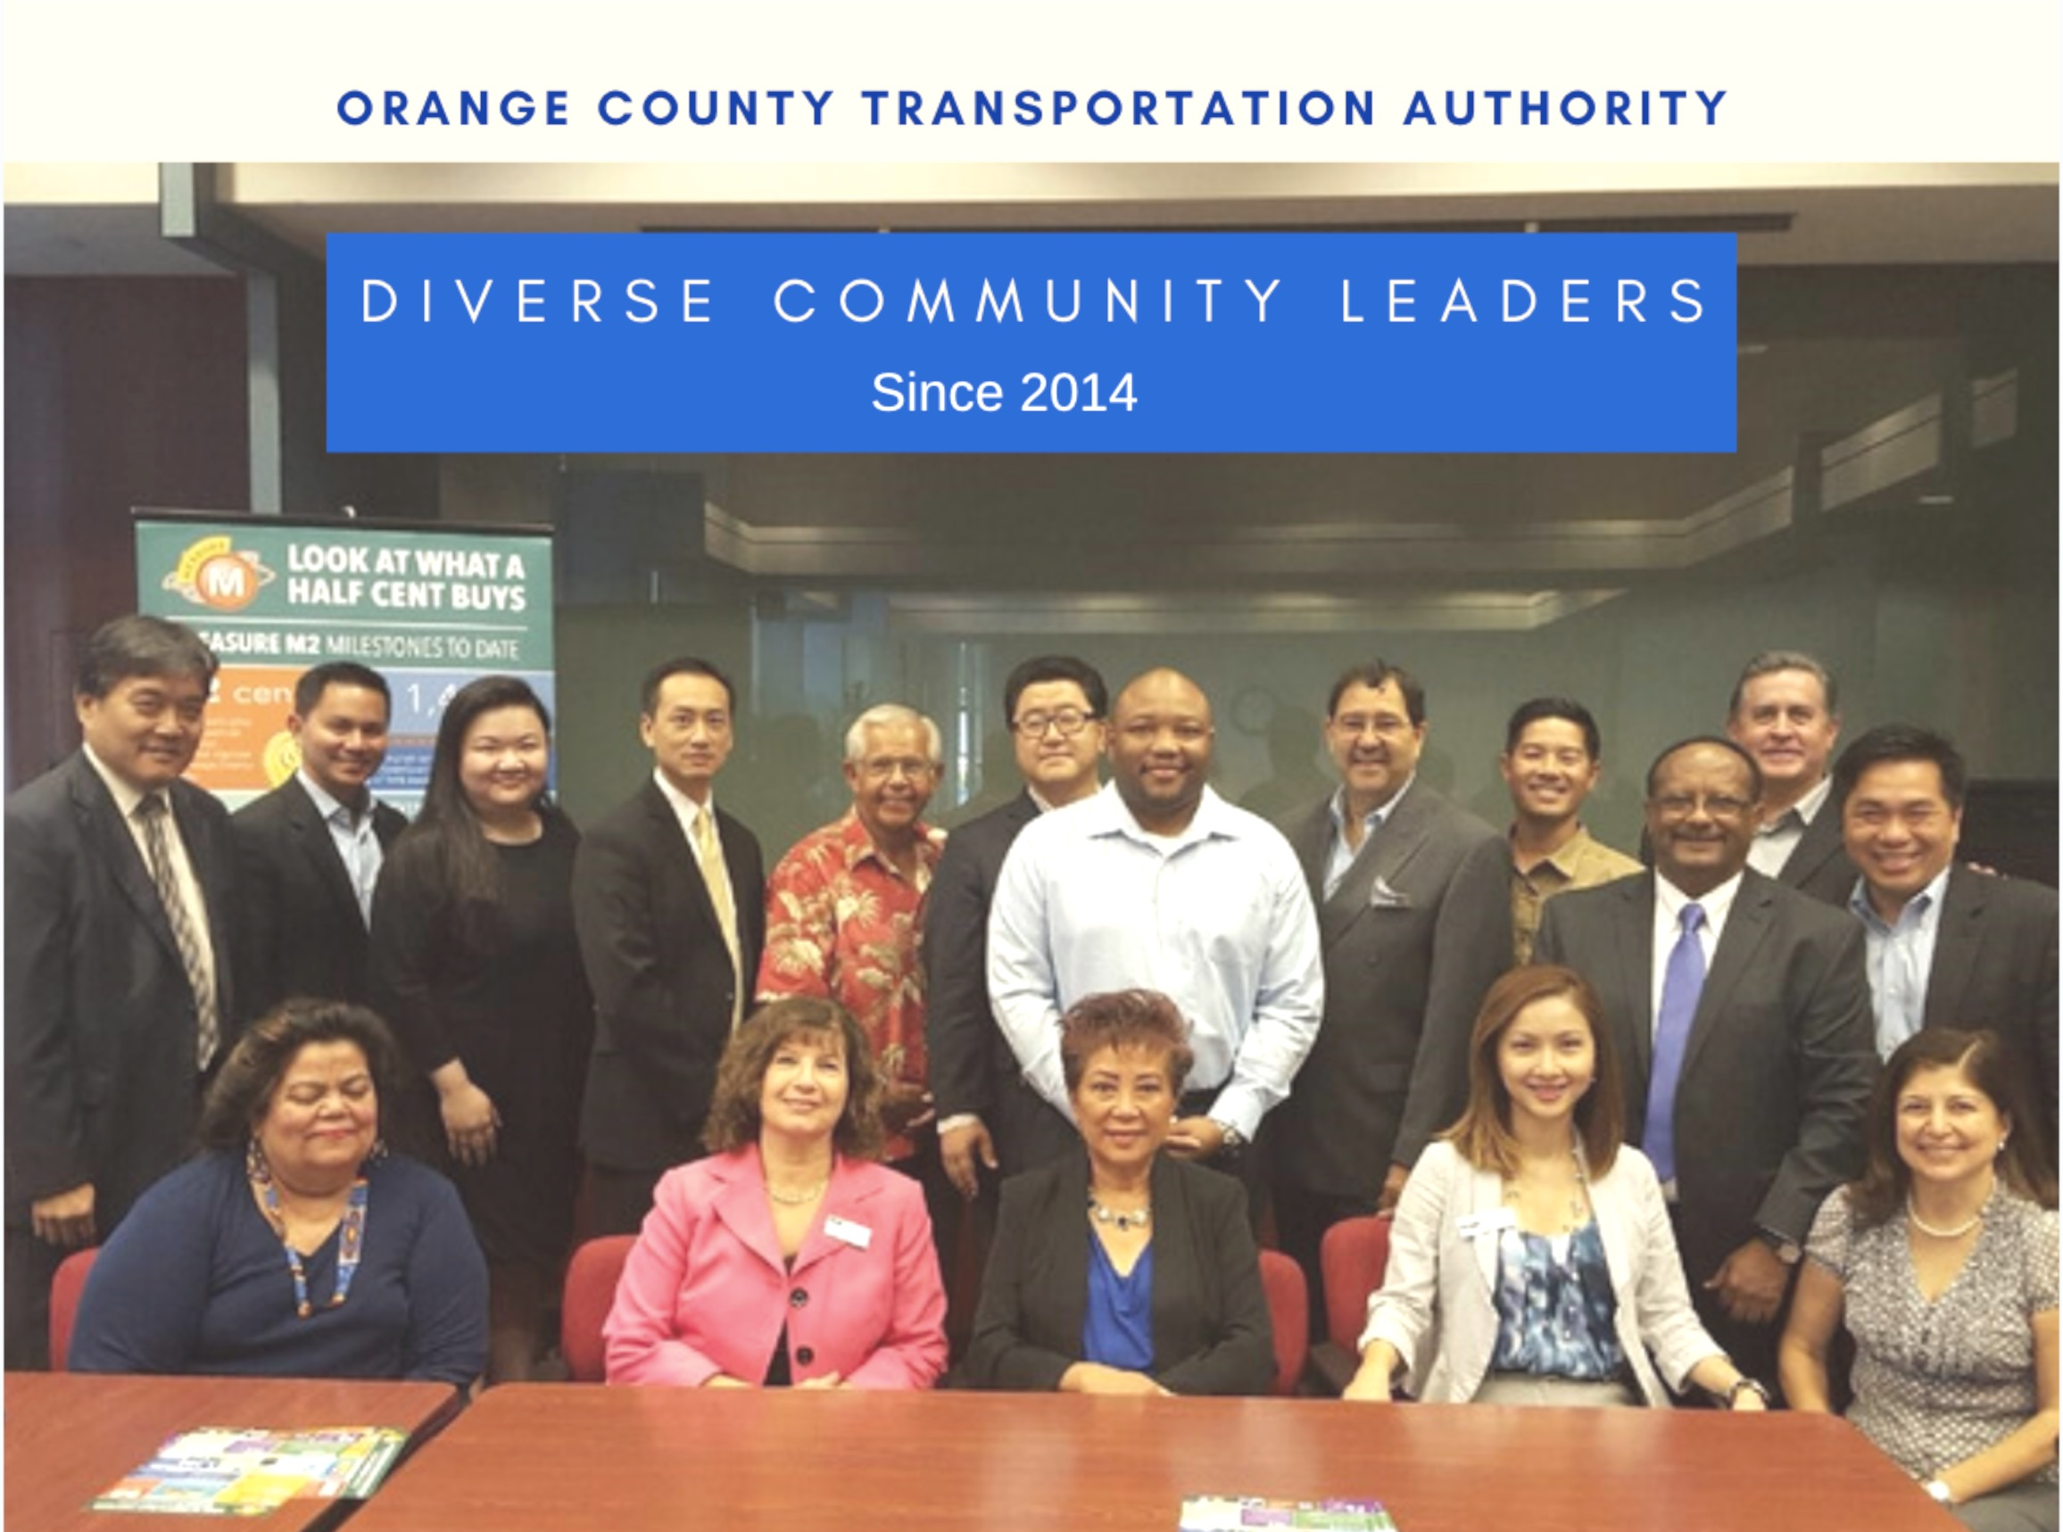
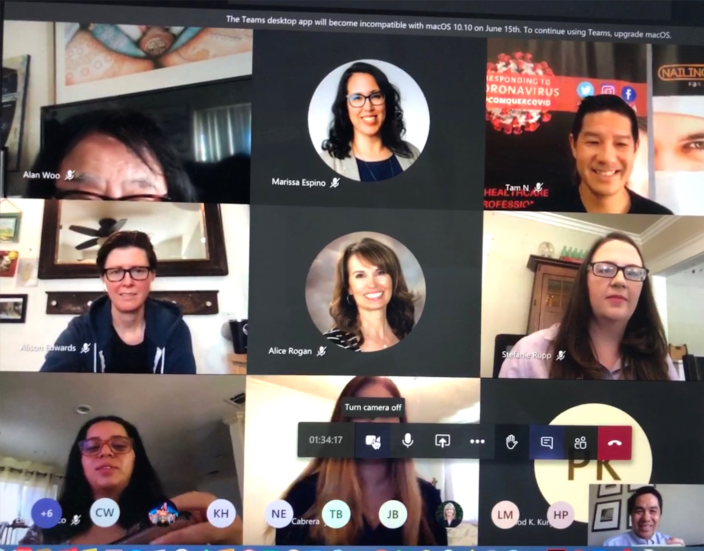
Diversity Community Leaders Group
Virtual Meeting
10

Slide 11
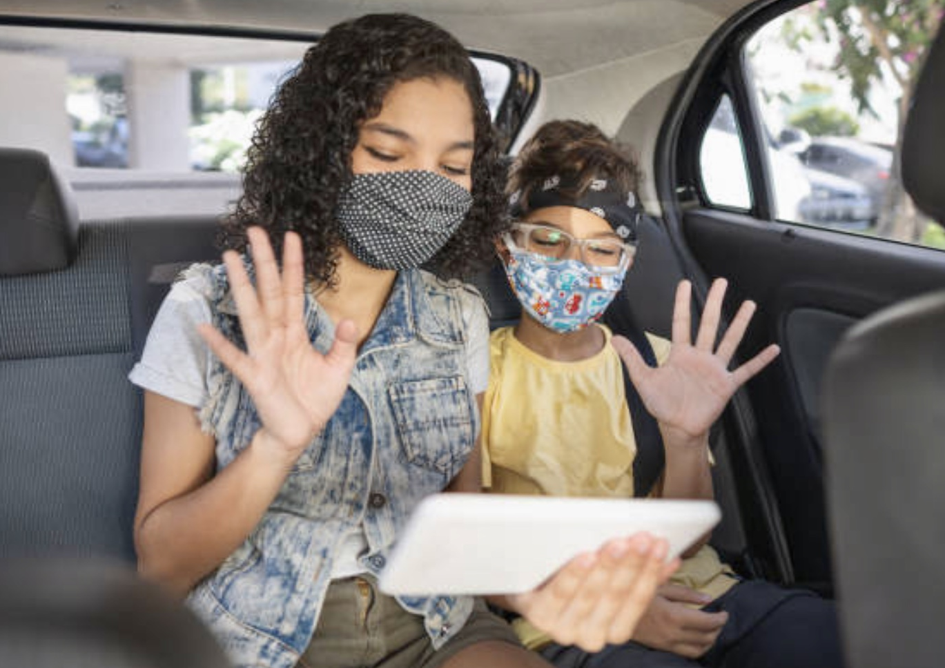
Creating Future Meaningful Outcomes
11

