Slide 1
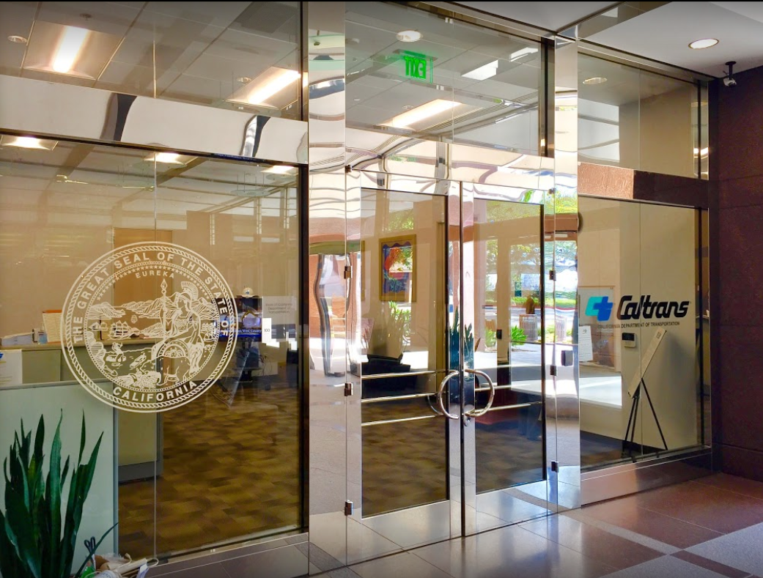
TECHNICAL ADVISORY COMMITTEE MEETING
LOCAL ASSISTANCE UPDATE
Tifini Tran Mirna Beshay Tadrous
District Local Assistance Engineer Local Assistance Area Engineer
Caltrans District 12 Caltrans District 12
Tifini.Tran@dot.ca.gov mirna.beshaytadrous@dot.ca.gov
(657) 328-6275 (657) 328-6640
Oct 26, 2022

Slide 2
TECHNICAL ADVISORY COMMITTEE MEETING
LOCAL ASSISTANCE UPDATE
TABLE OF CONTENTS
PAGE | UPDATE ITEM
1 CTC Meetings
2 Inactive Invoices
3 Disadvantaged Business Enterprise
4 Quality Assurance Program
5 Active Transportation Program
6 Clean California Local Grant Program
7 Clean California (Cont.)
8 HSIP
9 Buy America
10 CRRSAA
11 Training
12 Title VI
13 Staff Assignments/Contacts

Slide 3
CTC Meetings
Deadlines to submit allocations and time extensions to District Local Assistance:
October 10, 2022 for the December 2022 CTC Meeting
1

Slide 4
Inactive Invoices
The current inactive quarter began on October 1, 2022
The deadline to submit inactive invoices is November 23, 2022
The official inactive list can be viewed here: https://dot.ca.gov/programs/local-assistance/projects/inactive-projects
Agencies with inactive projects that still need invoice submittal as of 10/20/22:
Anaheim – 5055(191), 5055(193)
Mission Viejo – 5451(023)
OCTA – 6071(165)
Placentia – 5269(028)
Santa Ana – 5063(184), 5063(187), 5063(203)
If you have questions or issues with submitting invoices, please contact your area engineer/planner for further assistance
2

Slide 5
Disadvantaged Business Enterprise (DBE)/American with Disabilities Act (ADA)
Exhibits 9-B and 9-C were due on June 30, 2022
9-B: Local Agency DBE Annual Submittal Form
9-C: Local Agency ADA Annual Certification Form
Both forms are required for projects in order to get authorization and funding
If you have questions about these forms, please contact Monroe Johnson at Monroe.Johnson@dot.ca.gov or (657) 328-6274
3

Slide 6
Quality Assurance Program (QAP)
QAP needs to be updated and approved every 5 years
Ensures that materials and work for each project conforms to contract plans and specs
Required for projects in order to get authorization and funding
See Chapter 16 of the LAPM for more information
If you have questions about QAP, please contact Monroe Johnson at Monroe.Johnson@dot.ca.gov or (657) 328-6274
4

Slide 7
Active Transportation Program
CTC will adopt the Statewide component of ATP Cycle 6 on December 7-8, 2022
MPO component should be posted May 2023 and finalized for the June 2023 CTC Meeting
For more info and guidance, please see Caltrans’ ATP webpage: https://dot.ca.gov/programs/local-assistance/fed-and-state-programs/active-transportation-program
5

Slide 8
Clean California Local Grant Program (CCLGP)
Cycle 2 has been announced for the Clean CA program thanks to the success of Cycle 1
Projected milestones for Cycle 2:
January 2023 for call for projects
April 2023 for project application deadline
August/September 23 for project award notification
Several workshops are planned for Cycle 2:
Program Guideline Updates: November 3, 2022 and December 2022
Application Workshops: February through March 2023
6

Slide 9
Clean California (Cont.)
Please see the Clean CA webpage for more info and how to register for the workshops: https://cleancalifornia.dot.ca.gov/local-grants/local-grant-program
If you have questions about Clean CA, please contact Troy Andres at troy.andres@dot.ca.gov or (657)328-6310
7

Slide 10
HSIP
HSIP Cycle 11 applications are currently under review, and project selection will be made later this year in December
$174 M statewide for Benefit Cost Ratio (BCR) applications and $36 M for funding set-asides
Cycle 11 will be state funded
For more info and guidance, please see the Caltrans HSIP webpage: https://dot.ca.gov/programs/local-assistance/fed-and-state-programs/highway-safety-improvement-program
8

Slide 11
Buy America
Caltrans has approved the standard special provision (SSP) for the new Buy America requirements, which is required for federal project authorization after November 9, 2022
Per FHWA, iron, steel, construction materials, and manufactured products used for federalized projects must be purchased under Buy America requirements after this date
If you do not use Caltrans Specs, you will need to incorporate the updated 12-G for the required SSP language
Link for more information about these new requirements: https://www.localassistanceblog.com/2022/09/21/update-build-america-buy-america-act-2-0/
9

Slide 12
CRRSAA
Coronavirus Response and Relief Supplemental Appropriations Act
Passed in 2021 to assist states and local agencies with covering revenue losses due to COVID
Over $14,591,402 has been apportioned across 33 projects in Orange County
CRRSAA funds are distributed in Orange County under OCTA’s Pavement Management Relief Funding (PMRF)
For more information, please see Caltrans’ CRRSAA webpage: https://dot.ca.gov/programs/local-assistance/fed-and-state-programs/crrsaa
10

Slide 13
Training
LTAP link for training registration and info: https://ca-ctap.org/index.cfm?pid=1609
Federal Aid Series
Project Development: Design to Construction (Nov 16-17, Jan 11-12, Feb 8-9, Mar 15-16)
Getting Your Federal Aid Started (Nov 29-30)
Federal Rules for Contract Administration & Project Completion (Dec 1-2, Jan 18-19, Feb 15-16, Apr 20-21)
Environmental Requirements (Dec 13-14)
Local Assistance Training Day (Nov 3)
Residents Engineer Academy (Nov 14-17 in 2022; Jan 9-12, Feb 6-9, and Mar 13-16 in 2023)
11

Slide 14
Title VI
Title VI of the Civil Rights Act of 1964 prohibits discrimination by recipient of Federal assistance on the basis of race, color, and national origin, including the denial of meaningful access for limited English proficient (LEP) Persons.
Requirements include but are not limited to:
Title VI nondiscrimination statement
Assurances (as part of the Master Agreement and Program Supplement Agreement.
Designation of a Title VI Coordinator.
Complaint Procedures.
Data Collection.
Training.
Dissemination of Information.
Contracts and Agreements.
Environmental Justice.
Public Hearings and Meetings.
Right of Way activities.
Construction contract compliance.
Monitoring.
Caltrans has also recently updated our webpage on Filing a Complaint, and it provides guidance to local agencies on how to process Title VI complaints.
12

