Slide 1
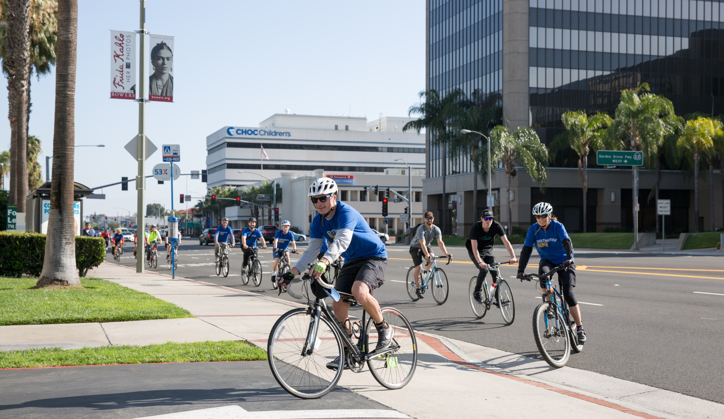
BIKE MONTH 2019

Slide 2
SITUATION ANALYSIS
Pledging = main data source
Highlight pairing bike with other transit options
Strava engages the bicycling community
Updated 3/26/19

Slide 3
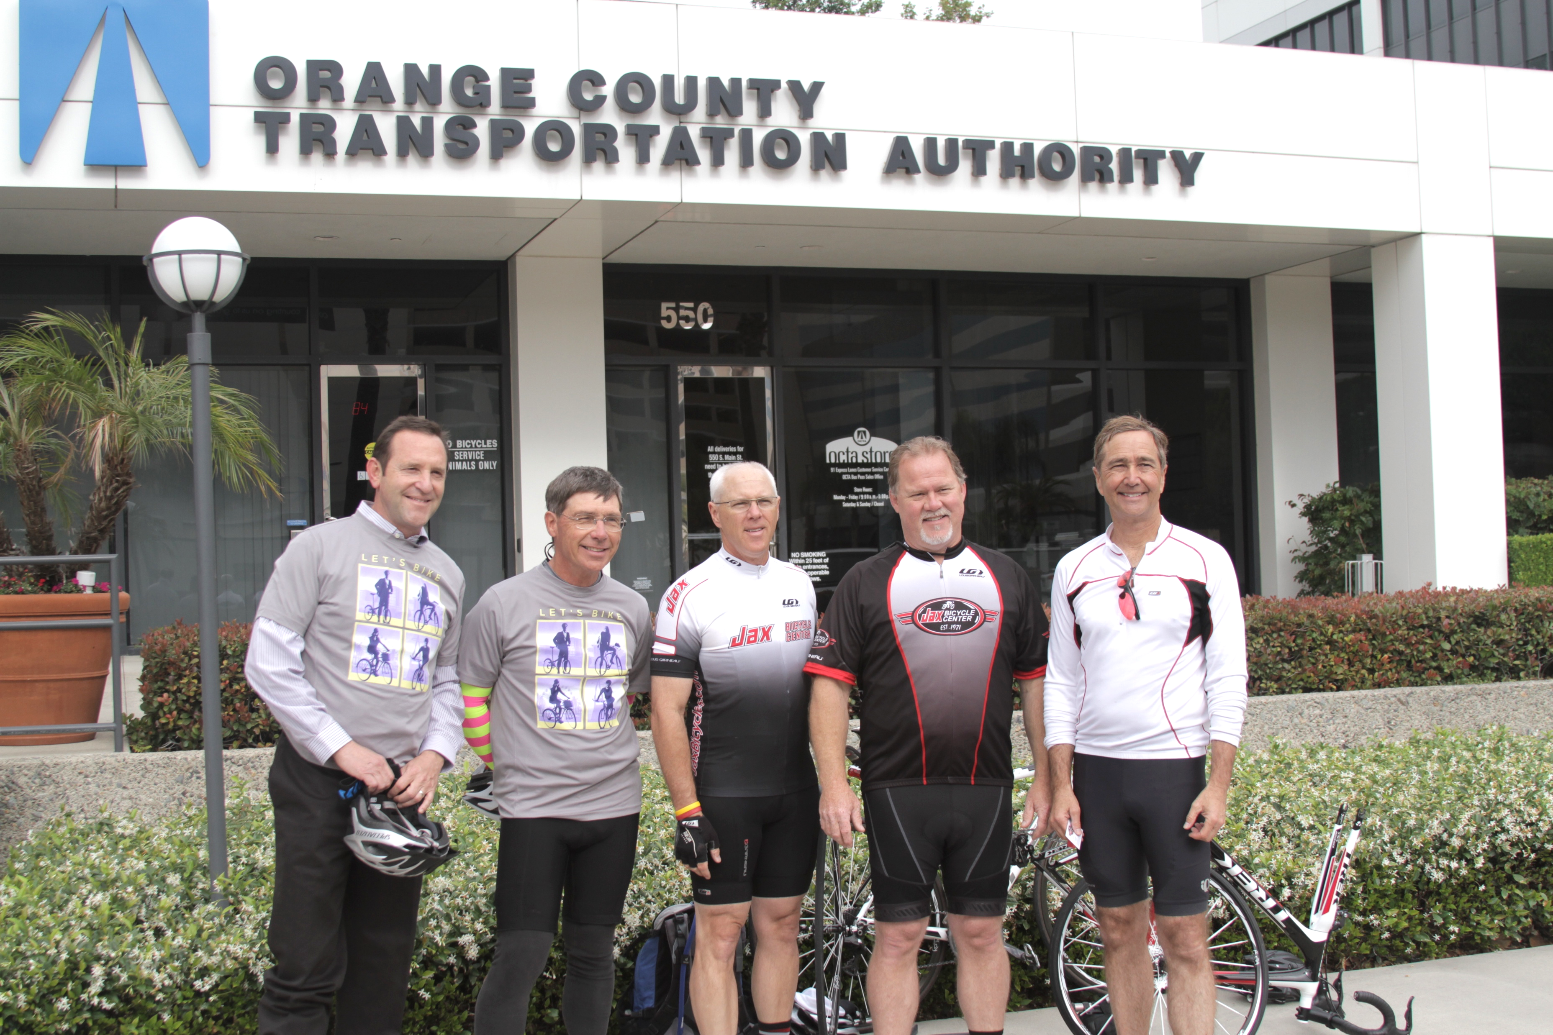
CONCLUSIONS
Continue with pledging
Continue to encourage Strava participation
Gain partners to include enticing prizes
Updated 3/26/19

Slide 4
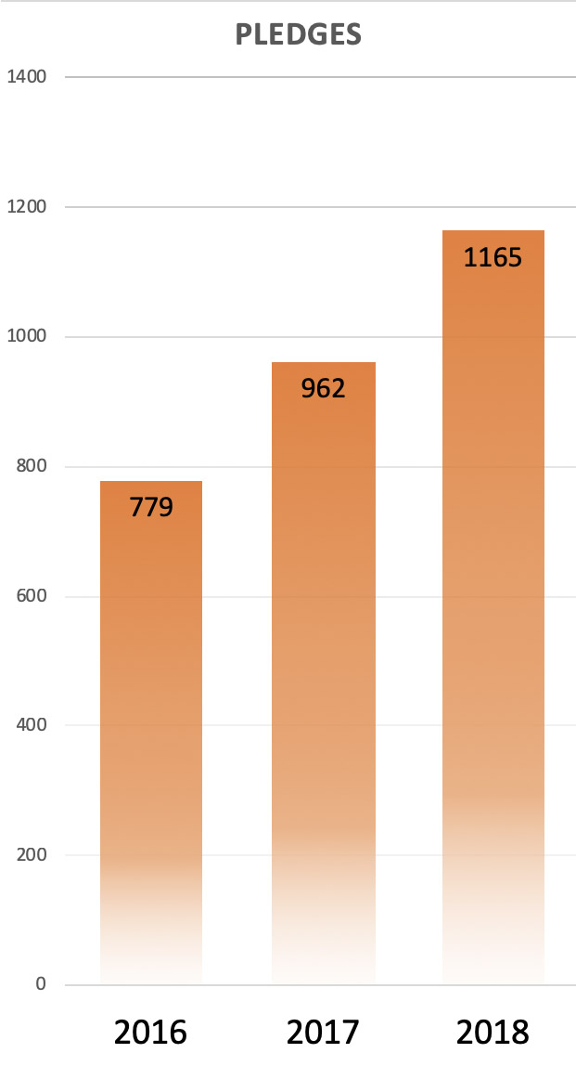
GOALS & OBJECTIVES
Goals:
Increase bicycle commuting in Orange County
Increase awareness of bicycle safety best practices
Objectives:
Increase number of Bike Month pledges by 15%
Increase number of Strava rides by 10%
Increase Bike Rally attendance by 10%
Updated 3/26/19

Slide 5
TACTICS
Use an online pledging form to track participation
Utilize social gathering platforms, such as Meetup, to find local bike riding communities and distribute information
Organize a Bike Rally to celebrate Bike-to-Work Week
Utilize traditional marketing channels (digital, social, print and bus ads)
Encourage riders to track miles ridden on Strava
Updated 3/26/19

Slide 6
OUTREACH EVENTS
ETC Marketing Meeting – April 9th
Hines Earth Day – April 17th
Santiago Canyon College Sustainability Fair – April 18th
CSUF Earth Week Transportation & Bike Festival – April 18th
Whimcycle – May 7th & 8th
Bike to Work Week – May 13th – 17th
Ride of Silence – May 15th
OCTA Bike Rally – May 16th
Bike to Work Day – May 17th
Updated 3/26/19

Slide 7
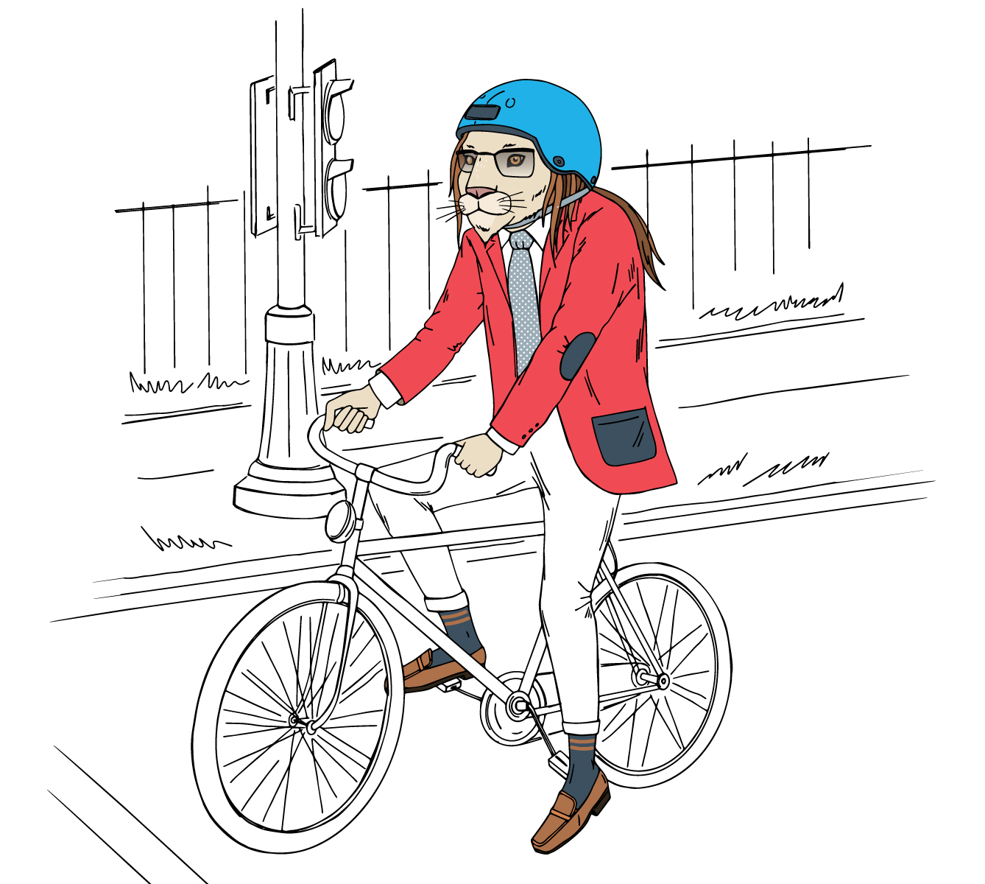
CREATIVE
Keep similar brand to Rideshare Week 2018
Highlight pairing Bicycling with other commute options
Updated 3/26/19

Slide 8
Bike + Bus
“Having to find parking is irrelephant now”
Bike
“Have a commute that's faster than a cheetah - bike to work”
Bike + Carpool/Vanpool
“Combine biking with carpooling and vanpooling - just imagine all the pawsibilites”
Bike + Metrolink
“Don't put all your eggs in one basket - share your commute”

