Slide 1

Bravo! 529 LAUNCH MARKETING

Slide 2
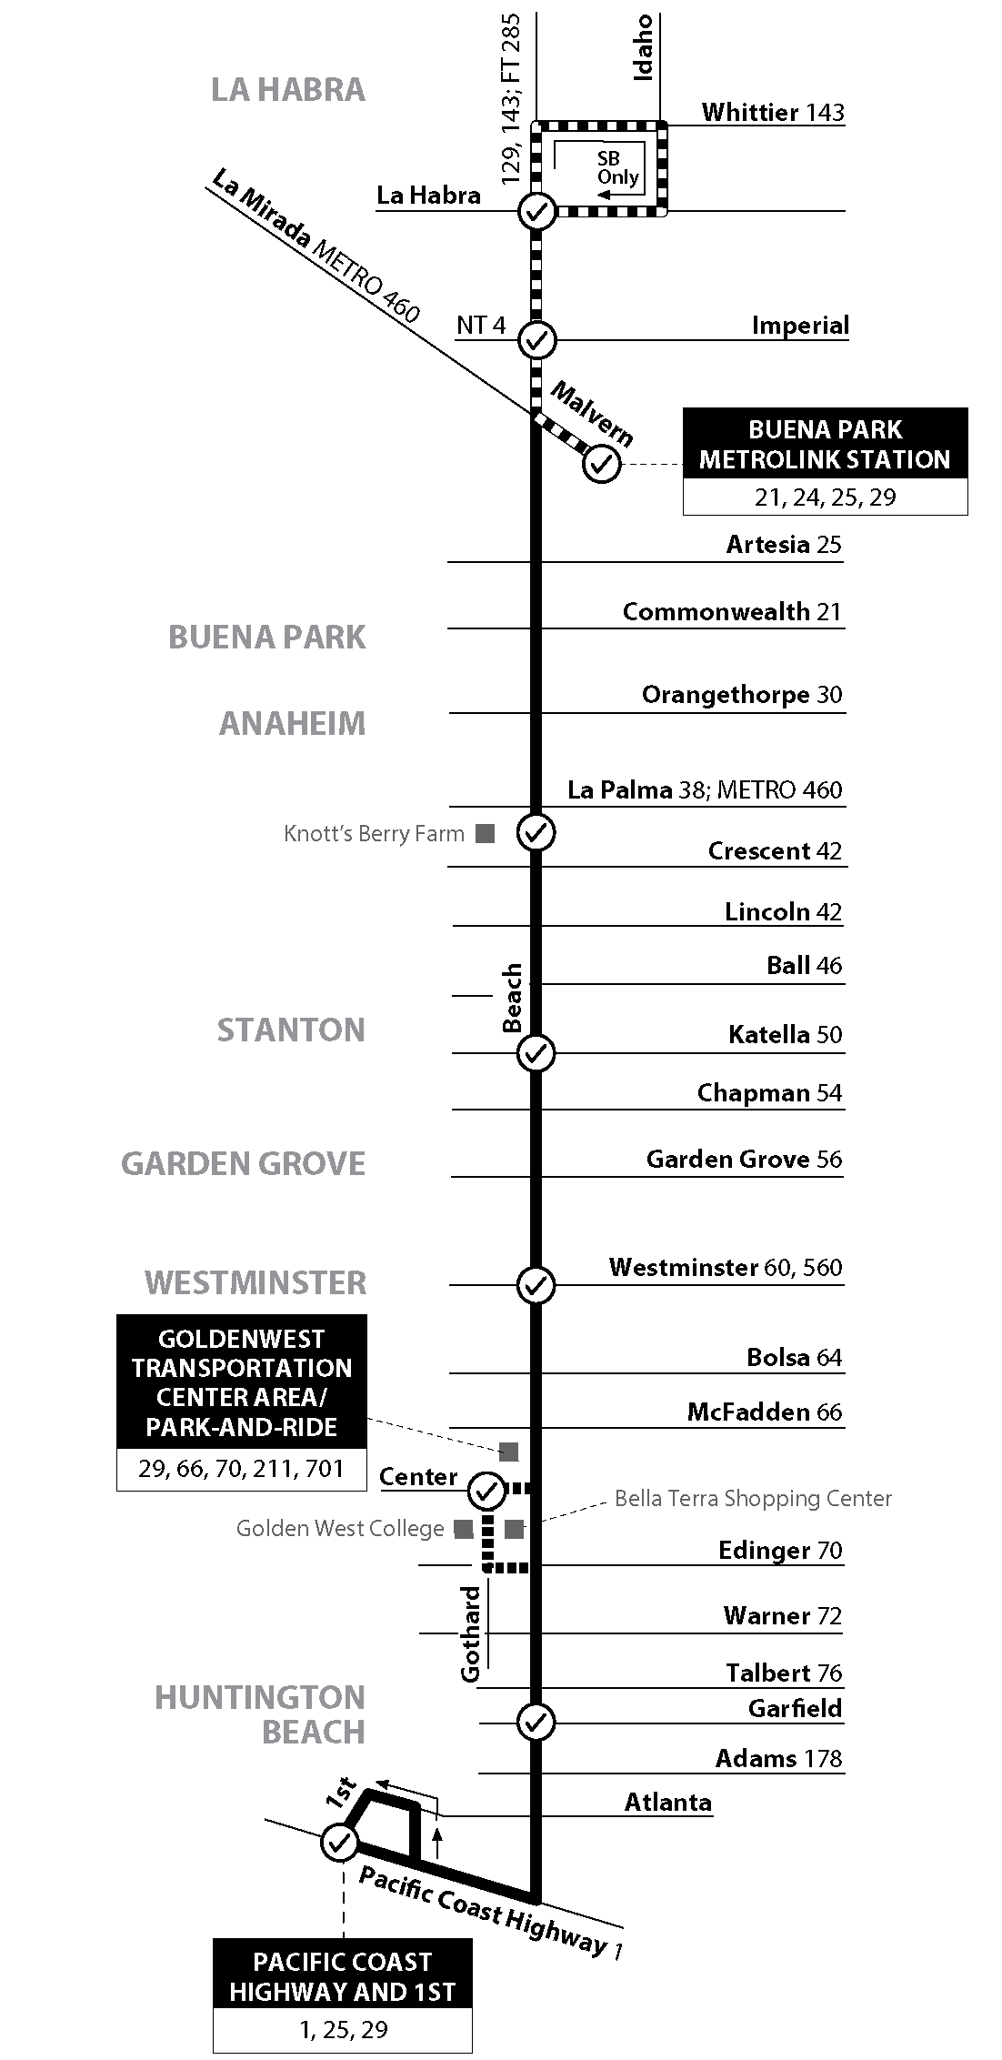

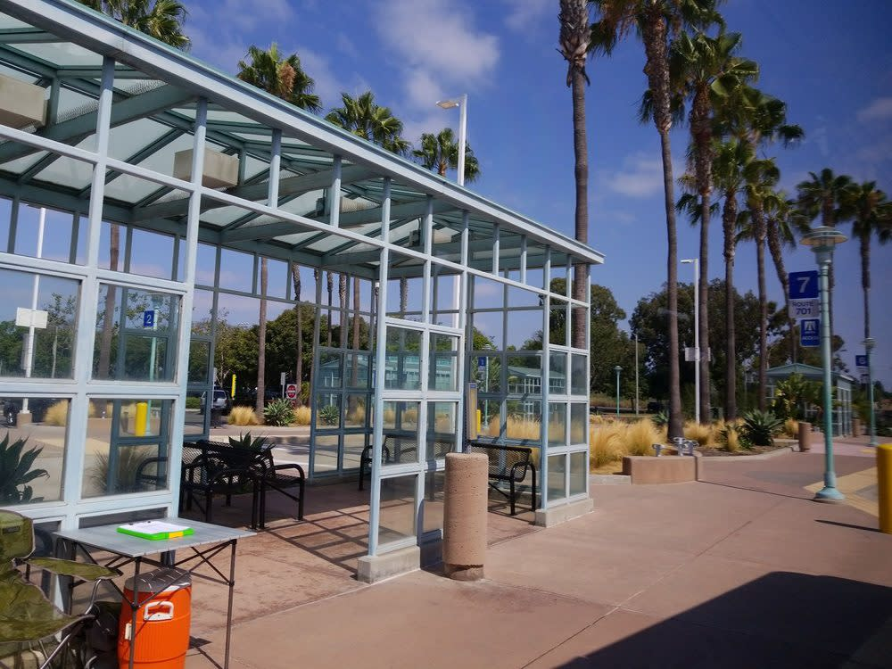
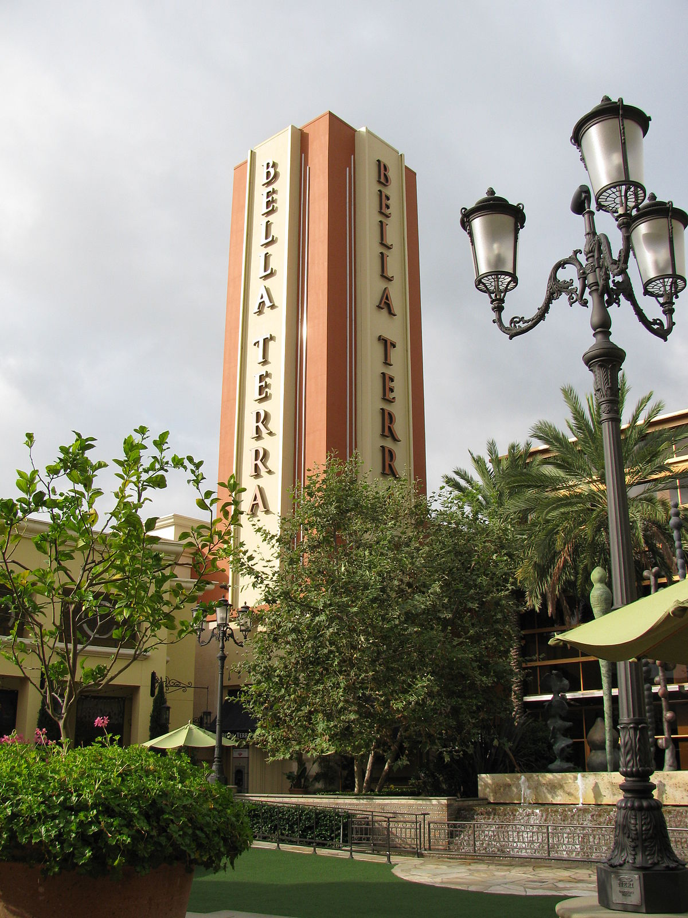
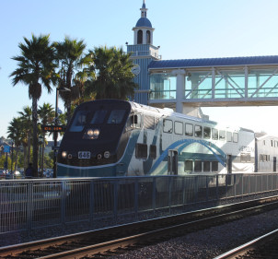
Route 29
About Route 29 and 529
KEY OBJECTIVES
Route 529
  Top 10 Busiest OC Bus Routes
  2.16 mil annual boardings (Nov. 2017 – Nov. 2018)
  7 days a week
  21 mi. North / South trip crosses eight cities and two counties
  Connects to 28 other bus routes
  Projected 620,000 annual boardings
  Weekdays 6 a.m. to 6 p.m.
  12 mi. North / South trip
  with 13 stops
  Connects to 18 other bus routes, including two other BRAVO! routes

Slide 3
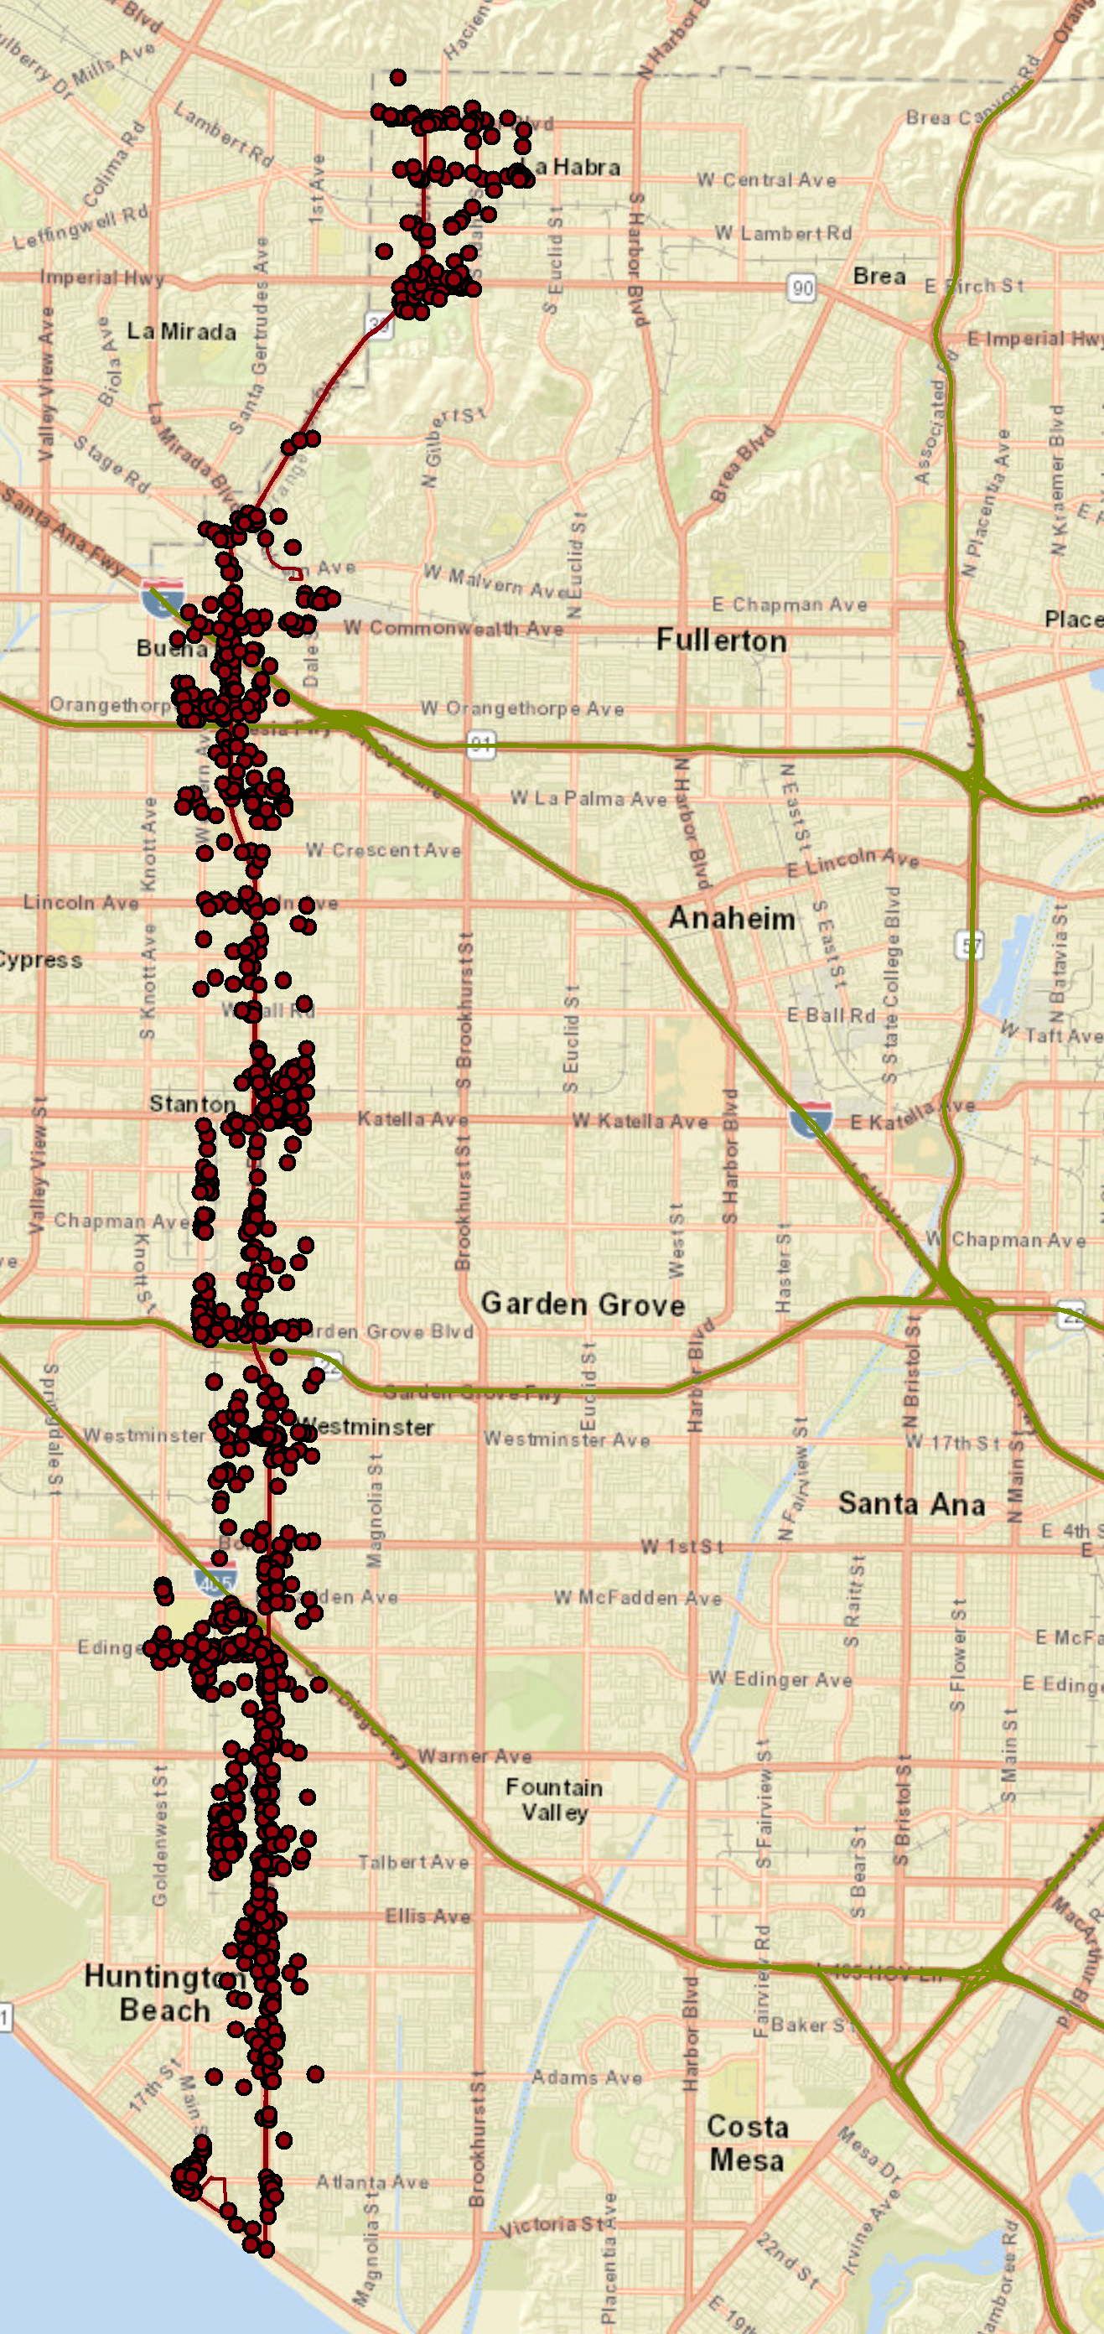
Residents
Within ½ mi. of Route 29
  1,318 employers with more than 10 employees
  52,105 employees
Key Businesses
  222 Restaurants with 7,409 employees
  Elementary and secondary schools with 2,847 employees
  Department stores (1,744 employees) and warehouse clubs (1,020 employees)
Market Profile
KEY OBJECTIVES
Businesses
Languages
Within ¼ mi. of Route 29
60,000 households
28% Hispanic or Latino
12% Vietnamese
5% Korean
Within ½ mi. of Route 29
  52,105 total employees
  1,318 businesses with more than 10 employees
    Restaurants
    Elementary and secondary schools
    Warehouse / department stores
10.8% of Area Households (6,439 households)
Sources: Datausa.io 2016 (Combined number of households for each of the 12 cities along the Beach Blvd Corridor that use public transit as their most common method of travel);
American Community Survey 2017 (5 Year Estimate for area census blocks); Melissa Business Data (Nov. 2015)
Provides descriptive groups and characteristics for U.S. neighborhoods with similar characteristics
Product based on Census, ACS and other data sources for updates
Segments created based on socioeconomic and demographic information, further divided by urbanization (urban, rural, etc.) and lifestyle / stage of life.
Selected any census blocks within
¼ mi. of Route 29
Due to size of census blocks, effective area is within ½ mi. of Route 29
Shaded blocks show the predominate group within that census block by household
16,000
households along the Beach Boulevard corridor area use public transit*
Provides descriptive groups and characteristics for U.S. neighborhoods with similar characteristics
Product based on Census, ACS and other data sources for updates
Segments created based on socioeconomic and demographic information, further divided by urbanization (urban, rural, etc.) and lifestyle / stage of life.
Households
60,000 households within ¼ mi. of Route 29
16,000 households along Beach Blvd. corridor use public transit

Slide 4
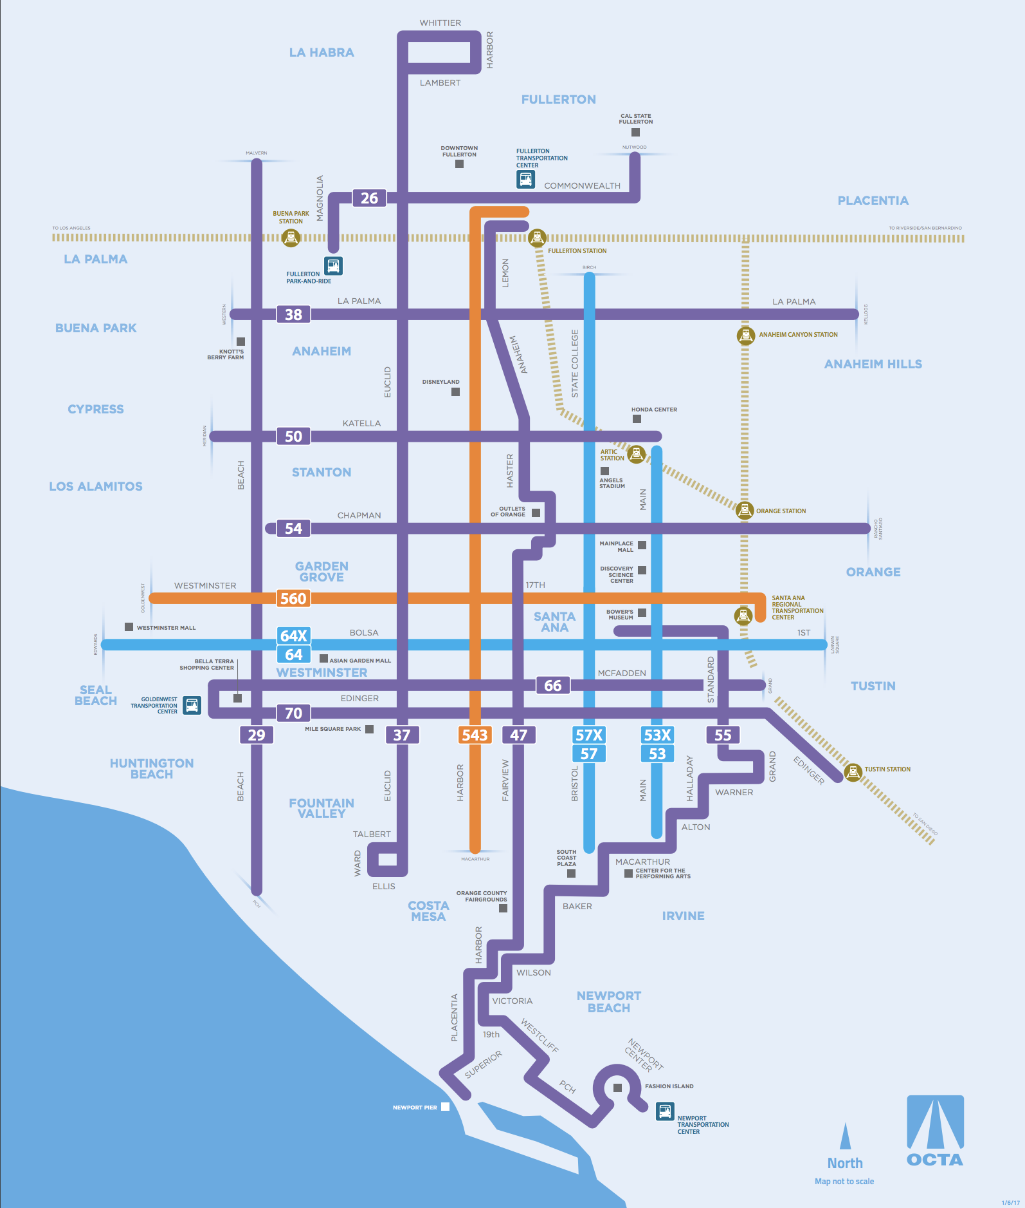
MARKETING GOALS/STRATEGIES
Position BRAVO! 529 as a faster travel option on Beach Blvd.
Create awareness and trial use of BRAVO! 529 among non-riders
Target key market segments
  Workers/Employers
  Students/Colleges
  Diverse communities
  Existing riders
Increase ridership on connected bus services
529

Slide 5

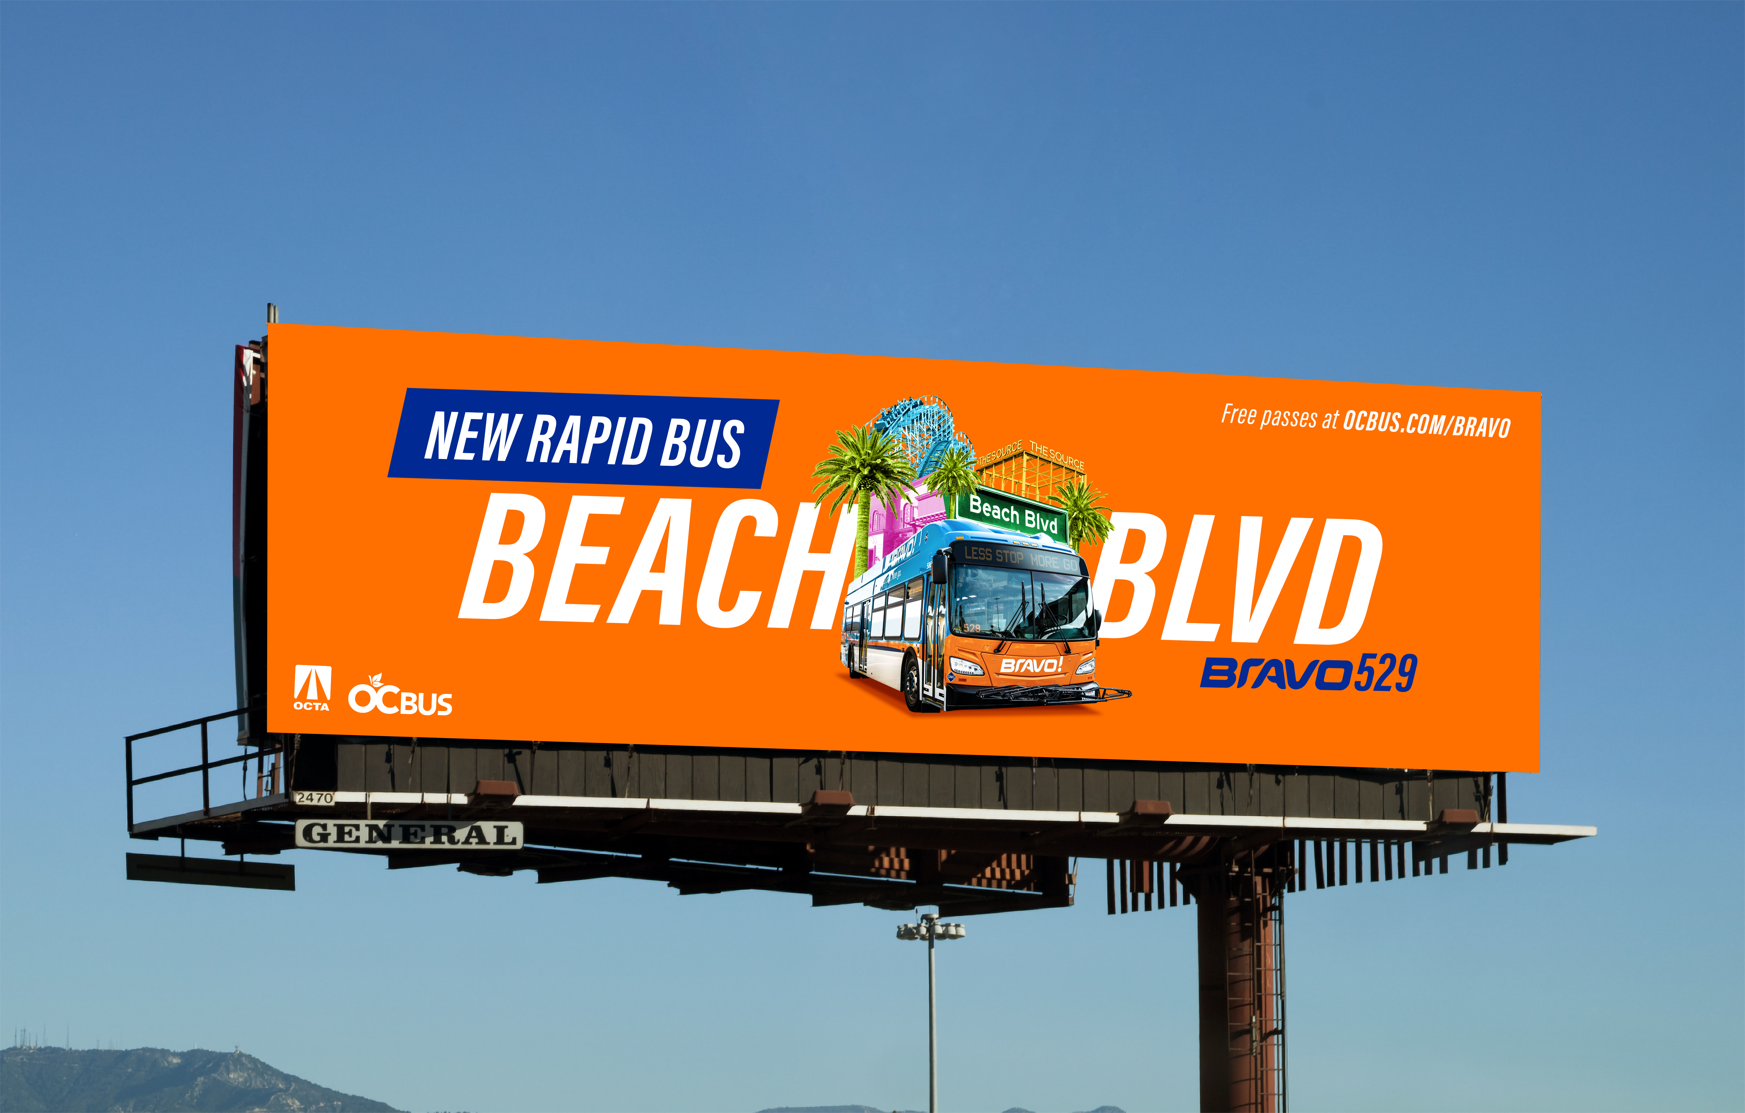
Billboard

Slide 6
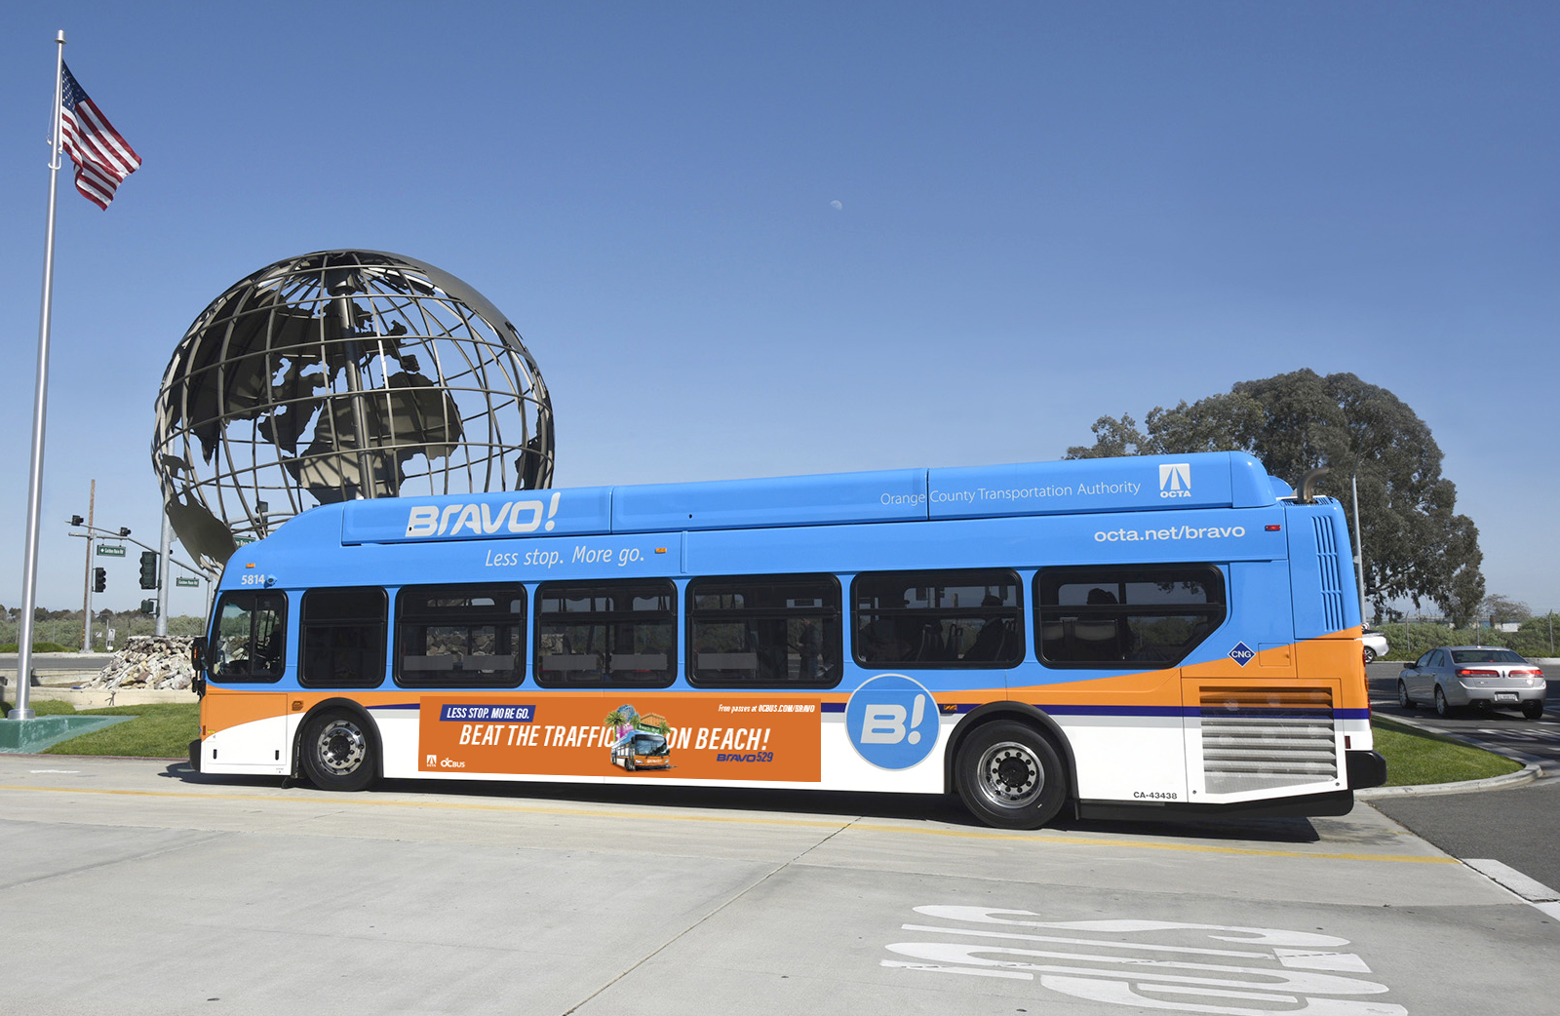
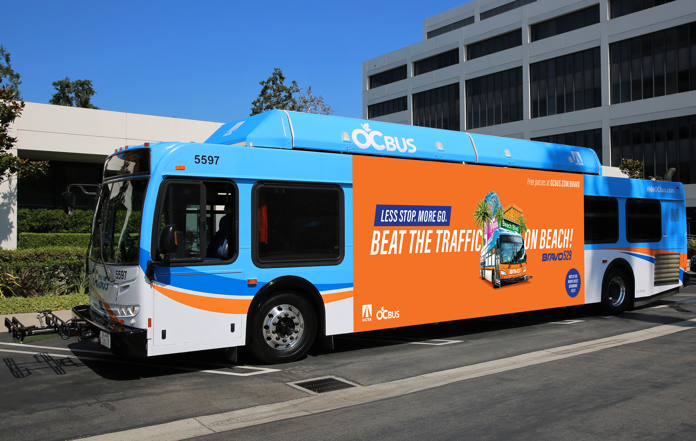
Bus Advertising

Slide 7
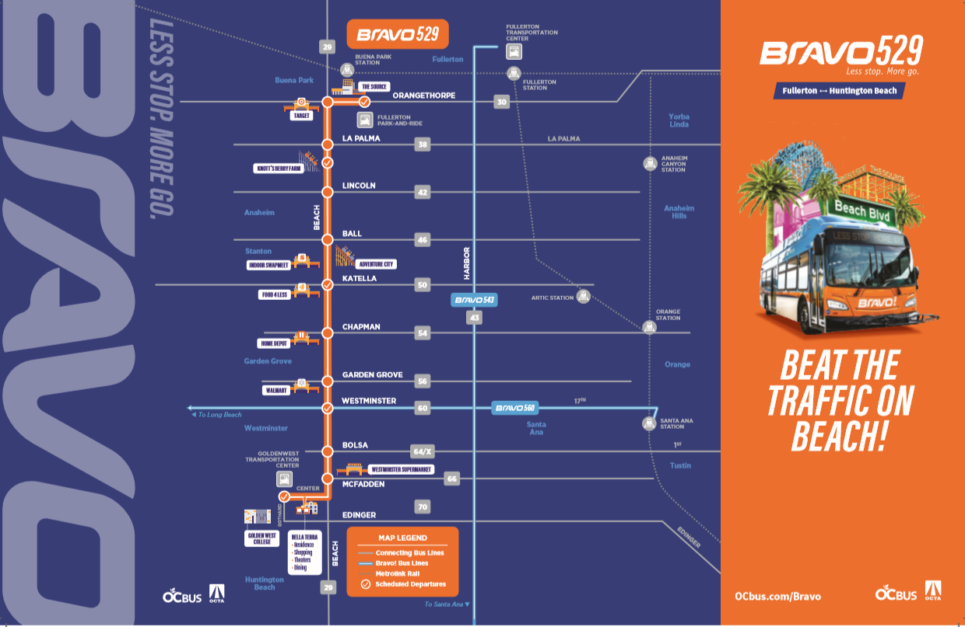
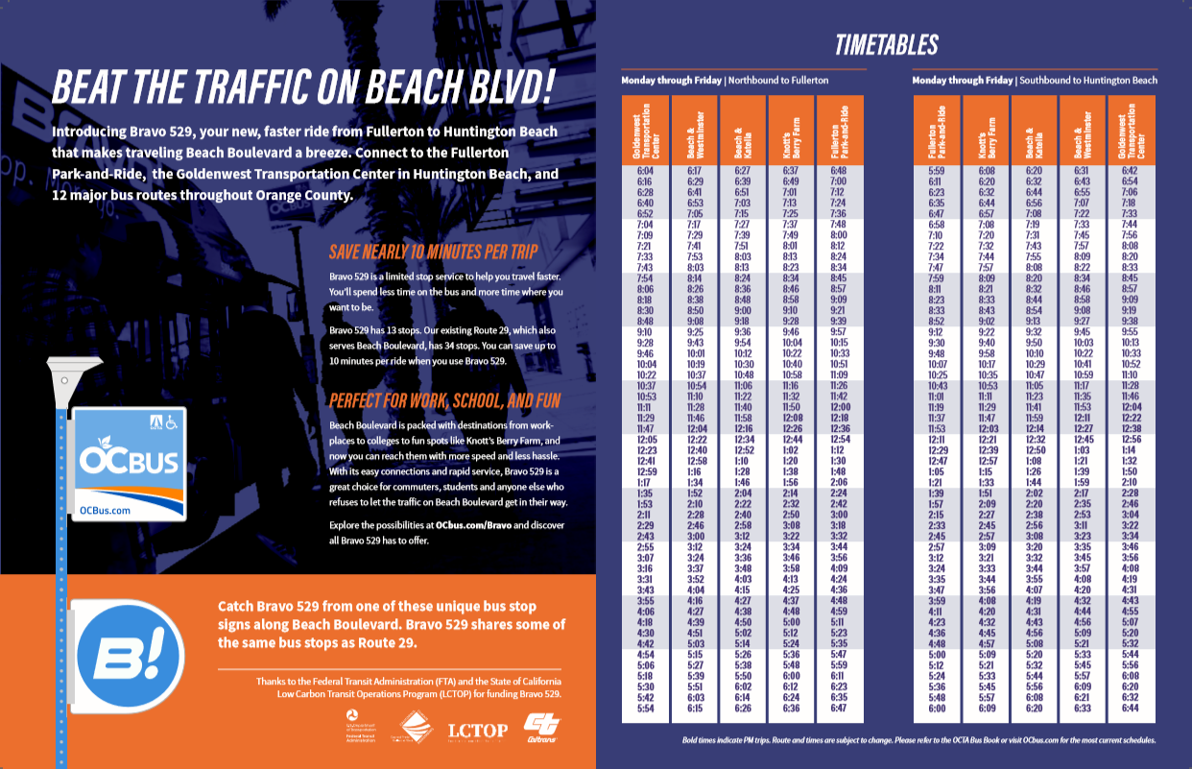
Brochures

Slide 8
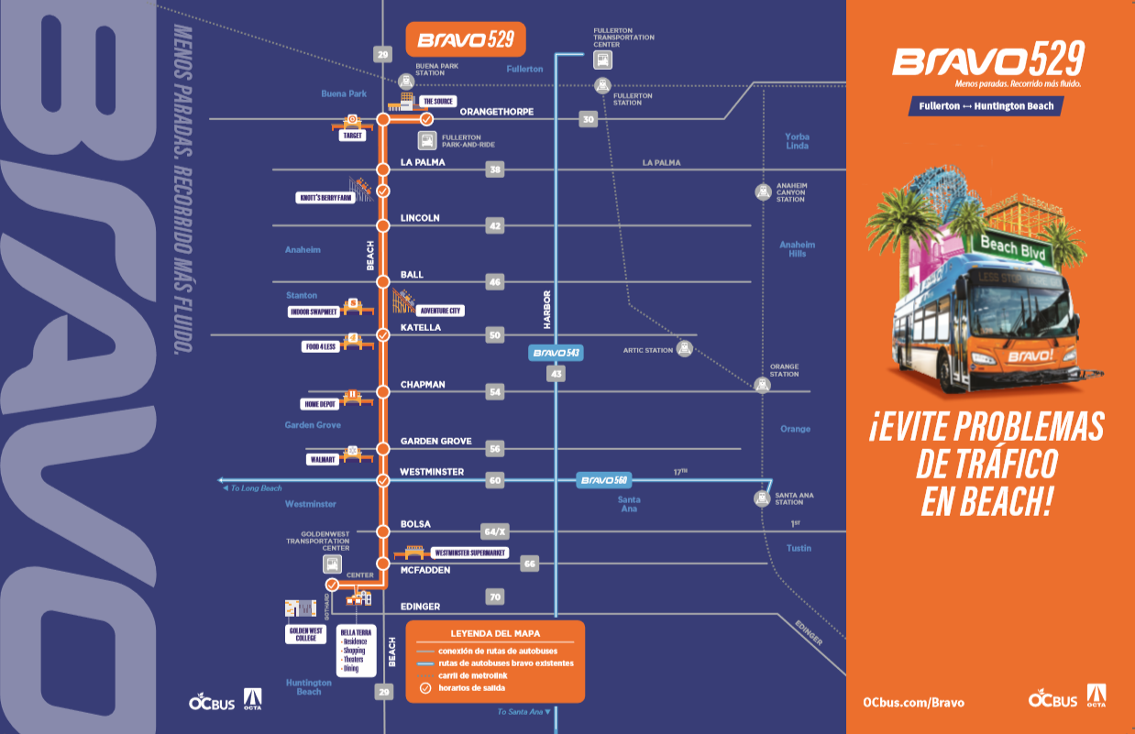

Brochures
Spanish Vietnamese

Slide 9
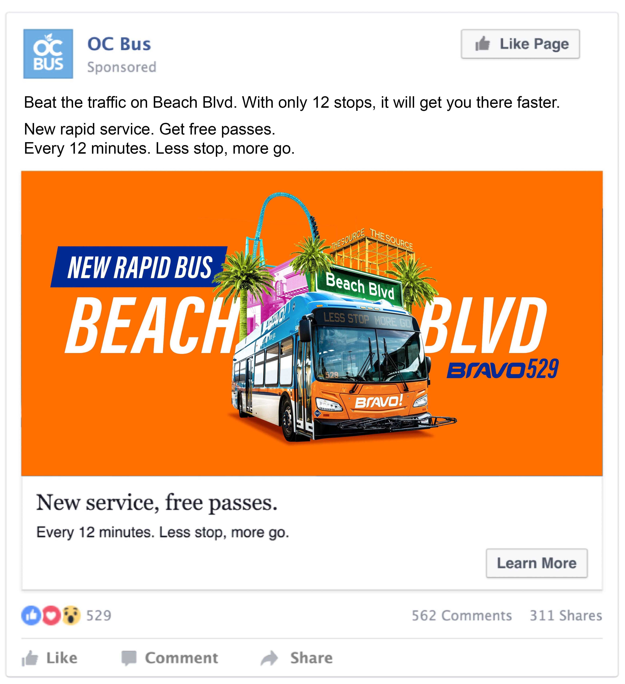
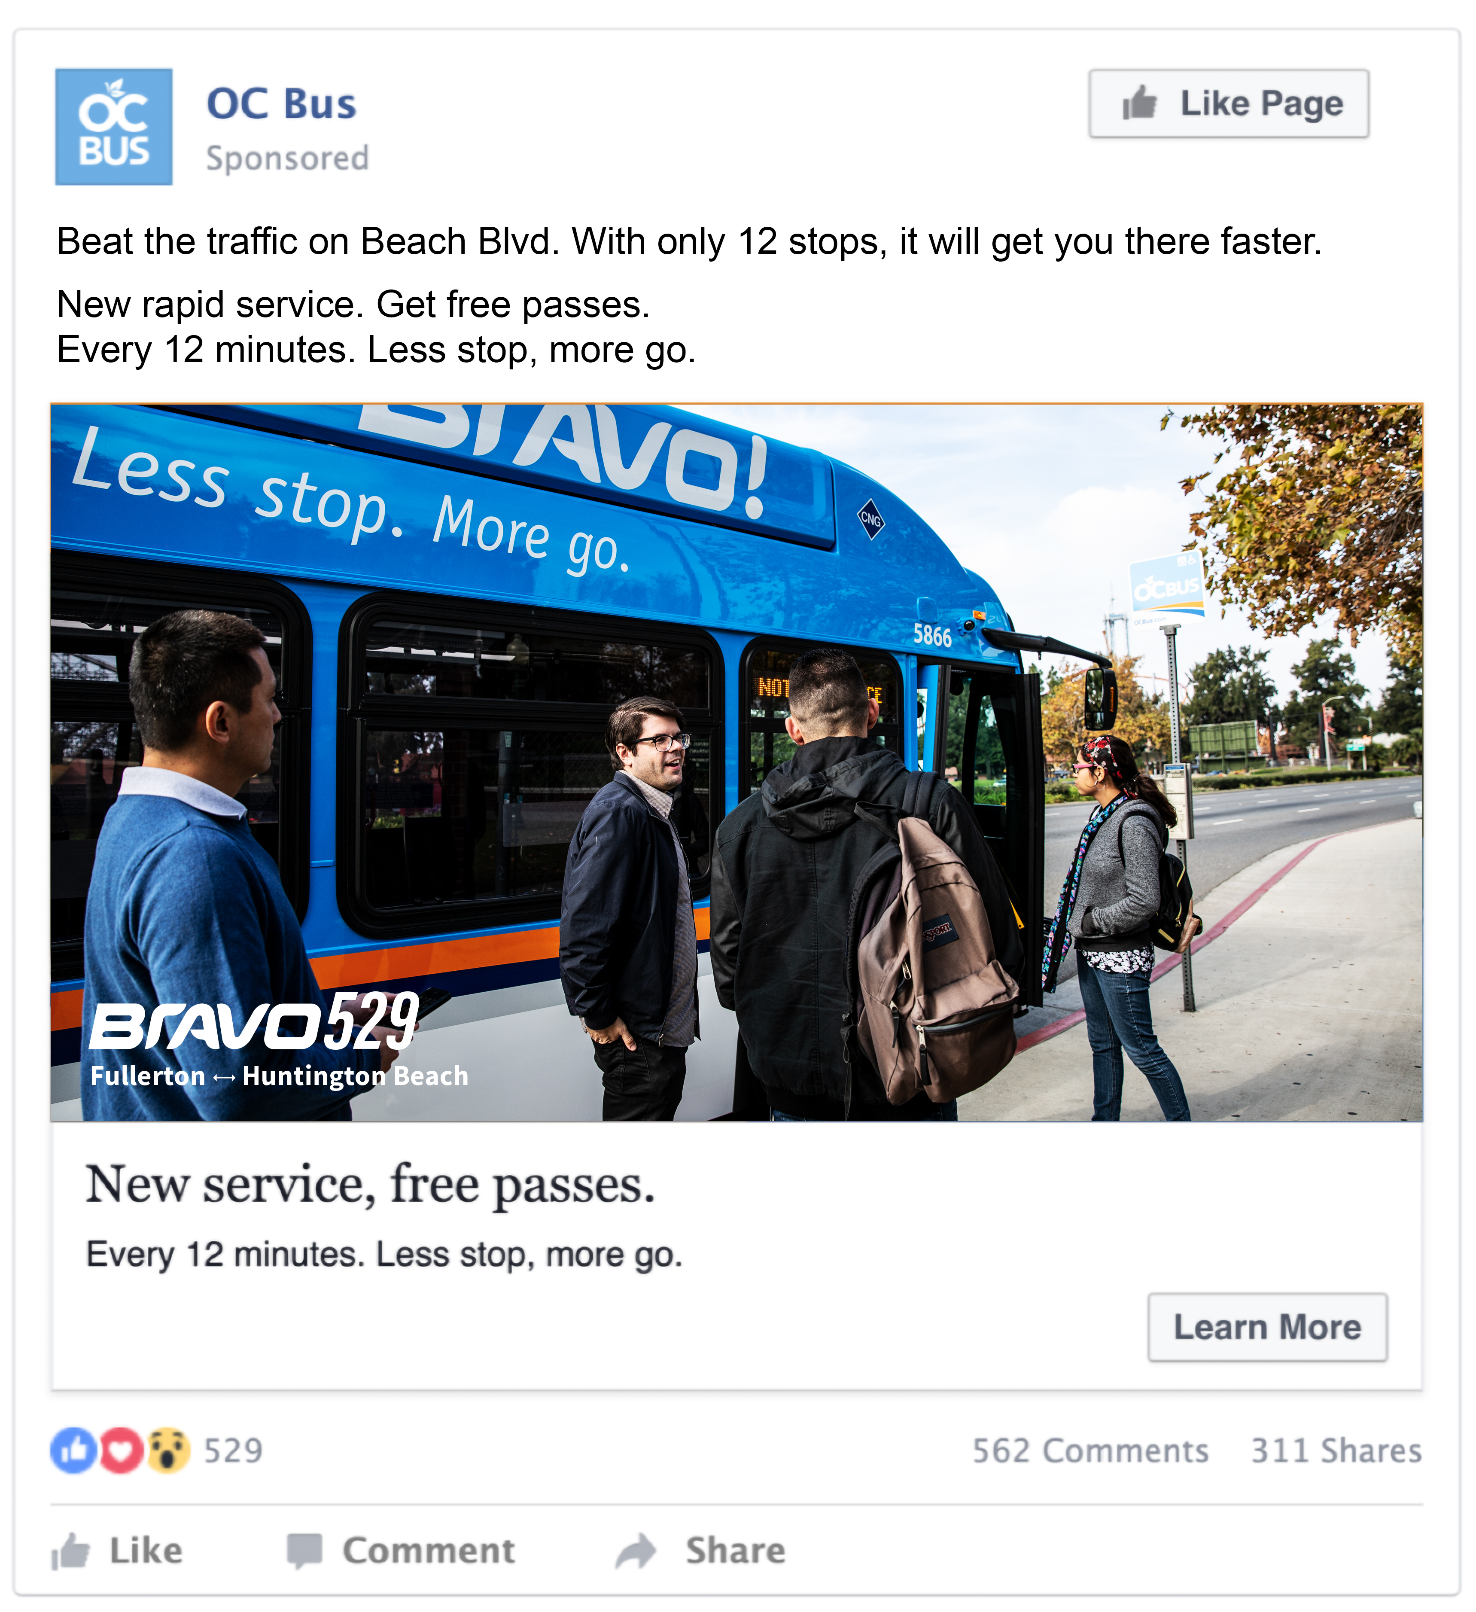
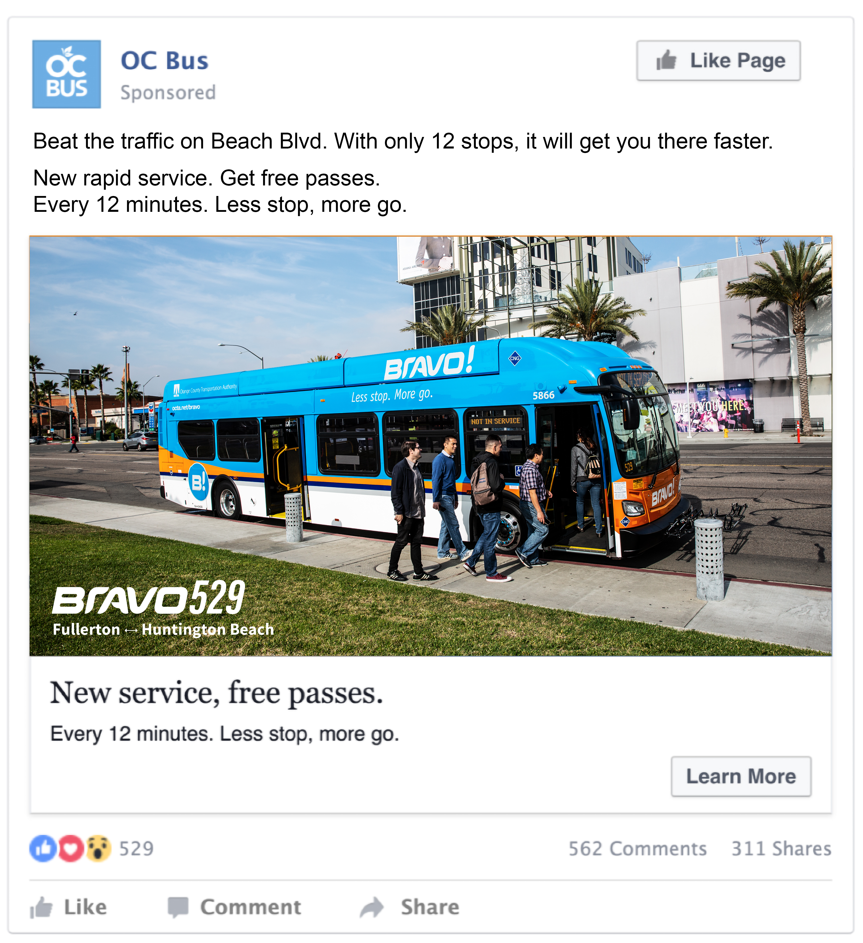
Social Media Advertising

Slide 10
Marketing Tactics
Direct mails to 70,000 households
Diverse community advertising
  La Rancheras Radio
  Little Saigon TV
  Bolsa Vietnamese Radio
  Unidos
  Nguoi Viet
  The Korea Daily
Grassroot Outreach
  Community organizations
  Middle/high schools
  Colleges
  Senior centers
  Employers

Slide 11
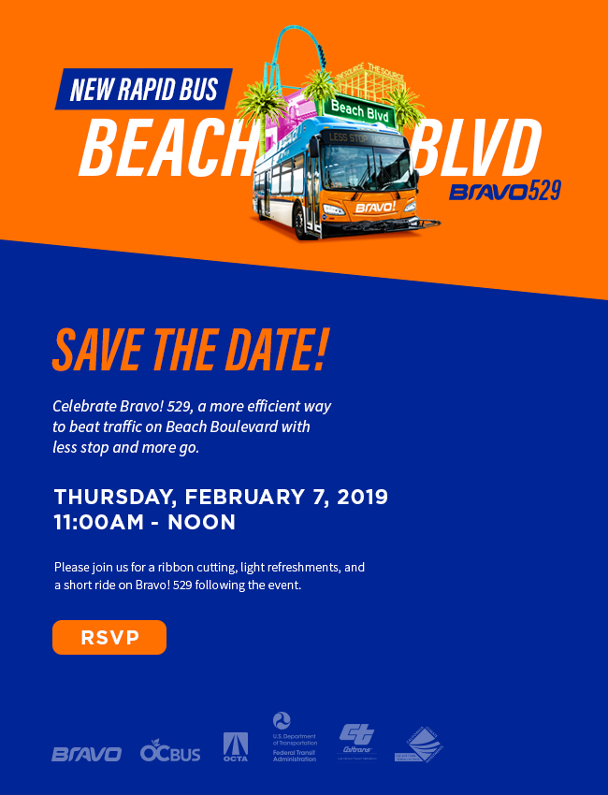
Pre-Service Launch Event/Tour
Location: TBD
Time/Date: 11 a.m. Thursday, February 7th
Invitees:
  OCTA Board, Community leaders, Elected officials from cities, State and Federal, Media
Highlight:
  Start with a ribbon-cutting and a short ride following the event

